Slide 1
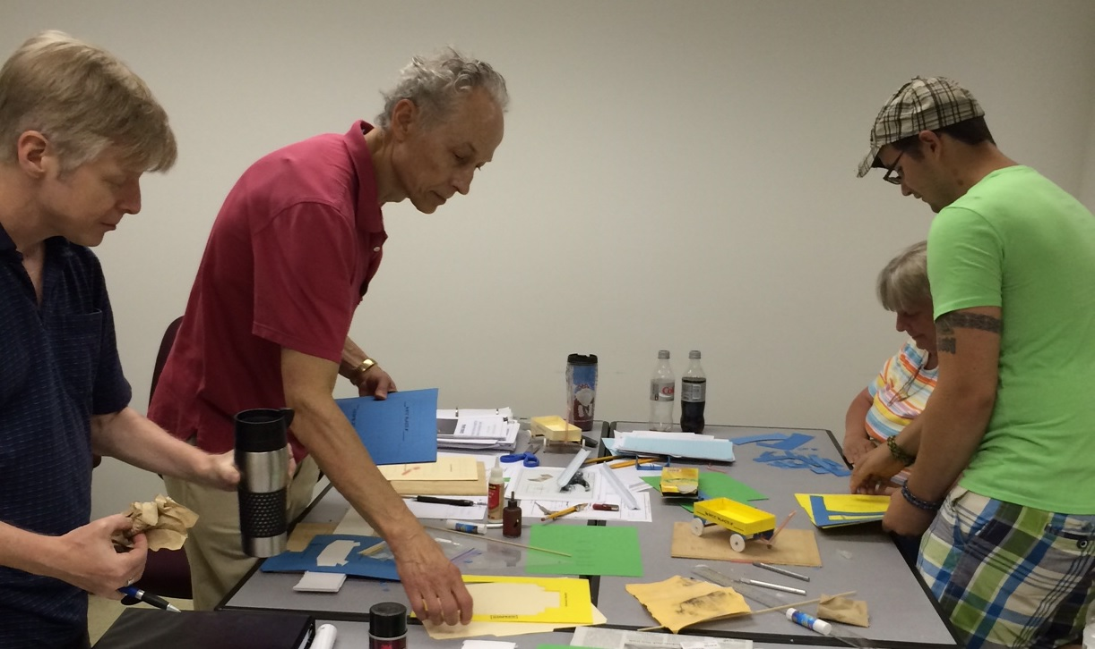
Team Building
This project is sponsored by a $15.9 million grant from the U.S. Department of Labor, Employment and Training Administration.
The AMMQC program is an Equal Opportunity program. Adaptive equipment is available upon request for individuals with disabilities. This workforce product was funded by a grant awarded by the U.S. Department of Labor’s Employment and Training Administration. The product was created by the grantee and does not necessarily reflect the official position of the U.S. Department of Labor. The U.S. Department of Labor makes no guarantees, warranties, or assurances of any kind, express or implied, with respect to such information, including any information on linked sites and including, but not limited to, accuracy of the information or its completeness, timeliness, usefulness, adequacy, continued availability, or ownership.

Slide 2
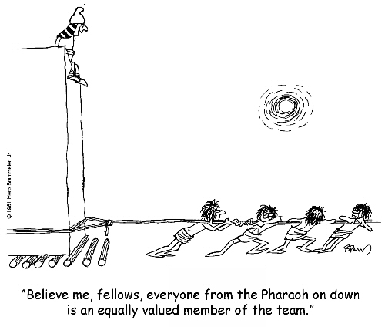
What is a Team?
Who has been on a successful team?
What made that team successful?
What are some other characteristics of a successful team?
Who has been on an unsuccessful team?
What made that team unsuccessful?
What are some other characteristics of an unsuccessful team?

Slide 3
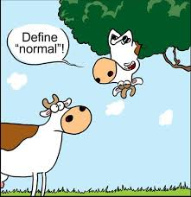
Team Norms
What are team norms?
Norm: a principle of right action binding upon the members of a group and serving to guide, control, or regulate proper and acceptable behavior.

Slide 4
Team Norms
All teams have norms, rules or guidelines that guide the behavior of a team
In most cases, they are not written down
Norms can be positive and help the team
Norms can also be counterproductive
Some teams spend time establishing a set of norms or ground rules

Slide 5
IRT Norms
Code of Ethics
Attend class regularly and not miss more than two days of class.
Be on time for Morning Meeting at 8:30 and return on time from breaks.
Demonstrate respect and dignity at all times to classmates, instructors, staff, and guests by using professional language, listening when others are speaking, and paying attention.
Not use cell phones, computers, or other electronic devices inappropriately.
Respect classroom materials and equipment and operate them with care.
Display teamwork skills by cooperating with students, instructors, and staff and following directions.
Practice proactive communication by communicating any concerns or issues to appropriate staff in a timely manner, particularly by informing Career Development Coaches of any emergencies that will impact attendance.
Wear appropriate clothing, including close-toed shoes.
Practice problem solving skills by asking constructive questions and maintaining an open mind.
Meet with Career Development Coaches at scheduled performance review meetings.
Take responsibility for my own learning and professional development, give my best effort at all times, and be accountable for my actions.

Slide 6
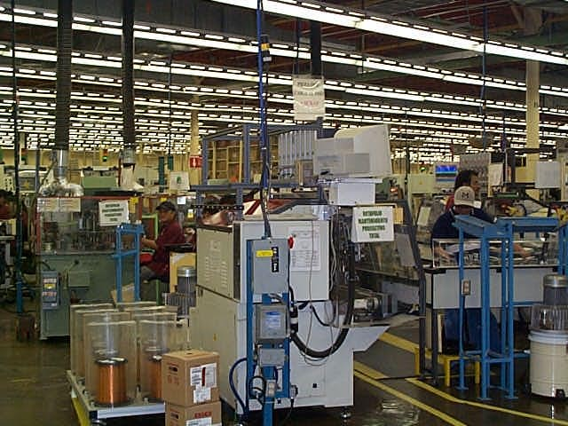
Advanced Manufacturing Norms
Clean/organized work environment
LEAN Six Sigma
Diverse workforce
Colorful language
Potentially loud work environment
Sitting/standing for long periods
Repetitive tasks that require close attention to detail

Slide 7
Steps to a Successful Team
Set and adjust goals and priorities.
Analyze or allocate the way work is being performed.
Evaluate the way the team is working.
Examine how the group handles agreement and conflict, and how group members relate to one another.
https://www.youtube.com/watch?v=BBEbNsib6TY

Slide 8
Stranded on a Mountain
After your small light aircraft crashes, your group, wearing casual clothing, is stranded on a forested mountain in winter weather (snow covered, sub-freezing conditions), anywhere between 50 and 200 miles from civilization (you are not sure of your whereabouts, and radio contact was lost one hour before you crashed, so the search operation has no precise idea of your location either). The plane is about to burst into flames and you have a few moments to gather some items. Aside from the clothes you are wearing, which does not include coats, you have no other items. It is possible that you may be within cell phone signal range, but unlikely.
Your aim is to survive as a group until rescued. From the following list choose just ten items that you would take from the plane, after which it and everything inside is destroyed by fire.

Slide 9
Choose 10 Items
Pack of 6 boxes x 50 matches
Roll of polythene sheeting 3m x 2m
1 bottle of brandy
1 crate of bottled spring water (six gallons)
Small toolbox containing hammer, screwdriver set, adjustable wrench, hacksaw, large pen-knife
Box of distress signal flares
Small basic first-aid kit containing plasters, bandages, antiseptic ointment, small pair of scissors and pain-killer tablets
Cell phone with battery half-charged
Clockwork transistor radio
Gallon container full of fresh water
Box of 36 chocolate bars
Shovel
Short hand-held axe
Box of 24 bags of peanuts
Box of tissues
Laptop computer with unknown software and data and unknown battery life
Inflatable 4-person life-raft
Compass
Large full Aerosol can of insect killer spray
Small half-full aerosol can of air freshener spray
Notebook and pencil
Travel game kit containing chess, backgammon, & checkers
Sewing kit
Whistle
Flashlight with a set of spare batteries
Box of 50 6hr candles
Bag of 6 large blankets
Hand-gun with magazine of 20 rounds
20ft of nylon rope

Slide 10
Review: Steps to a Successful Team
Set and adjust goals and priorities.
Analyze or allocate the way work is being performed.
Evaluate the way the team is working.
Examine how the group handles agreement and conflict, and how group members relate to one another.
Notes:
How was the work performed in this activity?
What have you learned about team member roles and responsibilities?
What processes did the group use?
Were they effective?
What have you learned about team processes and their effectiveness or ineffectiveness?
What kind of decision making did the group use?
How did it handle decision making?
Are there any processes you would like to change?
What have you learned about handling agreement and conflict?
Were the communications effective?
Does any part of the communication process need attention?

Slide 11
Review: Did you Collaborate as a Successful Team?
What was difficult about the process?
What skills were important during the process?
Were there established leaders?
Did the leadership role change as the group progressed through the activity?
Were you successful in completing the task? Why/why not?
Notes:
How was the work performed in this activity?
What have you learned about team member roles and responsibilities?
What processes did the group use?
Were they effective?
What have you learned about team processes and their effectiveness or ineffectiveness?
What kind of decision making did the group use?
How did it handle decision making?
Are there any processes you would like to change?
What have you learned about handling agreement and conflict?
Were the communications effective?
Does any part of the communication process need attention?

Slide 12
The Five Stages of Team Development
Forming
Storming
Norming
Performing
Adjourning

Slide 13
Factors in Team Development
Commitment
Trust
Purpose
Communication
Involvement

Slide 14
Characteristics of Great Teams
Clear purpose
Informality
Participation
Listening
Civilized disagreements
Consensus decisions
Open communication
Clear roles and work
assignments
Shared leadership
External relations
Style diversity
Self-assessment

Slide 15
Preventing Team Conflict
Deal with conflict immediately
Be open with your co-workers
Practice clear communication/active listening
Focus on the things that can be changed
Find a solution, instead of focusing on issues
RESPECT each other or take a break until you can

Slide 16
Preventing Team Conflict #2
Make an effort to get to know team members.
Be genuinely interested in your team.
Talk about what other’s interests.
Make others feel important.
Try to see things from another’s point of view.
Smile! ☺

Slide 17
Resolving Team Conflict
A Three Step Process
Prepare for Resolution
Acknowledge conflict, discuss impact and agree to a cooperative process by agreeing to openly communicate.
Understand the Situation
Clarify positions as this will help to see facts more objectively and with less emotion.
Reach Agreement
With the facts and assumptions considered, it’s easier to reach a decision/action.

Slide 18
Resolving Team Conflict #2
Resolution of Conflict Starts Here…
Express the need
Find out if the need can or cannot be met
Yes = Resolution
No = Options:
Negotiation
Management of conflict
Mediator
https://www.youtube.com/watch?v=KY5TWVz5ZDU

