Slide 1
Workplace Success
The AMMQC program is an Equal Opportunity program.
Adaptive equipment is available upon request for individuals with disabilities.
http://creativecommons.org/licenses/by/3.0 This work is licensed under a Creative Commons Attribution 3.0 Unported License [http://creativecommons.org/licenses/by/3.0]
This project is sponsored by a $15.9 million grant from the U.S. Department of Labor, Employment and Training Administration.
The AMMQC program is an Equal Opportunity program. Adaptive equipment is available upon request for individuals with disabilities. This workforce product was funded by a grant awarded by the U.S. Department of Labor’s Employment and Training Administration. The product was created by the grantee and does not necessarily reflect the official position of the U.S. Department of Labor. The U.S. Department of Labor makes no guarantees, warranties, or assurances of any kind, express or implied, with respect to such information, including any information on linked sites and including, but not limited to, accuracy of the information or its completeness, timeliness, usefulness, adequacy, continued availability, or ownership.

Slide 2
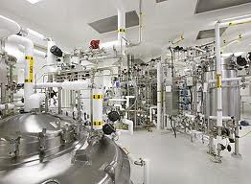
Manufacturing Environment #1
Uses machines, tools, and human labor to make products for use by others
Typically involves a combination of automated machines and human labor
Often operates on an assembly schedule
Goal-oriented: focused on meeting set production goals and product demand
Time is money: the faster and better that workers and the machines around them work, the better their companies perform
Create product as quickly and inexpensively as possible and in the necessary quantities
Lean, Six Sigma, kaizen
Safety-minded
Team-oriented
Strong workplace culture

Slide 3
Manufacturing Environment #2
http://www.youtube.com/watch?v=Ngy-dAEwAW0
http://www.pbslearningmedia.org/resource/wlvt07-cargates.manufacturing/career-gates-manufacturing/

Slide 4
Workplace Experiences
What are some positive work experiences? Why were they positive? What made them positive?
What are some of your negative work experiences? Why were they negative? What made them negative?
What kind of employee are you? What are some of your positive work habits? What are some of your negative work habits or areas for improvement?

Slide 5
Accountability in the Workplace
Responsible to somebody or for something
Acknowledgment and assumption of responsibility for actions
Being willing to answer for the outcomes resulting from your choices, behaviors, and actions
Being true to your word, yourself, and your personal expectations
A personal choice to demonstrate the ownership necessary for achieving desired results
See It, Own It, Solve It, Do It

Slide 6
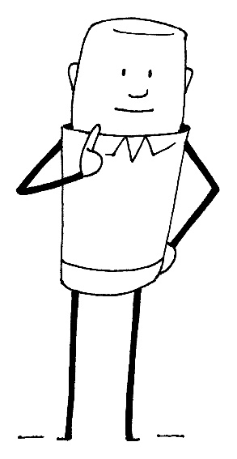
Defining Accountability
Must exist at every level.
Requires transparency, trust, honesty, integrity, and credibility from all involved.
Accountability is a personal value.
Accountability requires work!

Slide 7
Accountability
Personal/Professional Accountability: Take action consistent with your desired results.
Organizational Accountability: People can count on each other to keep commitments and agreements within the company and as a company to others outside of the company.
Build personal commitment: There is an increasing amount of empowerment in the workplace. Accountability is the other side of that equation. One can only be as empowered as one is accountable.
Build personal ownership: Learn how to curb an increasing sense of “entitlement” and lack of personal ownership.

Slide 8
Workplace Accountability
Examples of Accountability in the Workplace
Being present for your entire required shift
Completing any tasks that have been assigned to you
Performing and being responsible for the specific duties that go along with your job
Being consistent in doing the right thing in all aspects
Working together towards a common goal for the business
Responsibility for dealing with the repercussions if tasks are not completed and functions of the job are not performed properly

Slide 9
Accountability Case Study 1
It was Thursday of a busy week and Harry Henderson was just about ready to quit his job as marketing manager of Comic Clowns. It seemed like he couldn’t count on anyone.
On Monday, he had asked Jean, his head customer service representative, to call an upset customer and solve their problem. She told him that she had, but the customer had called today and said they hadn’t heard from anyone in weeks! When Harry confronted Jean she became defensive and said the customer was supposed to call her. He didn’t know what the truth was, except that his upset customer had spent his money elsewhere by hiring a clown from another company.
Harry also had heard from a sales rep this morning that the new website guru hadn’t graduated from the college he said he had. What was he supposed to do about that?
To top things off, the VP of Sales had just informed him that none of the reps had submitted last month’s reports. They were due two weeks ago!
Harry sat at his desk with his head in his hands. What was wrong with people these days?
Where did Harry go wrong? What should he do now?

Slide 10
Accountability Case Study 2
Marsha delegated an assignment to Jack and later found out that Jack hesitated to ask for help when he was having difficulties. Marsha and Jack set up performance standards for the task, but their system for monitoring was ineffective. On his weekly activity reports, Jack never indicated there were problems. Yet he couldn't finish the assignment on time because he was having trouble getting necessary information from other departments.
Jack didn't want to mention the problem to Marsha because he thought Marsha would think he was incapable. Just before the project was due, Marsha found out it would be late. "Why didn't you let me know sooner?" Marsha asked Jack. "I thought I could work it out myself, and I didn't want to bother you with another problem," Jack replied.

Slide 11
Creating Accountability
Assess yourself and your culture
Know your role: Request a job description if you don’t have one
Be honest
Apologize
Use time wisely: Procrastination is a common way to avoid responsibility, as it delays dealing with a problem, meaning that someone else may solve it instead. Your colleagues may feel that they can’t rely on you, and this will affect your professional reputation.
Don't overcommit: When you take on too much, something will eventually fall through the cracks. That means that you've let someone down.
Recognize and combat the “victim cycle”
Be solution oriented
Make changes: When something hasn’t gone to plan, ask for feedback, and look for ways to do things differently in the future.

Slide 12
Being Accountable
Take ownership of what happens as a result of your choices and actions.
Don’t blame others or make excuses.
When you mess up, fix it.
To become more accountable, make sure that you're clear about your roles and responsibilities. Be honest with yourself and others so you can admit when you’re wrong, apologize, and move on.
Make the most of your time, and manage it carefully so that you don't take on too much.
Think carefully about situations where you didn’t take responsibility but should have. Mistakes and failures can be valuable teaching tools if you have the courage to learn from them.

Slide 13
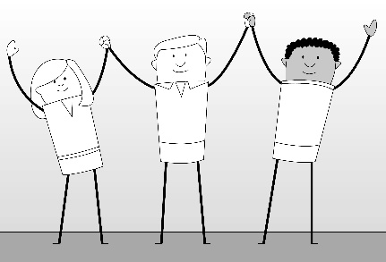
Working with Others #1
Diversity: a diverse range; a variety
Diversity is about more than just differences.
It’s about recognizing those differences, accepting them, and allowing them to change our perceptions.
Find Someone Who…

Slide 14
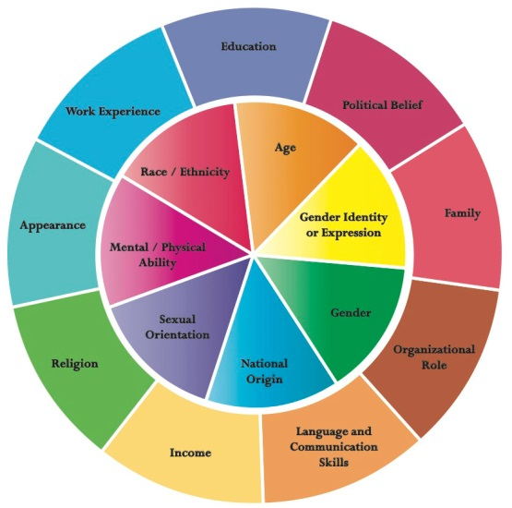
Diversity Wheel #1

Slide 15
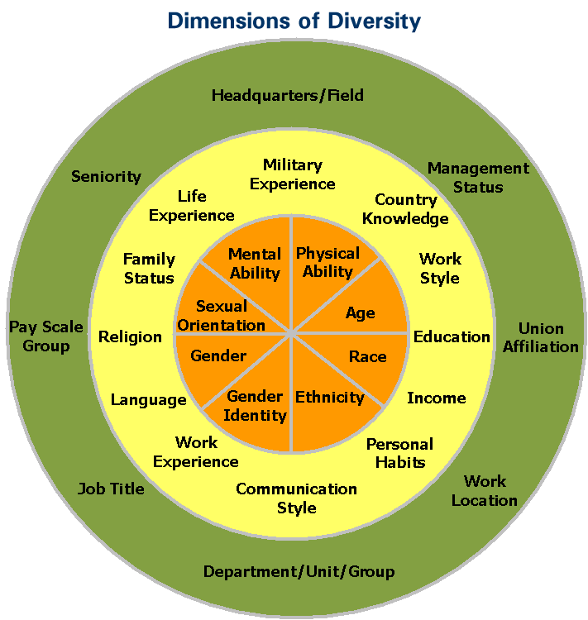
Diversity Wheel #2

Slide 16
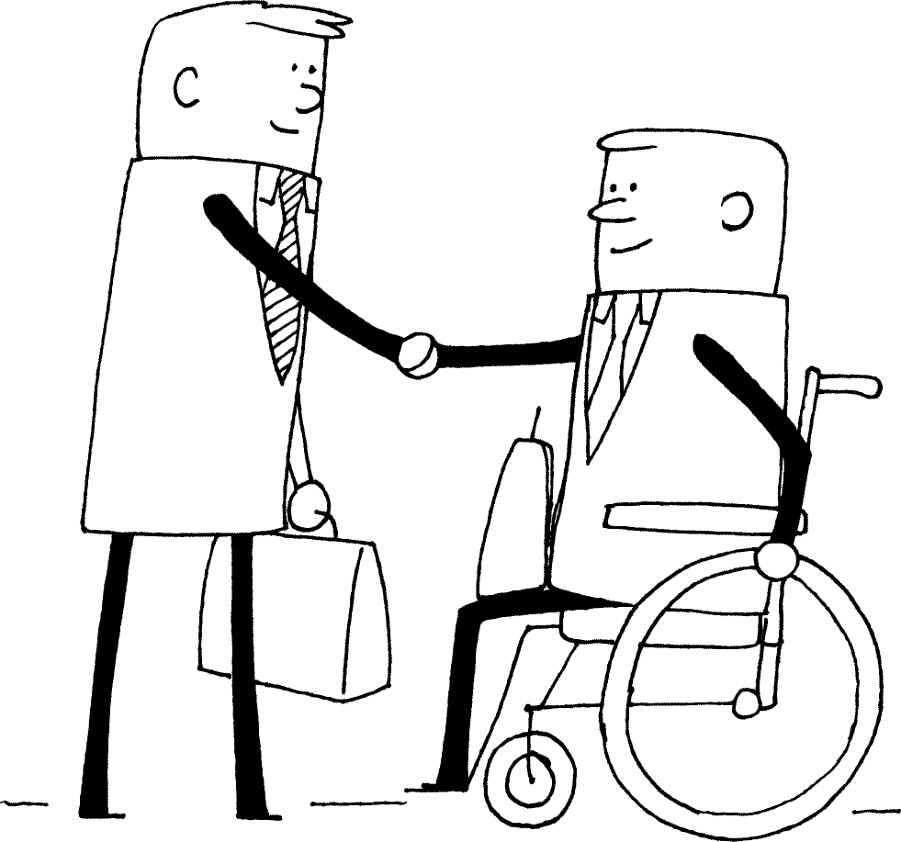
Advantages to Diversity
Advantages to a diverse culture or workplace can include:
Different points of view
Better productivity
Better teamwork
Ability to attract business from a variety of areas
Opportunity to learn

Slide 17
Self-Awareness Inventory #1
Self-Awareness Inventory
Never do/feel
1
Sometimes do/feel
3
Always do/feel
5

Slide 18
Self-Awareness Inventory #2
Statement | My Rating
I try to look for similarities between people instead of differences.
I know that I have biases and I am aware of them.
I am interested in learning more about diversity and try to seek out information whenever I can.
I like being in new situations and trying new things.
I try to look for the positive aspects in situations and people.
I follow the platinum rule: treat others the way they want to be treated.
I try to be an effective communicator.
I try to practice empathy and put myself in other people’s shoes.
I know that diversity and discrimination can mean different things to different people.
I enjoy travelling to different places and experiencing new cultures.
TOTAL

Slide 19
How Does Diversity Affect Me?
10-24
May want to consider some changes
25-40
Pretty good attitude
41-50
Excellent attitude

Slide 20
The Cornerstones of Diversity
Increase your knowledge of different cultures and ways of being.
Implement ways to better understand someone else’s experience.
Use knowledge, acceptance, and understanding to shape your behavior and stop making assumptions.

Slide 21
Dealing with Difficult People
Check yourself and consider other point of view
Separate the person from the problem: consider good points
Be objective and maintain emotional control
Ask yourself if the situation warrants action
Can affect your behavior: whining and becoming difficult
Be proactive and a problem-solver focused on solutions
Stay away
Talk with someone
Talk with your difficult coworker
Consider body language
Use humor
Be specific
Create consequences

Slide 22
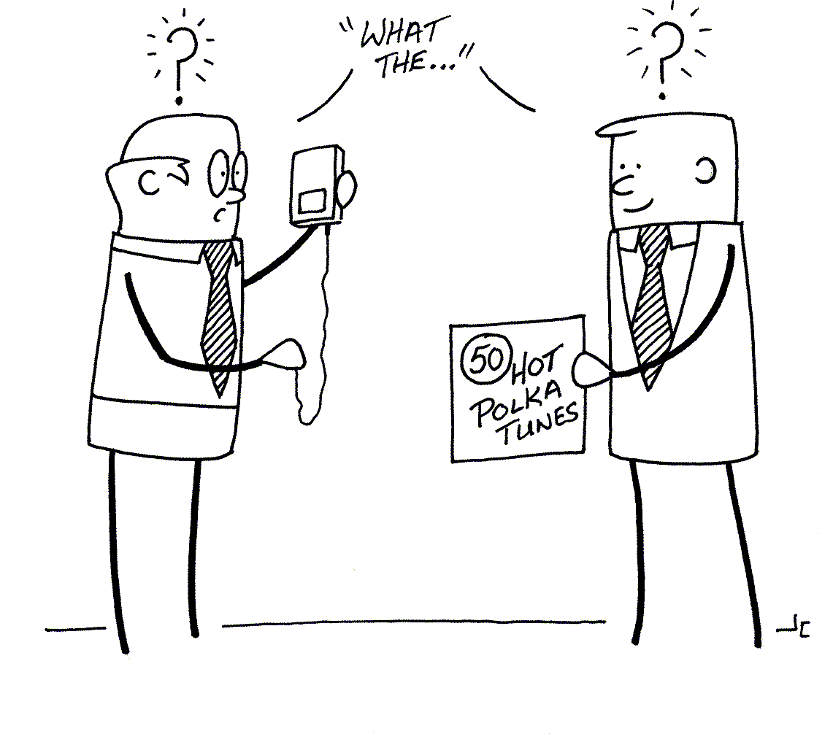
Generation Gap
Perception that one generation is vastly different from the other in terms of values, attitudes, and lifestyle.
Increasingly cross-generational workplace.
Individuals across all generations have very similar values.
The top four values across all generations are consistently family, integrity, love, and spirituality.
The place where conflict arises is not in the values themselves, but in how the values are expressed.

Slide 23
What Would You No?
Your production team has soda and pizza every Friday at lunch. Your newest coworker does not eat meat nor drink caffeine for religious reasons.
You’re in a training class and you’ve noticed that one person is being excluded from the activities because English is a second language for him/her.

Slide 24
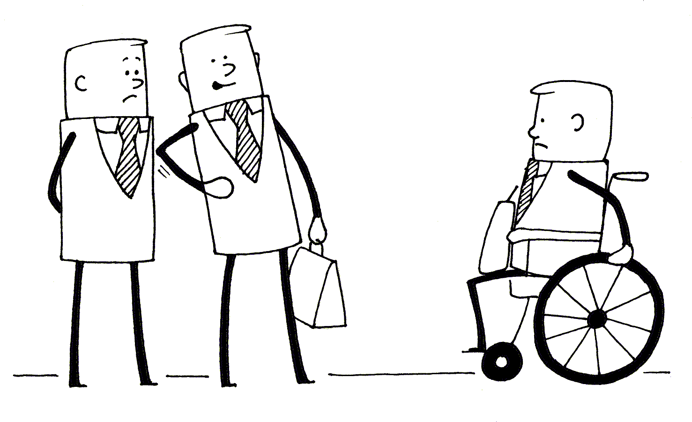
Dealing with Discrimination
Discrimination is prejudicial treatment of an individual or group based on their actual or perceived membership in a certain group or category, such as age, race, physical appearance, ethnicity, ability, gender, or medical status.

Slide 25
Dealing with Discrimination
Document each event.
Present your complaint to your manager.
If you can’t complain to your manager or you don’t receive results from this step, then speak to your Human Resources department or union.
If you don’t receive an appropriate response from the Human Resources department or union, you may want to consult with a lawyer.

Slide 26
Working with Others #2
Don’t make fun.
Don’t make assumptions.
Ask what a person prefers.
Don’t include ethnic, racial, physical status, etc. traits in a person’s description unless necessary.
Apologize if you make a mistake.

Slide 27
Workplace Rules to Live by:
Attitude Is Everything
Use Time Wisely
Use Resources Wisely
Grow and Develop Your Skills

