Slide 1
Resume & Cover Letter
The AMMQC program is an Equal Opportunity program.
Adaptive equipment is available upon request for individuals with disabilities.
http://creativecommons.org/licenses/by/3.0 This work is licensed under a Creative Commons Attribution 3.0 Unported License [http://creativecommons.org/licenses/by/3.0]
This project is sponsored by a $15.9 million grant from the U.S. Department of Labor, Employment and Training Administration.
The AMMQC program is an Equal Opportunity program. Adaptive equipment is available upon request for individuals with disabilities. This workforce product was funded by a grant awarded by the U.S. Department of Labor’s Employment and Training Administration. The product was created by the grantee and does not necessarily reflect the official position of the U.S. Department of Labor. The U.S. Department of Labor makes no guarantees, warranties, or assurances of any kind, express or implied, with respect to such information, including any information on linked sites and including, but not limited to, accuracy of the information or its completeness, timeliness, usefulness, adequacy, continued availability, or ownership.

Slide 2
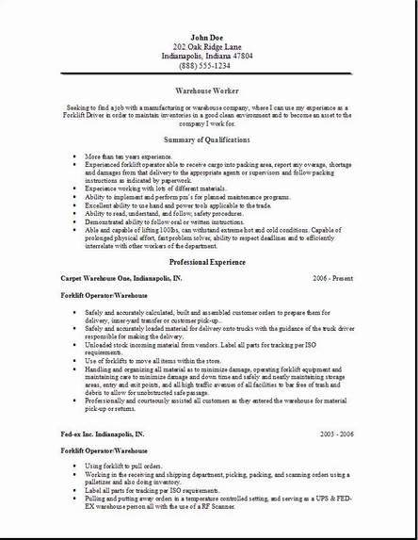
Resumes #1

Slide 3
Heading
Your contact information
Name
Street Address
City, State, Zip Code
Home/Cell Phone
E-mail Address
Make sure your heading is free of typographical
errors.

Slide 4
Examples of Headings
Name
Street Address
City, State, Zip
Phone Number
E-mail Address
FIRST LAST
Street Address, City, MA 01453 ∙ (978) 630-9553 ∙ e-mail@mwcc.edu

Slide 5
Profile
Also called “Summary,” “Background,” or “Qualifications”
Two or three sentences that summarize your most marketable skills and qualifications
Select four to six of your most outstanding features as they relate to the job you are targeting
Example: Bilingual Quality Control Manager with nine years of progressive professional experience. Results oriented with strong leadership skills and proven ability to consistently meet and exceed targeted results.

Slide 6
Summary of Qualifications
Several bullet statements summarizing your qualifications for the job you’re seeking
Short statements no longer than two lines
Prioritize statements so that the most relevant comes first

Slide 7
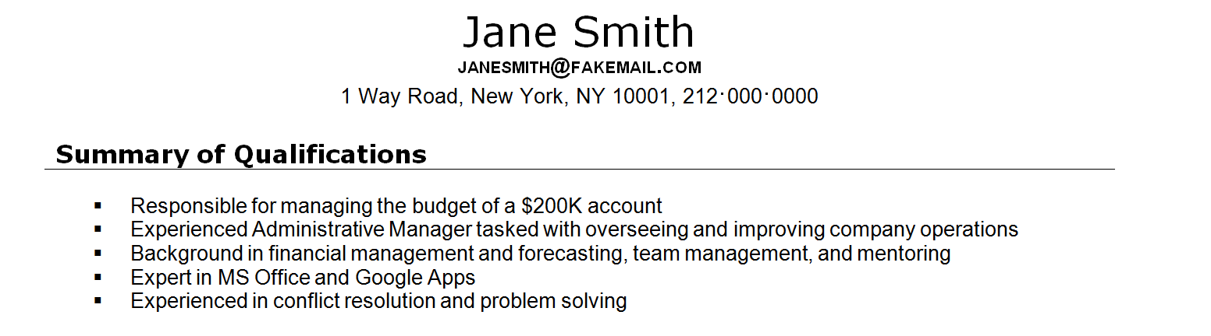
Examples of Summaries

Slide 8
Resumes #2

Slide 9
Work/Professional Experience
Reverse chronological order: start with your current or most recent employer
List your job title, the employer’s name and location, and the dates of employment
Include your duties/responsibilities by focusing on accomplishments, achievements, and completed projects
You may want to list education before your work history

Slide 10
Resumes #3

Slide 11
Examples of Experience #1
EXPERIENCE December 2000 – Present Bio Works Inc. Production Worker • Monitor production line at each stage • Maintain and handle tools and equipment used for production procedures • Monitor hoppers on the machine and keep them sufficiently filled • Check the parts bins at regular intervals • Inspect product constantly to maintain highest quality parts

Slide 12
Education #1
Start with the most recent
Include the name of the institution, the credential (certificate, diploma, degree, license, etc.), and the date of completion
Advanced Manufacturing Industrial Readiness Training Program 2014
Mount Wachusett Community College
Devens, MA
Mount Wachusett Community College, Devens, MA June 2014
Advanced Manufacturing Industrial Readiness Training Program
If not yet completed, list the date you expect to finish
Advanced Manufacturing Industrial Readiness Training Program
Expected May 2016 Mount Wachusett Community College, Devens, MA

Slide 13
Education #2
If you did not complete your education and do not plan to do so, you can still list the training you received
Coursework in Advanced Manufacturing Industrial Readiness Training 2014
Mount Wachusett Community College
Devens, MA
You may also list any memberships in professional organizations under this heading, such as the Association for Manufacturing Excellence or the American Welding Society

Slide 14
Examples of Education

Slide 15
Chronological examples

Slide 16
Resumes #4

Slide 17
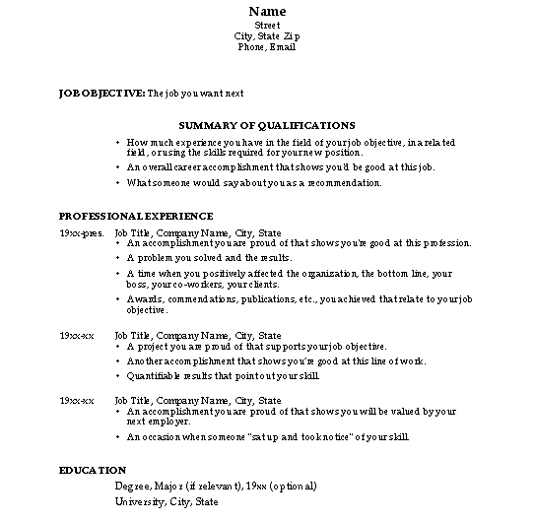
Resumes #5

Slide 18
Resumes #6

Slide 19
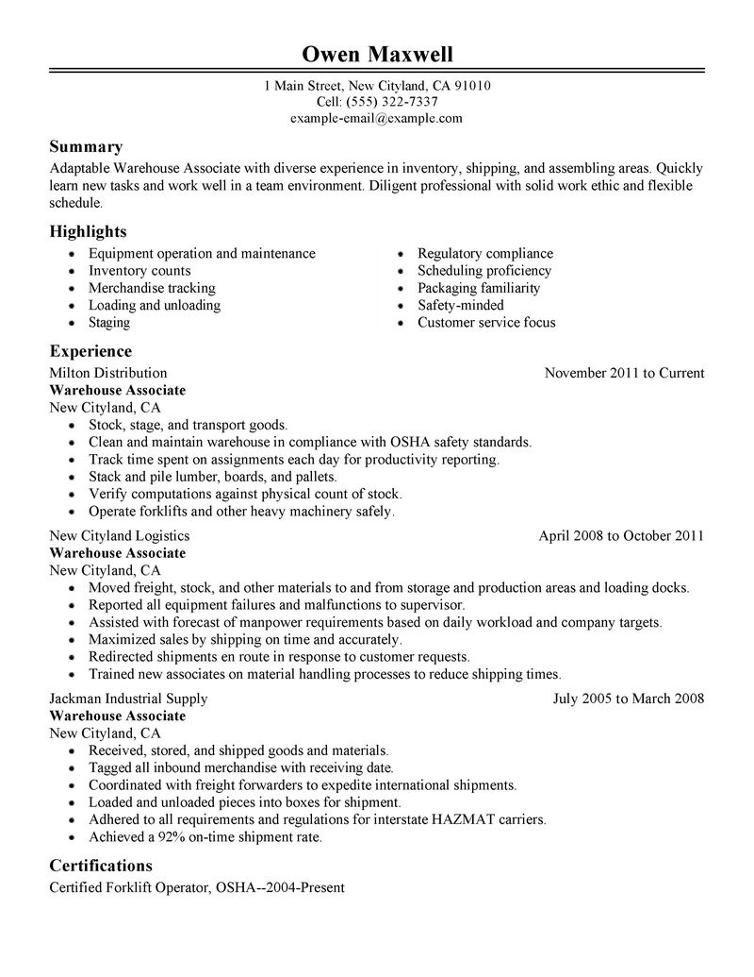
Resumes #7

Slide 20
Combination Format
Focuses on your skills and experience
Displays skills not used in recent work experience
You are entering the job market for the first time or re-entering the job market after an absence

Slide 21
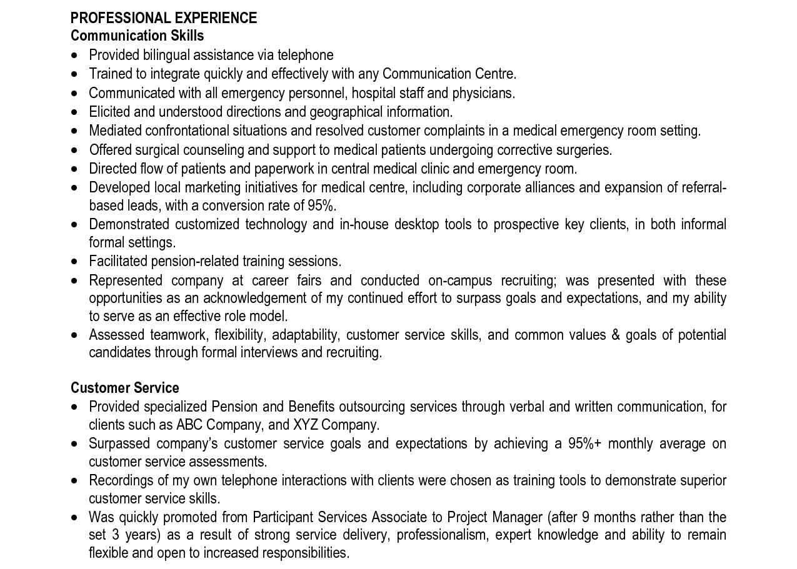
Examples of Experience #2

Slide 22
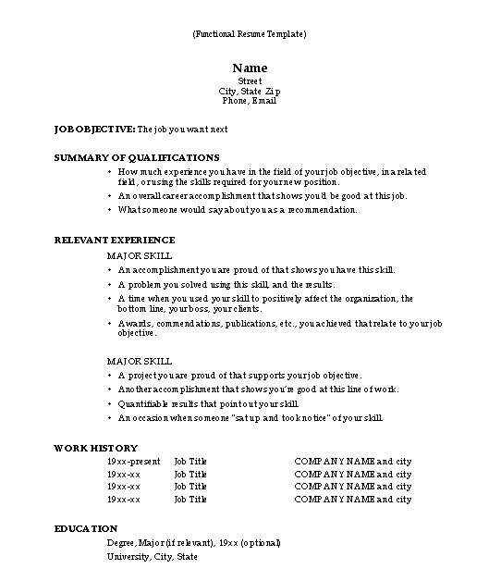
Resumes #8

Slide 23
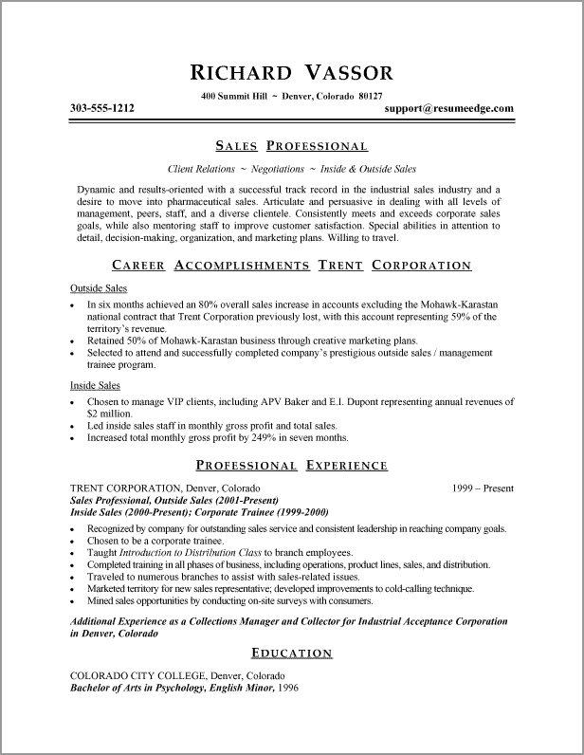
Resumes #9

Slide 24
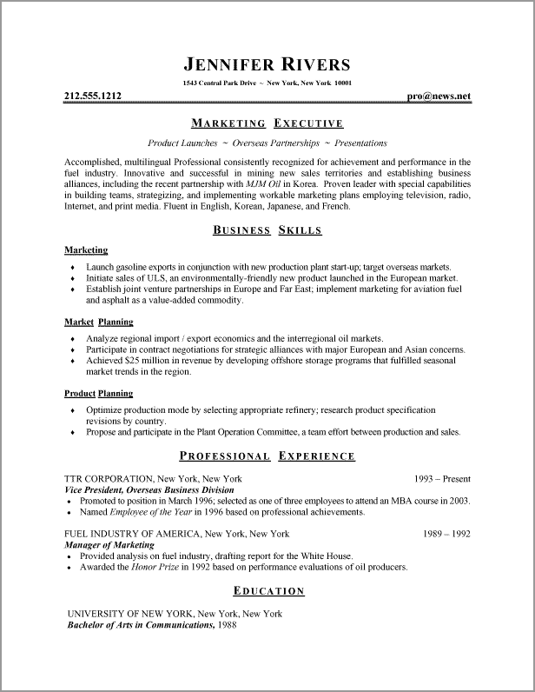
Resumes #10

Slide 25
Resumes #11

Slide 26
Resumes #12

Slide 27
Cover Letter
Explains the reasons for your interest in the specific organization and/or position and identifies your most relevant skills or experiences
Used to inquire about openings in a company or to apply for known job openings
Narrative that tells the employer why they should hire you and how you are the best candidate for the position
Complements your resume (does not duplicate it) and adds a personal touch
Accompany every resume you send out with a cover letter
Customized to each position to match your skills to employer needs

Slide 28
Parts of a Cover Letter #1
Heading
Date
Employer Address
Salutation
Body
Closing
Signature and Typed Name

Slide 29
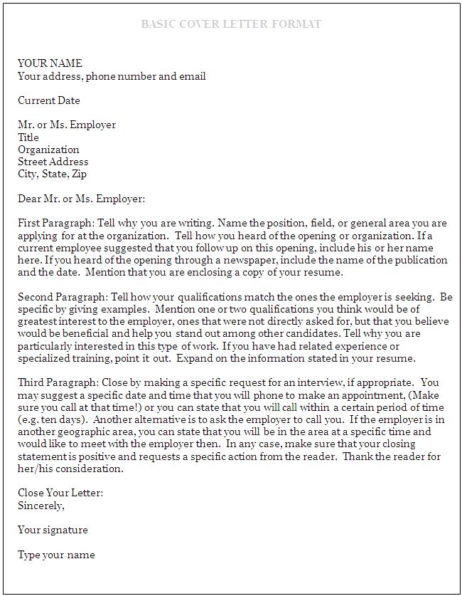
Cover Letters #1

Slide 30
Parts of a Cover Letter #2
First paragraph: Tell why you are writing. Name the position you are applying for and how you heard of the opening. If it was through an employee, name that person.
Middle paragraph: Tell how your qualifications meet the employer’s needs. Be specific and give examples.
Concluding paragraph: Request an interview and say you will follow up at a specific time. Thank the reader for his/her consideration.

Slide 31
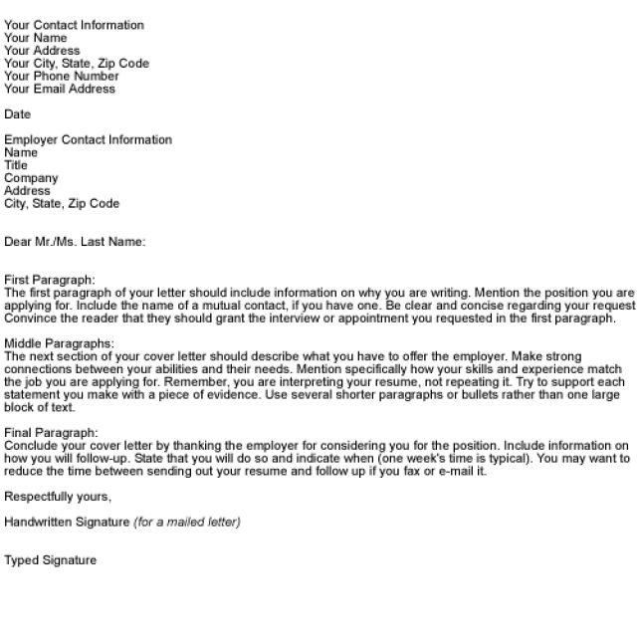
Cover Letters #2

Slide 32
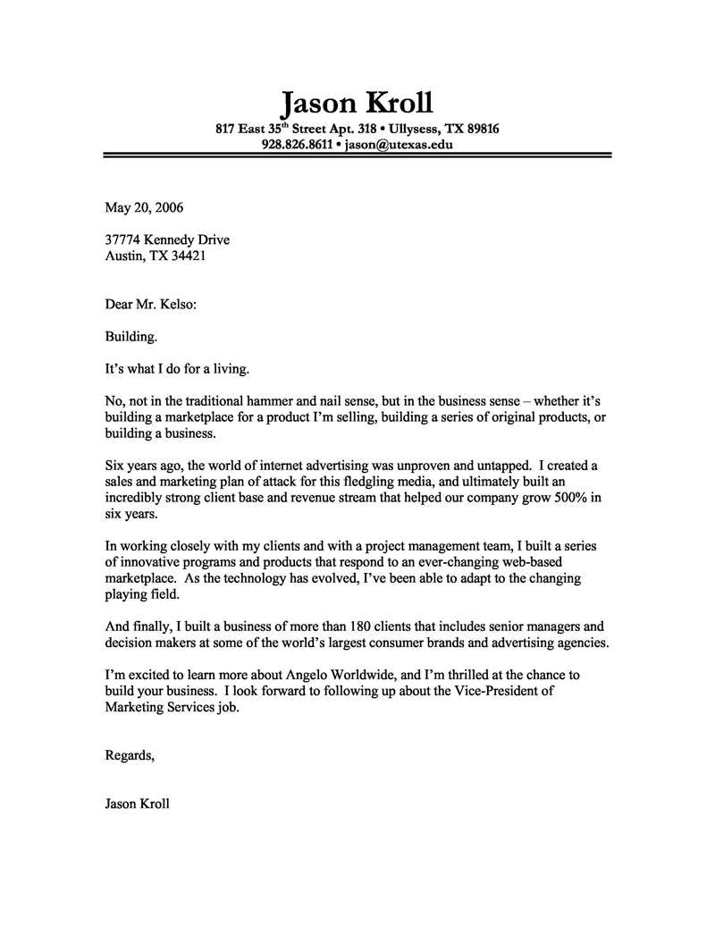
Cover Letters #3

