Slide 1


Stress Management
This project is sponsored by a $15.9 million grant from the U.S. Department of Labor, Employment and Training Administration.
The AMMQC program is an Equal Opportunity program. Adaptive equipment is available upon request for individuals with disabilities. This workforce product was funded by a grant awarded by the U.S. Department of Labor’s Employment and Training Administration. The product was created by the grantee and does not necessarily reflect the official position of the U.S. Department of Labor. The U.S. Department of Labor makes no guarantees, warranties, or assurances of any kind, express or implied, with respect to such information, including any information on linked sites and including, but not limited to, accuracy of the information or its completeness, timeliness, usefulness, adequacy, continued availability, or ownership.

Slide 2
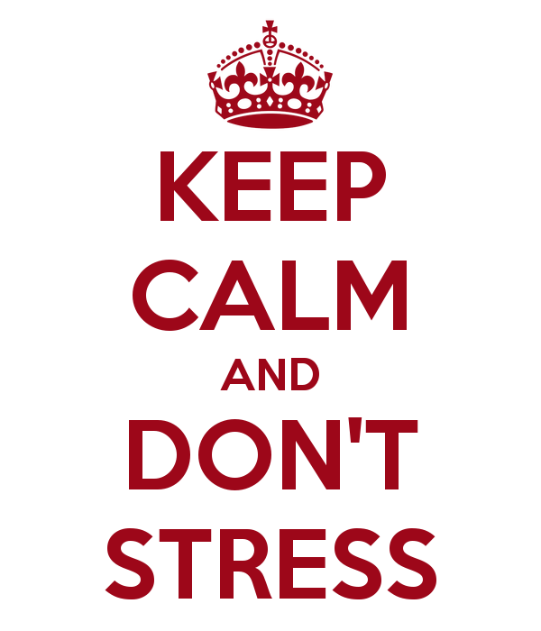
What is Stress?
Stress is our mental, physical and behavioral response to something that could threaten our safety or well-being.
Too much stress vs. too little
Good stress vs. bad stress

Slide 3
Assess Your Stress
Complete Stress Vulnerability Assessment
What you can change today to make yourself less susceptible to stress?
What can’t you change that you can deal with differently? How?

Slide 4
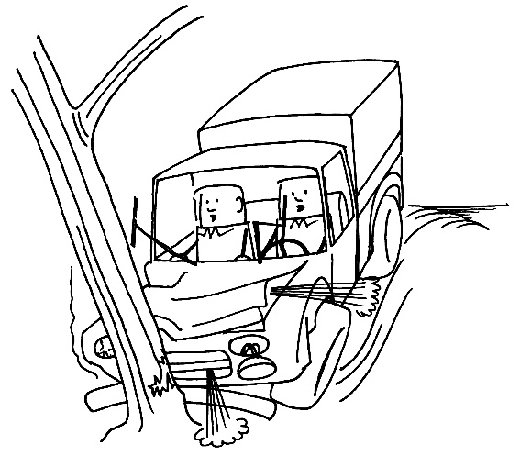
A Closer Look at Stress
Stressors lead to stimuli which evoke some kind of a response.
The greater the gap between the demands and the resources, the more stressful a situation becomes for us.
Events over which we have very little control, which occur suddenly and unpredictably, and which have an impact that lasts for a long period of time, generally have the biggest impact on physical and emotional health.
Small events that are chronically repeated over a long period of time can be equally taxing.
What are some stressors that you’ve had to deal with in
your life and how did you manage that stress?

Slide 5
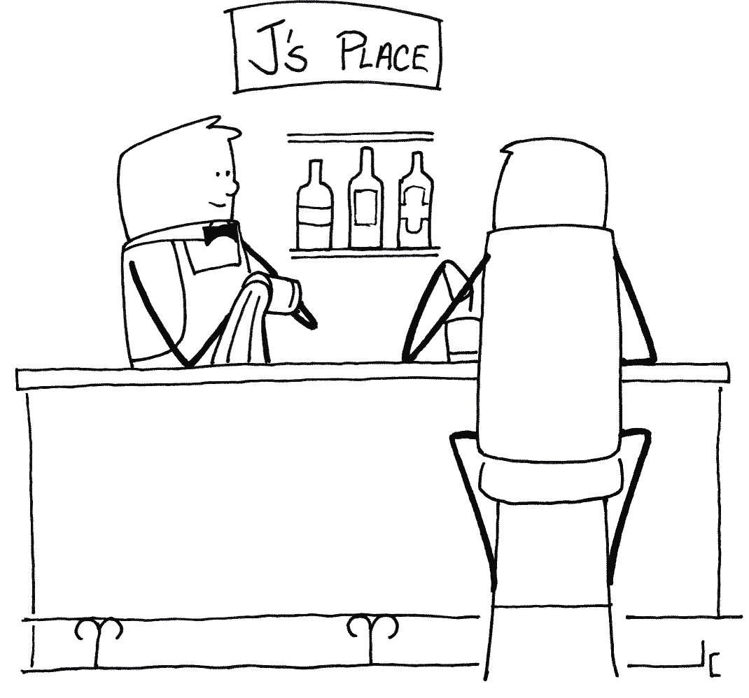
Coping Behaviors
Positive
Taking a yoga class
Practicing mindfulness exercises
Reading a book
Taking a walk
What are some other examples?
Negative
Avoiding priority tasks
Rigidity or disorganization
Self-destructive behaviors

Slide 6
Stress and Your Health
Heart attack
Stroke
Substance abuse
Abdominal problems
Physical illness
Depression
Anxiety
Insomnia
Migraines
High cholesterol

Slide 7
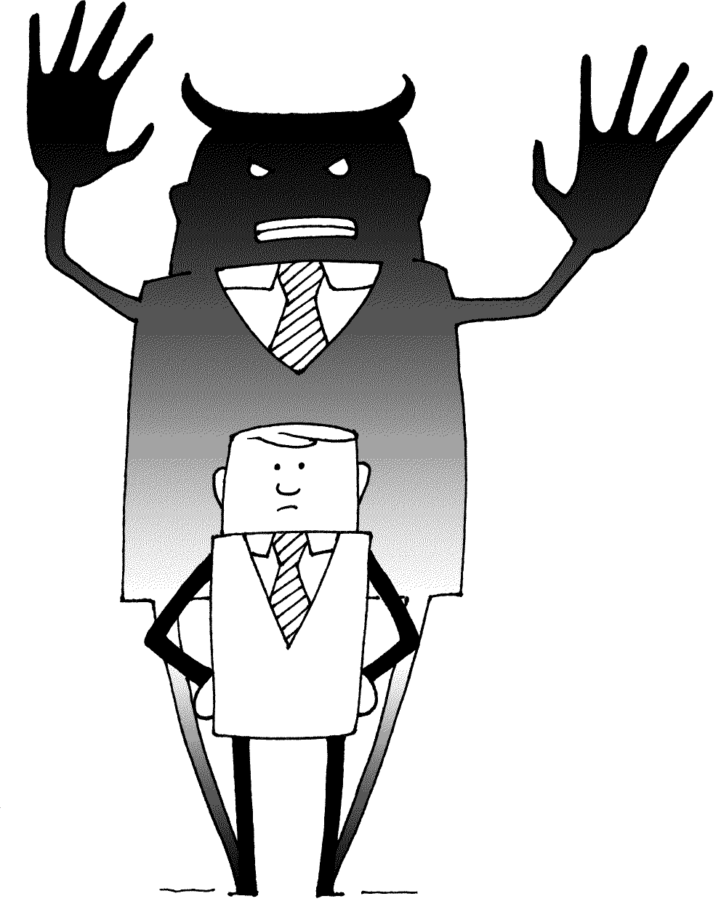
Stress at Work
The Stress Tax
Costs of Stress on the Job
Errors
Absenteeism
Conflict
Low morale
High staff turnover
Poor decisions/no decisions
Accidents

Slide 8
Building a Solid Foundation
Taking Care of Your Body and Your Mind
Stress Management
Exercise
Strong, supportive relationships
Relaxation techniques
Good nutrition

Slide 9
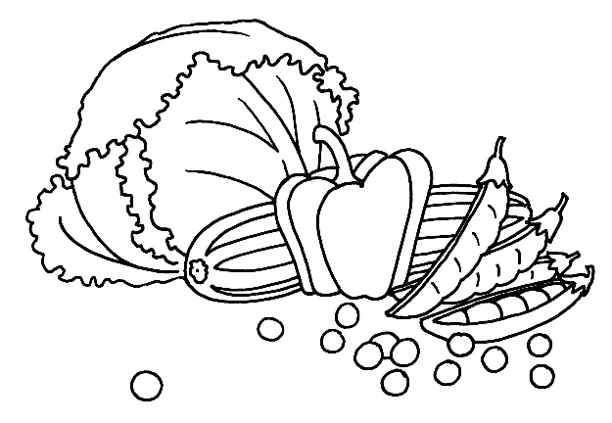
Building a Solid Foundation
Nutrition
Coffee intake
Avoid junk food and foods that are high in carbs and fat
Eat lots of fruit and vegetables
Eat breakfast
Try to eat several small meals throughout the day
Drink water, water and more water
Limit alcohol intake

Slide 10
Food Tracker
Food Journal
Date:
 | Dairy | Fruit | Grains | Protein | Veggies | Other
Totals

Slide 11
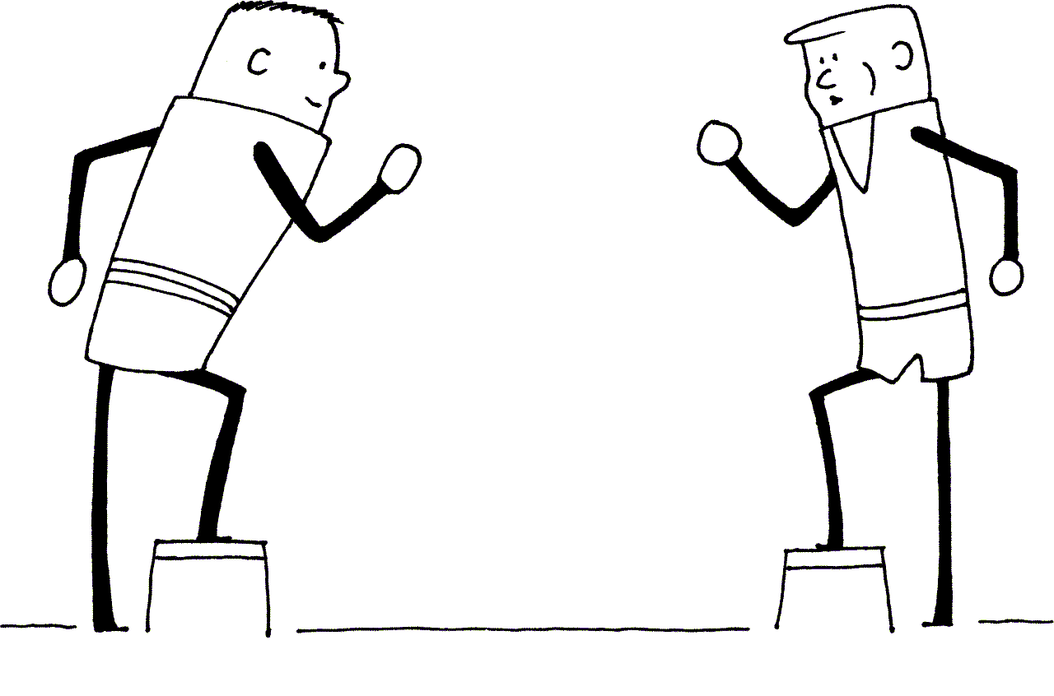
Building a Solid Foundation
Exercise
Cardiac exercise for at least 20 minutes 3x/week.
Walk it out
Stretch it out
Buddy = Motivator
http://www.ted.com/talks/nilofer_merchant_got_a_meeting_take_a_walk

Slide 12
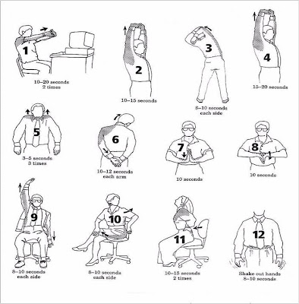
Workplace Stretching

Slide 13
Building a Solid Foundation
Relationships
Make friends at work
Smile and laugh more often
Get to know your neighbors
Volunteer
Have a positive relationship with yourself
Take time for yourself
Seek counseling, if needed
  Melissa Manzi, 978-630-9178 or m_manzi@mwcc.mass.edu

Slide 14
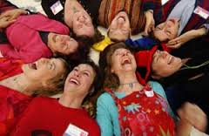
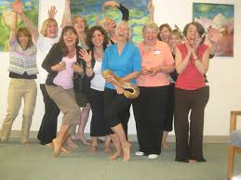
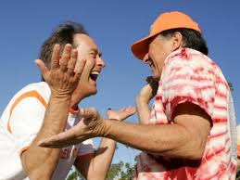
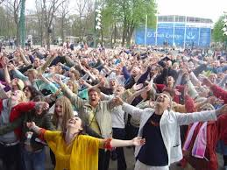
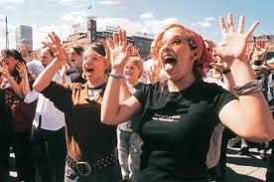
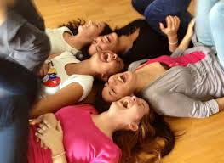
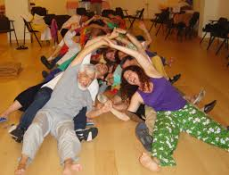
Laughing Yoga
https://www.youtube.com/watch?v=P92pJ9VaX4k

Slide 15
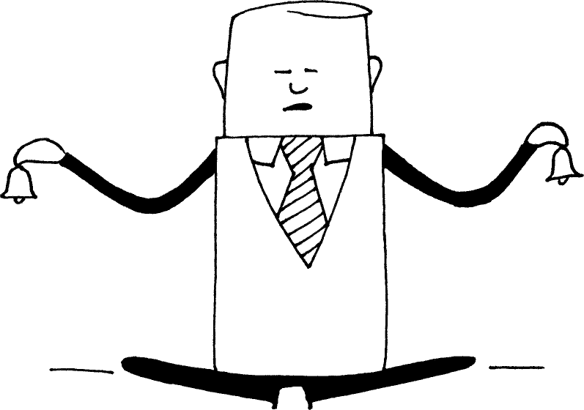
Building a Solid Foundation
Relaxation
Remember to breathe and use deep breathing techniques
Listen to music
Exercise regularly
Take a long soak in the tub
Get a massage (or give one!)
Practice meditation or mindfulness activities
Practice relaxation on a regular basis to see results

Slide 16

Practicing Mindfulness
M&M Exercise
  Step One: Eat an M&M.
  Step Two: Eat another M&M, but slowly focusing on how it smells, feels, tastes, etc.
  Step Three: Think about how this technique can be applied to other parts of your life.

Slide 17

A Trip to the Beach
https://www.youtube.com/watch?v=wDYOenLmVTg

