Slide 1
Time Management
This project is sponsored by a $15.9 million grant from the U.S. Department of Labor, Employment and Training Administration. The AMMQC program is an Equal Opportunity program. Adaptive equipment is available upon request for individuals with disabilities. This workforce product was funded by a grant awarded by the U.S. Department of Labor’s Employment and Training Administration. The product was created by the grantee and does not necessarily reflect the official position of the U.S. Department of Labor. The U.S. Department of Labor makes no guarantees, warranties, or assurances of any kind, express or implied, with respect to such information, including any information on linked sites and including, but not limited to, accuracy of the information or its completeness, timeliness, usefulness, adequacy, continued availability, or ownership.

Slide 2
Writing about Time
What are your top three priorities?
What are the top three obstacles to working on your priorities or meeting your objectives?
On a scale of one to ten, how would you rate your organizational skills right now? Why?
How would you spend any additional time if you found a way to give it to yourself?

Slide 3
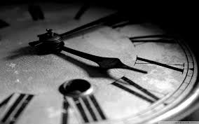
Time Management Self-Assessment

Slide 4
It’s about Time!
Essential skill.
Helps keep your work under control and stress to a minimum.
Prioritization.
Work smarter, not harder.
Scheduling.
Concentrate on results, not on being busy.

Slide 5
Aspects of Time Management
Goal setting
Prioritization
Managing interruptions
Procrastination
Scheduling

Slide 6
Goal Setting
Know where you're going.
Start with the end in mind.
Conflicting priorities.
Saves time, effort, and frustration in the future.

Slide 7
Prioritization
Focus on import tasks.
“To do” lists.
Be specific.
“Ta-da!” list.

Slide 8
Managing Interruptions
Minimize interruptions.
Not all interruptions need to be dealt with immediately.
Consider each one in light of your priorities.

Slide 9
Procrastination
Putting off tasks that you should be focusing on right now.
Ask yourself why.
Make a plan.
Small chunks.
Create habits and systems.
Reward yourself.

Slide 10
Scheduling
Keeps you on track and minimizes stress.
Consider the factors that affect your time.
Leave room for interruptions and unexpected events.
Controls time and maintains balance.

Slide 11
Case Study: Another Day at the Office
It was 7:20 a.m. when Myron arrived at the office. He was early because he wanted to clear the backlog of work that had been piling up on his desk. He turned on the lights and started to go through yesterday's mail. As he read the first piece, he realized he couldn't deal with it until a colleague arrived. He set it aside and went to the next. This item had potential application to a project he was working on, so he walked down the hall and made a copy for his personal use.
As he continued reading his mail, he came across a journal article of particular interest and become engrossed in it. As he looked up, he was startled to find that others were arriving and it was nearly 9:00.
He quickly pushed the remaining mail to a corner of his desk and reached for a project file due tomorrow with at least two days of work yet to be completed. As he opened the file, Bill and Claire stopped by and invited him to join them for coffee. Myron decided he could spare ten minutes. Bill and Claire were both anxious to share the details of a play they attended last night. Before Myron realized it, thirty minutes had passed and he hurried back to his office.
As Myron entered his office, the phone rang. It was Mr. Wilson, his manager. There was a meeting scheduled at 10:00. Could Myron sit in for him? There was something to be discussed that the department should know about. Myron looked at his watch. There wasn't enough time to get started on the project so he pushed the file aside and vowed to start it immediately after lunch.
The afternoon wasn't any better. A few visitors, a few phone calls, a couple of letters, and the day was over. Nothing had been accomplished on the project that was due tomorrow. As he stuffed papers into his briefcase, he wondered how Bill and Claire were able to attend plays during the evening.

Slide 12
Another Day at the Office
Did Myron make good use of his best time of day?
Did he work on his high priority items?
Did he have a problem saying no?
Did he complete the tasks he started?
Did he understand his problems?
What would you recommend for Myron?

Slide 13
How Do You Spend Your Time?
What are the things you have to do every day?
How much time must you allot to each thing?
Knowing approximately how much time tasks take can help us to plan for them.
What about the things you have to do each week or month?

Slide 14
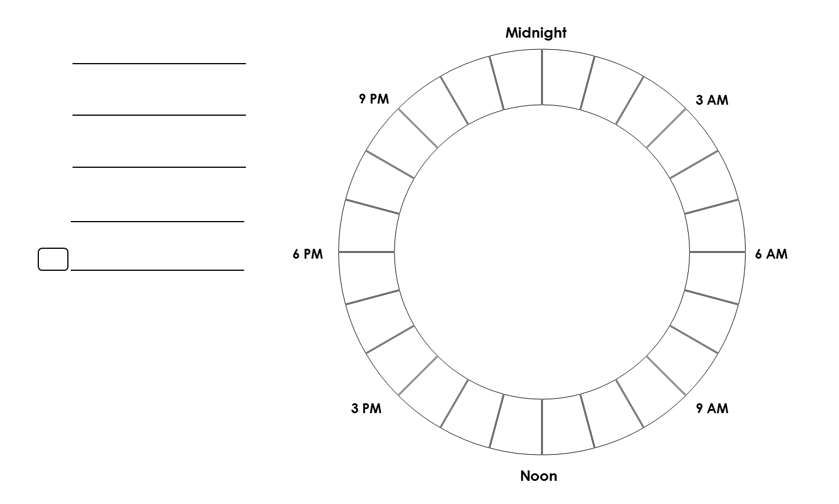
How Do You Spend Your Day?

Slide 15
Evaluating Your Day
What did you spend the most time doing?
Were there any surprises in how you spent the day or how much time you spent on a particular task/activity?
Did you take any time out just for you?
Did your day align with your goals and priorities?
Tomorrow is another day!

Slide 16
Time Management Tips
Focus on one task at a time.
Take breaks.
Use your best times.
Use to do lists, calendars, and planners and keep them up to date.
Work on projects a little at a time.
Simplify your life.
Use the “dump, sort, and group” method.
Turn piles into files.
Do I use it? Do I love it?

Slide 17
Setting Up Routines
Simplify, clarify, and create order.
Appropriate for any activity.
Ritualize sleep.
Fix mealtimes and plan in advance.
Exercise is easier to do when you make it a habit.

Slide 18
Creating Habits

Slide 19
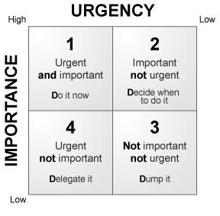
Time Management Quadrant

