Slide 1
Introduction to Computers
This project is sponsored by a $15.9 million grant from the U.S. Department of Labor, Employment and Training Administra)on.
The AMMQC program is an Equal Opportunity program. Adap)ve equipment is available upon request for individuals with disabili)es. This workforce product was funded by a grant awarded by the U.S. Department of Labor’s Employment and Training Administra)on. The product was created by the grantee and does not necessarily reﬂect the oﬃcial posi)on of the U.S. Department of Labor. The U.S. Department of Labor makes no guarantees,
warran)es, or assurances of any kind, express or implied, with respect to such informa)on, including any informa)on on linked sites and including, but not limited to, accuracy of the informa)on or its completeness, )meliness, usefulness, adequacy, con)nued availability, or ownership.
This work is licensed under a Crea)ve Commons AQribu)on 3.0 Unported License [hQp://crea)vecommons.org/licenses/by/3.0]

Slide 2
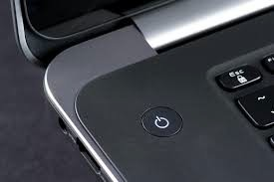
Power BuQons (1 of 3)
• Size and loca)on varies, but all buQons to power devices on have an icon with an
unclosed circle and a ver)cal line.

Slide 3
Power Buttons (2 of 3)
• A computer system may have mul)ple power buQons, one for the computer itself and another for the monitor, and more for peripherals.
• Users can control what happens when the power buQon is pressed.

Slide 4
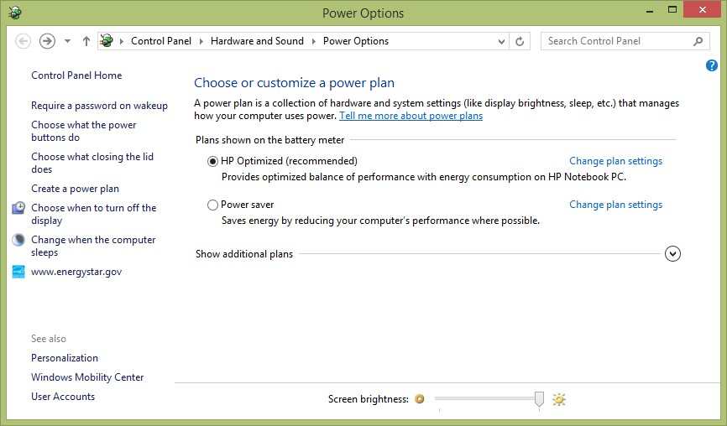
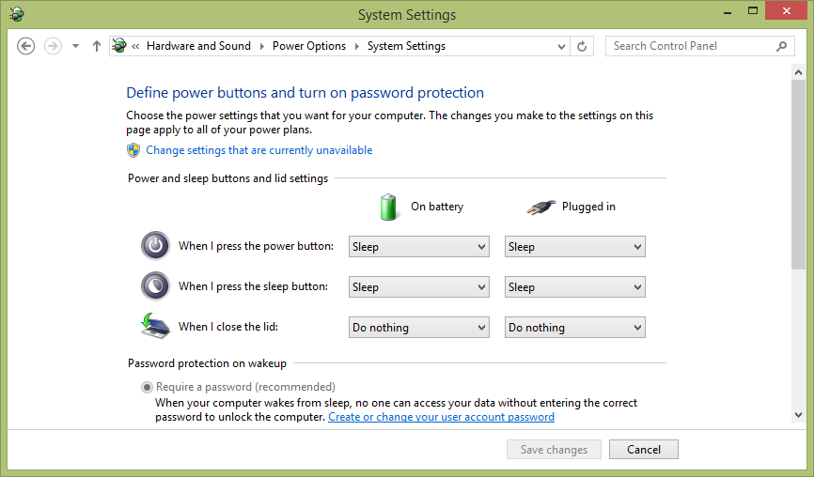
Power Buttons (3 of 3)
• search “Power Options”

Slide 5
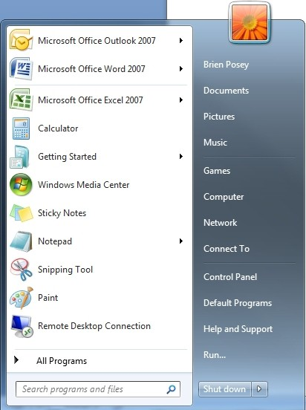
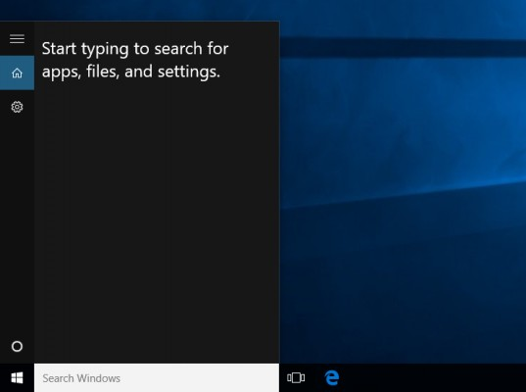
Finding Programs
• As systems have become more complicated, users have begun “searching” rather than “browsing.”

Slide 6
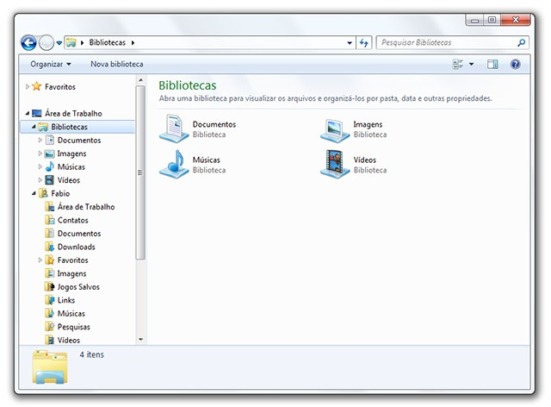
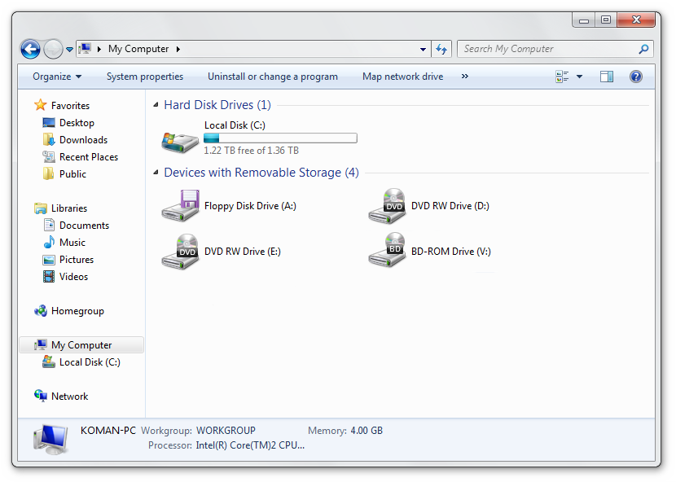
Finding and Saving Files
• Windows Explorer shows drives, folder, and ﬁles
• Save as… to change local on or name of a ﬁle

