Slide 1
Using the Internet
This project is sponsored by a $15.9 million grant from the U.S. Department of Labor, Employment and Training AdministraCon.
The AMMQC program is an Equal Opportunity program. AdapCve equipment is available upon request for individuals with disabiliCes. This workforce product was funded by a grant awarded by the U.S. Department of Labor’s Employment and Training AdministraCon. The product was created by the grantee and does not necessarily reﬂect the oﬃcial posiCon of the U.S. Department of Labor. The U.S. Department of Labor makes no guarantees,
warranCes, or assurances of any kind, express or implied, with respect to such informaCon, including any informaCon on linked sites and including, but not limited to, accuracy of the informaCon or its completeness, Cmeliness, usefulness, adequacy, conCnued availability, or ownership.
This work is licensed under a CreaCve Commons AQribuCon 3.0 Unported License [hQp://creaCvecommons.org/licenses/by/3.0]

Slide 2


GeYng Online
• Look for the green lights
– On the computer
– On the modem

Slide 3

Browsers
• Programs that display web pages

Slide 4
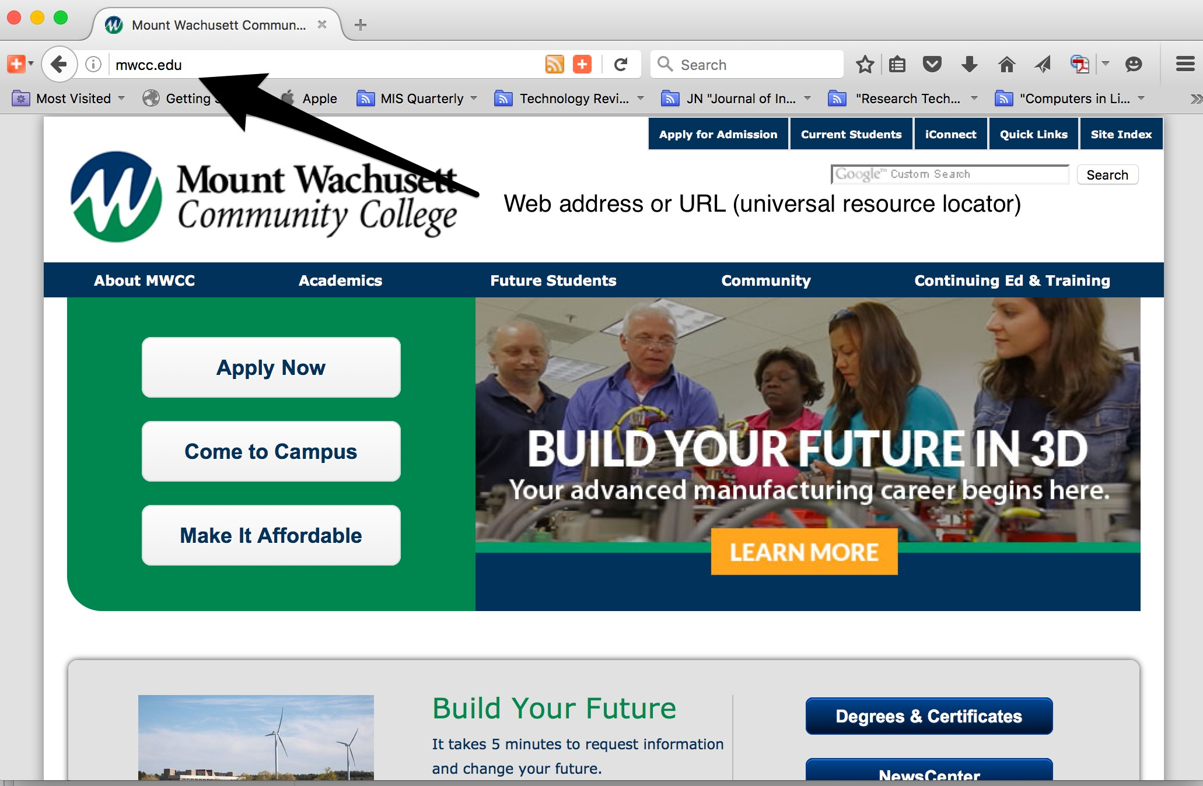
If You Know Were You Are Going
• Type into the address bar, or click a bookmark

Slide 5
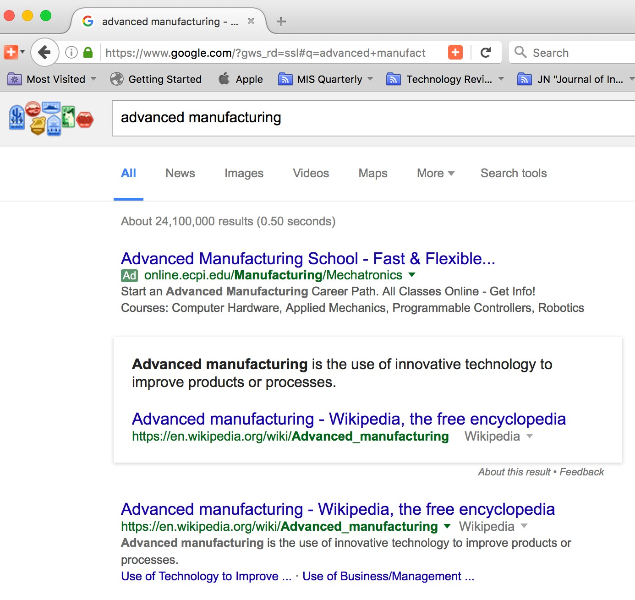
“Googling”
• Everyone uses Google search results

Slide 6


Internet Safety
• Financial data
• Look for locks
• Everything online is public

