Slide 1
Blueprint Reading
Section I - Introduction

Slide 2
Disclaimer
The AMMQC program is an Equal Opportunity program. Adaptive equipment is available upon request for individuals with disabilities. http://creativecommons.org/licenses/by/3.0 This work is licensed under a Creative Commons Attribution 3.0 Unported License [http://creativecommons.org/licenses/by/3.0] This project is sponsored by a $15.9 million grant from the U.S. Department of Labor, Employment and Training Administration. The AMMQC program is an Equal Opportunity program. Adaptive equipment is available upon request for individuals with disabilities. This workforce product was funded by a grant awarded by the U.S. Department of Labor’s Employment and Training Administration. The product was created by the grantee and does not necessarily reflect the official position of the U.S. Department of Labor. The U.S. Department of Labor makes no guarantees, warranties, or assurances of any kind, express or implied, with respect to such information, including any information on linked sites and including, but not limited to, accuracy of the information or its completeness, timeliness, usefulness, adequacy, continued availability, or ownership.

Slide 3
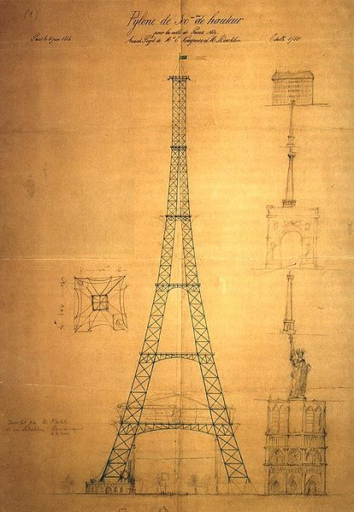
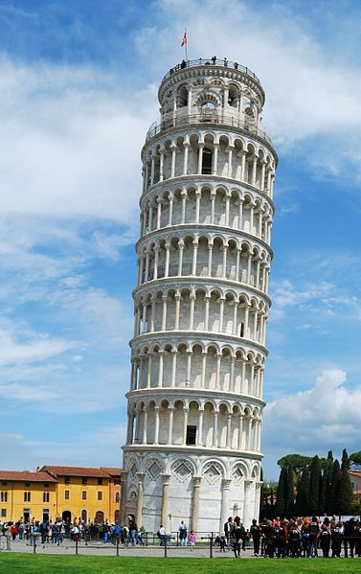
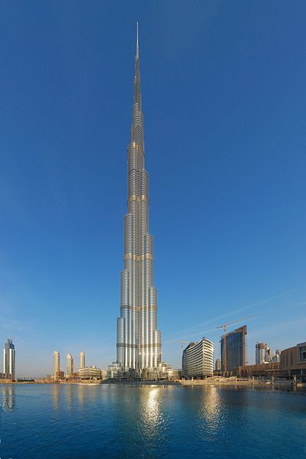
A little history…
Notes:
All Gizah Pyramids. Digital image. Wikipedia. N.p., n.d. Web. 9 Aug. 2013. <http://en.wikipedia.org/wiki/File:All_Gizah_Pyramids.jpg>.
Burj Khalifa Building. Digital image. Wikipedia. N.p., n.d. Web. 9 Aug. 2013. <http://en.wikipedia.org/wiki/File:Burj_Khalifa_building.jpg>.
Eiffel Tower Sketch Maurice Koechlin Pylone.jpg. Digital image. Wikipedia. N.p., n.d. Web. 9 Aug. 2013. <http://en.wikipedia.org/wiki/File:Maurice_koechlin_pylone.jpg>.
Leaning Tower of Pisa. Digital image. Wikipedia. N.p., n.d. Web. 9 Aug. 2013. <http://en.wikipedia.org/wiki/File:Leaning_Tower_of_Pisa_(April_2012).jpg>.
Drawings did not start out as mechanical drawings but architectural drawings
Hand tools and simple mechanisms were crafted and handed down – no drawings needed
Earliest drawings by engineers were probably - the pyramids?
Compared to the latest technology - Burj Khalifa – United Arab Emerites – Dubai – tallest building in the world
Along the way – Eiffal Tower
Sometimes there are mistakes – Leaning Tower of Pisa

Slide 4
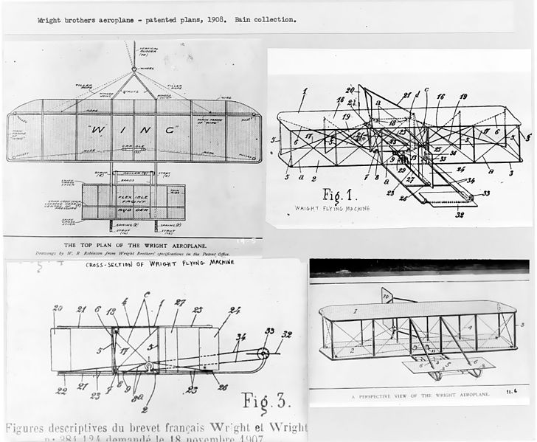
A little more history…
Patent Drawing
Notes:
Wright Brothers Patent. Digital image. Glencoe.com. N.p., n.d. Web. 9 Aug. 2013. <http://www.glencoe.com/sec/socialstudies/btt/cent_of_flight/images/wright_plans.jpg>.
Gillette Razor Patent. Digital image. Wikipedia. N.p., n.d. Web. 9 Aug. 2013. <http://en.wikipedia.org/wiki/File:US_Patent_775134.PNG>.
Patents for devices drove drawings to become documents
The Wright brothers made these drawings for one of their beginning planes for a patent
Shown is the patent drawing for a Gillette Razor.

Slide 5
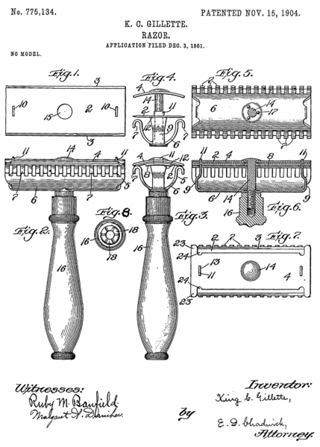
More history…
Patent Drawing
Notes:
Gillette Razor Patent. Digital image. Wikipedia. N.p., n.d. Web. 9 Aug. 2013. <http://en.wikipedia.org/wiki/File:US_Patent_775134.PNG>.

Slide 6
Types of Drawings
Part Drawing
Notes:
These are the types of drawings you are likely to encounter:
Part drawing (Picture 5)
Assembly drawing (Picture 7)
Isometric drawing (Picture 8)
Illustration – Drumset (Picture 9)
3D Model – Pistons and Crankshaft (Picture 10)
Cutaway view – It’s a Nash (Picture 11)
Exploded View (Picture 12)

Slide 7
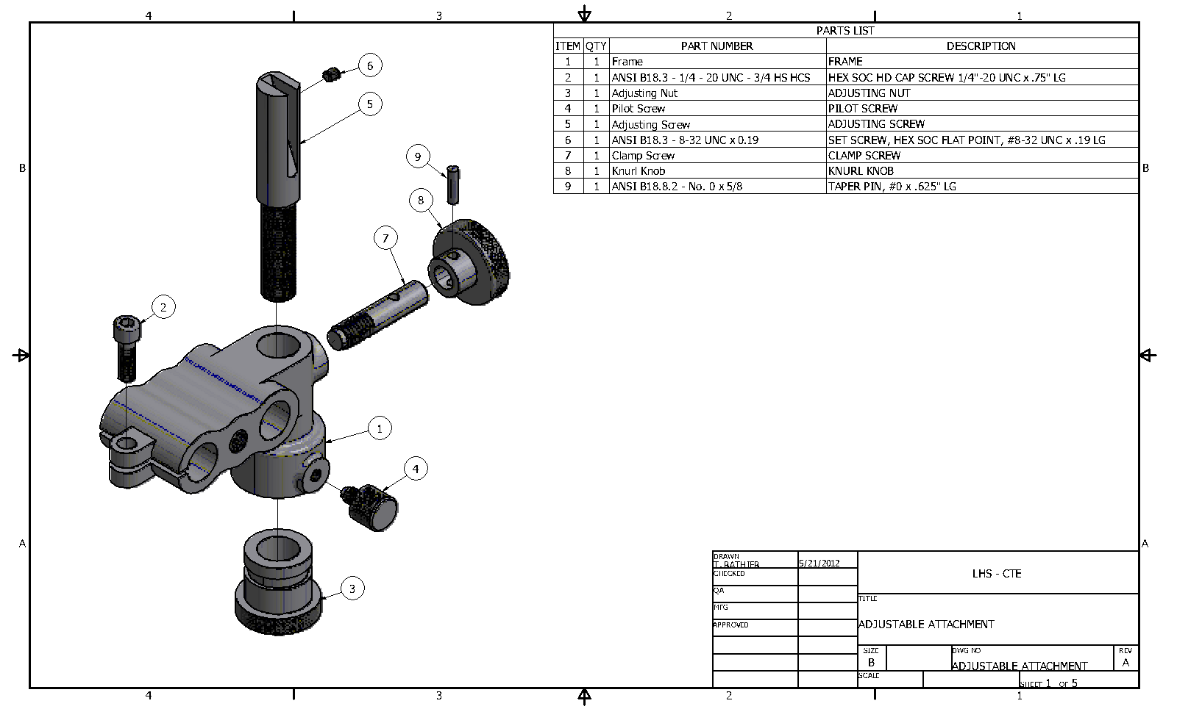
Types of Drawings #2
Assembly Drawing
Notes:
These are the types of drawings you are likely to encounter:
Part drawing (Picture 5)
Assembly drawing (Picture 7)
Isometric drawing (Picture 8)
Illustration – Drumset (Picture 9)
3D Model – Pistons and Crankshaft (Picture 10)
Cutaway view – It’s a Nash (Picture 11)
Exploded View (Picture 12)

Slide 8
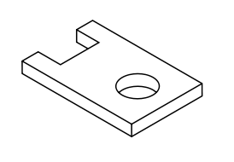
Types of Drawings #3
Isometric Drawing
Notes:
These are the types of drawings you are likely to encounter:
Part drawing (Picture 5)
Assembly drawing (Picture 7)
Isometric drawing (Picture 8)
Illustration – Drumset (Picture 9)
3D Model – Pistons and Crankshaft (Picture 10)
Cutaway view – It’s a Nash (Picture 11)
Exploded View (Picture 12)

Slide 9
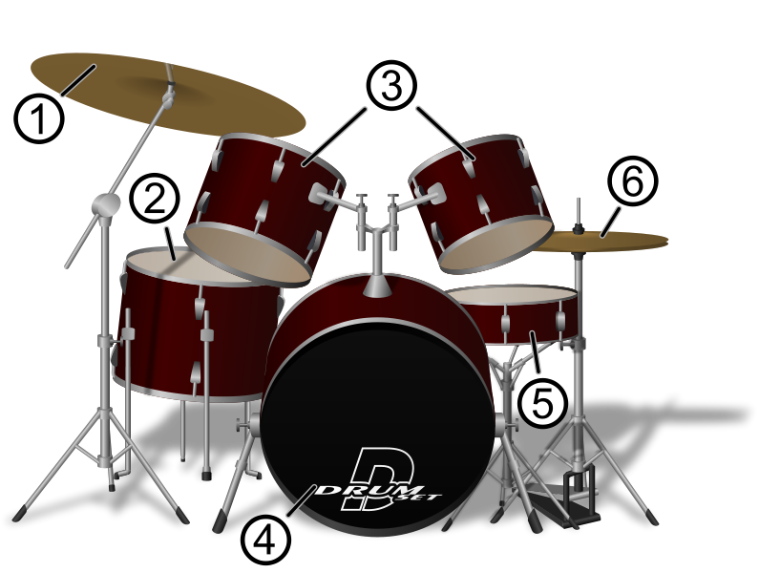
Types of Drawings #4
Illustration
Notes:
These are the types of drawings you are likely to encounter:
Part drawing (Picture 5)
Assembly drawing (Picture 7)
Isometric drawing (Picture 8)
Illustration – Drumset (Picture 9)
3D Model – Pistons and Crankshaft (Picture 10)
Cutaway view – It’s a Nash (Picture 11)
Exploded View (Picture 12)

Slide 10
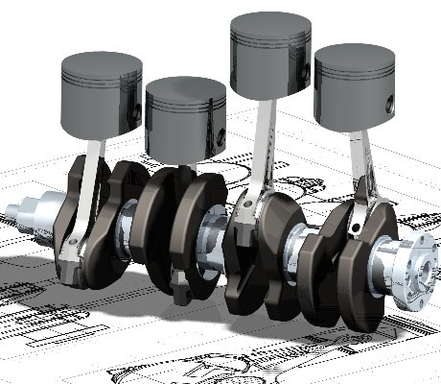
Types of Drawings #5
3D Model
Notes:
These are the types of drawings you are likely to encounter:
Part drawing (Picture 5)
Assembly drawing (Picture 7)
Isometric drawing (Picture 8)
Illustration – Drumset (Picture 9)
3D Model – Pistons and Crankshaft (Picture 10)
Cutaway view – It’s a Nash (Picture 11)
Exploded View (Picture 12)

Slide 11
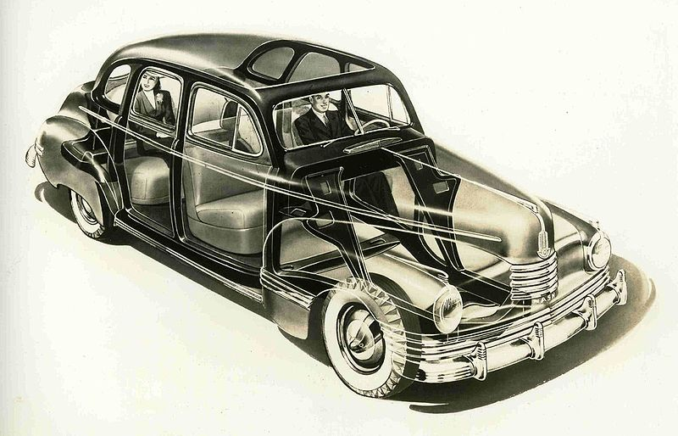
Types of Drawings #6
Cutaway View
Notes:
These are the types of drawings you are likely to encounter:
Part drawing (Picture 5)
Assembly drawing (Picture 7)
Isometric drawing (Picture 8)
Illustration – Drumset (Picture 9)
3D Model – Pistons and Crankshaft (Picture 10)
Cutaway view – It’s a Nash (Picture 11)
Exploded View (Picture 12)

Slide 12
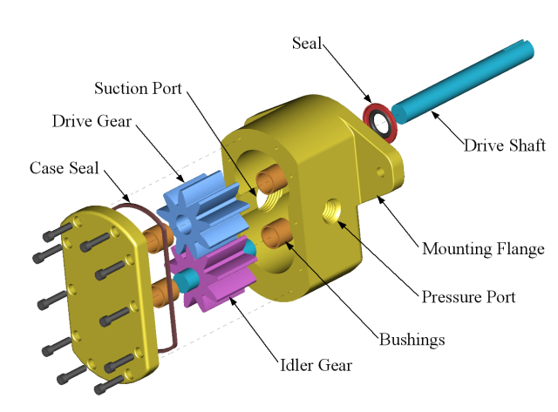
Types of Drawings #7
Exploded View
Notes:
These are the types of drawings you are likely to encounter:
Part drawing (Picture 5)
Assembly drawing (Picture 7)
Isometric drawing (Picture 8)
Illustration – Drumset (Picture 9)
3D Model – Pistons and Crankshaft (Picture 10)
Cutaway view – It’s a Nash (Picture 11)
Exploded View (Picture 12)

Slide 13
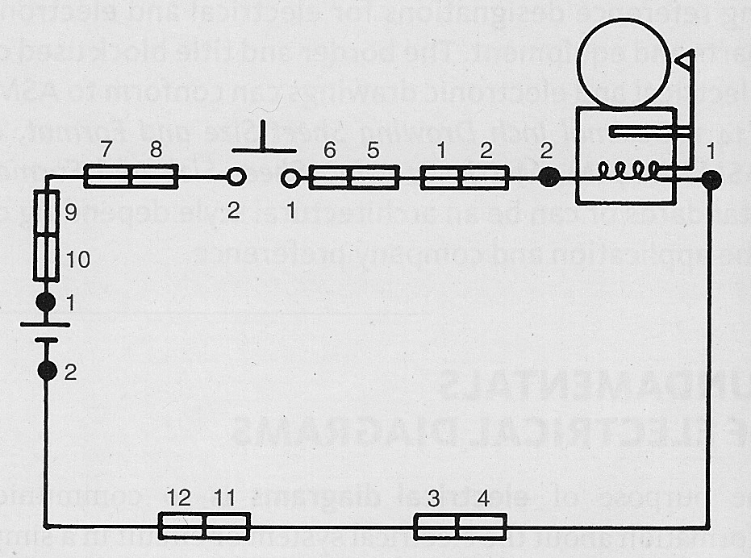
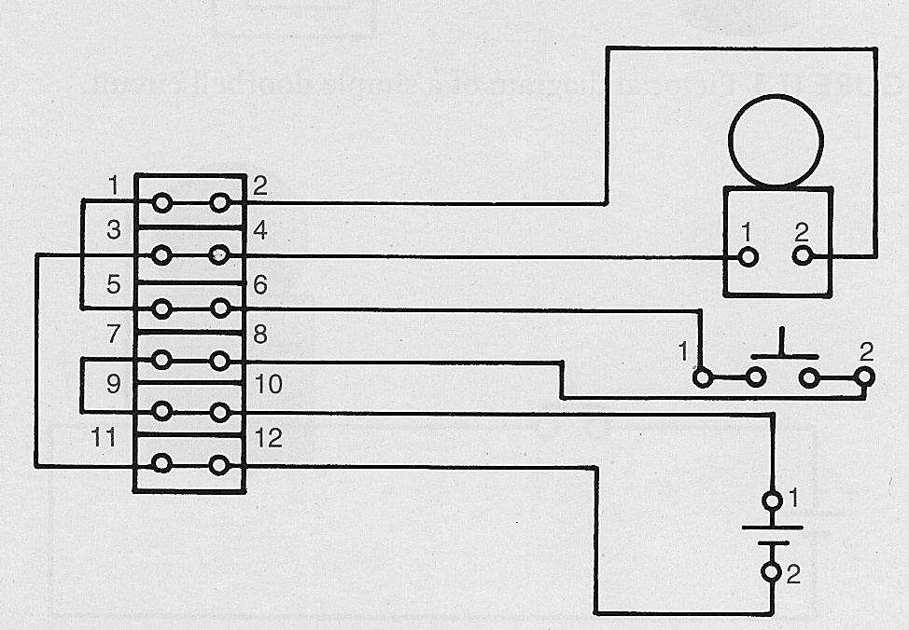
Other Types of Drawings
One Line Diagram
Schematic Diagram
Doorbell
Wiring Diagram
Notes:
Shows a doorbell circuit

Slide 14
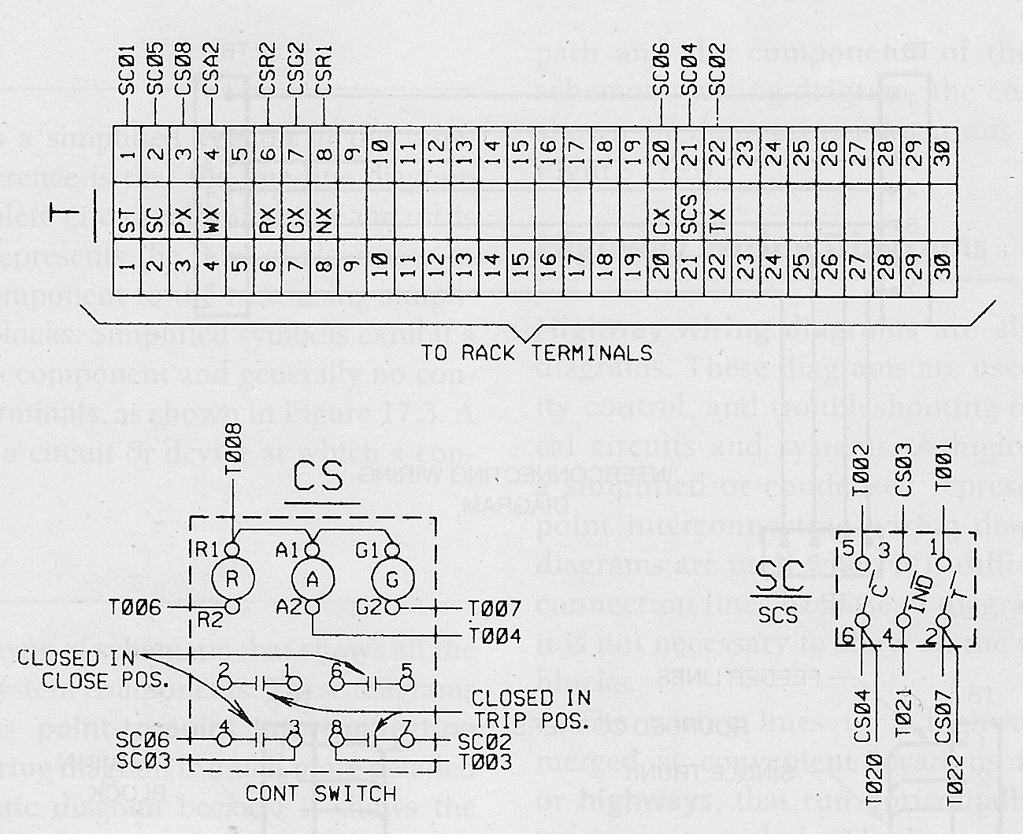
Other Types of Drawings #2
Cable Diagram
Wireless Diagram

Slide 15
Other Types of Drawings #3
Weldment
Shop Drawing

Slide 16
Other Types of Drawings #4
Sheetmetal

Slide 17
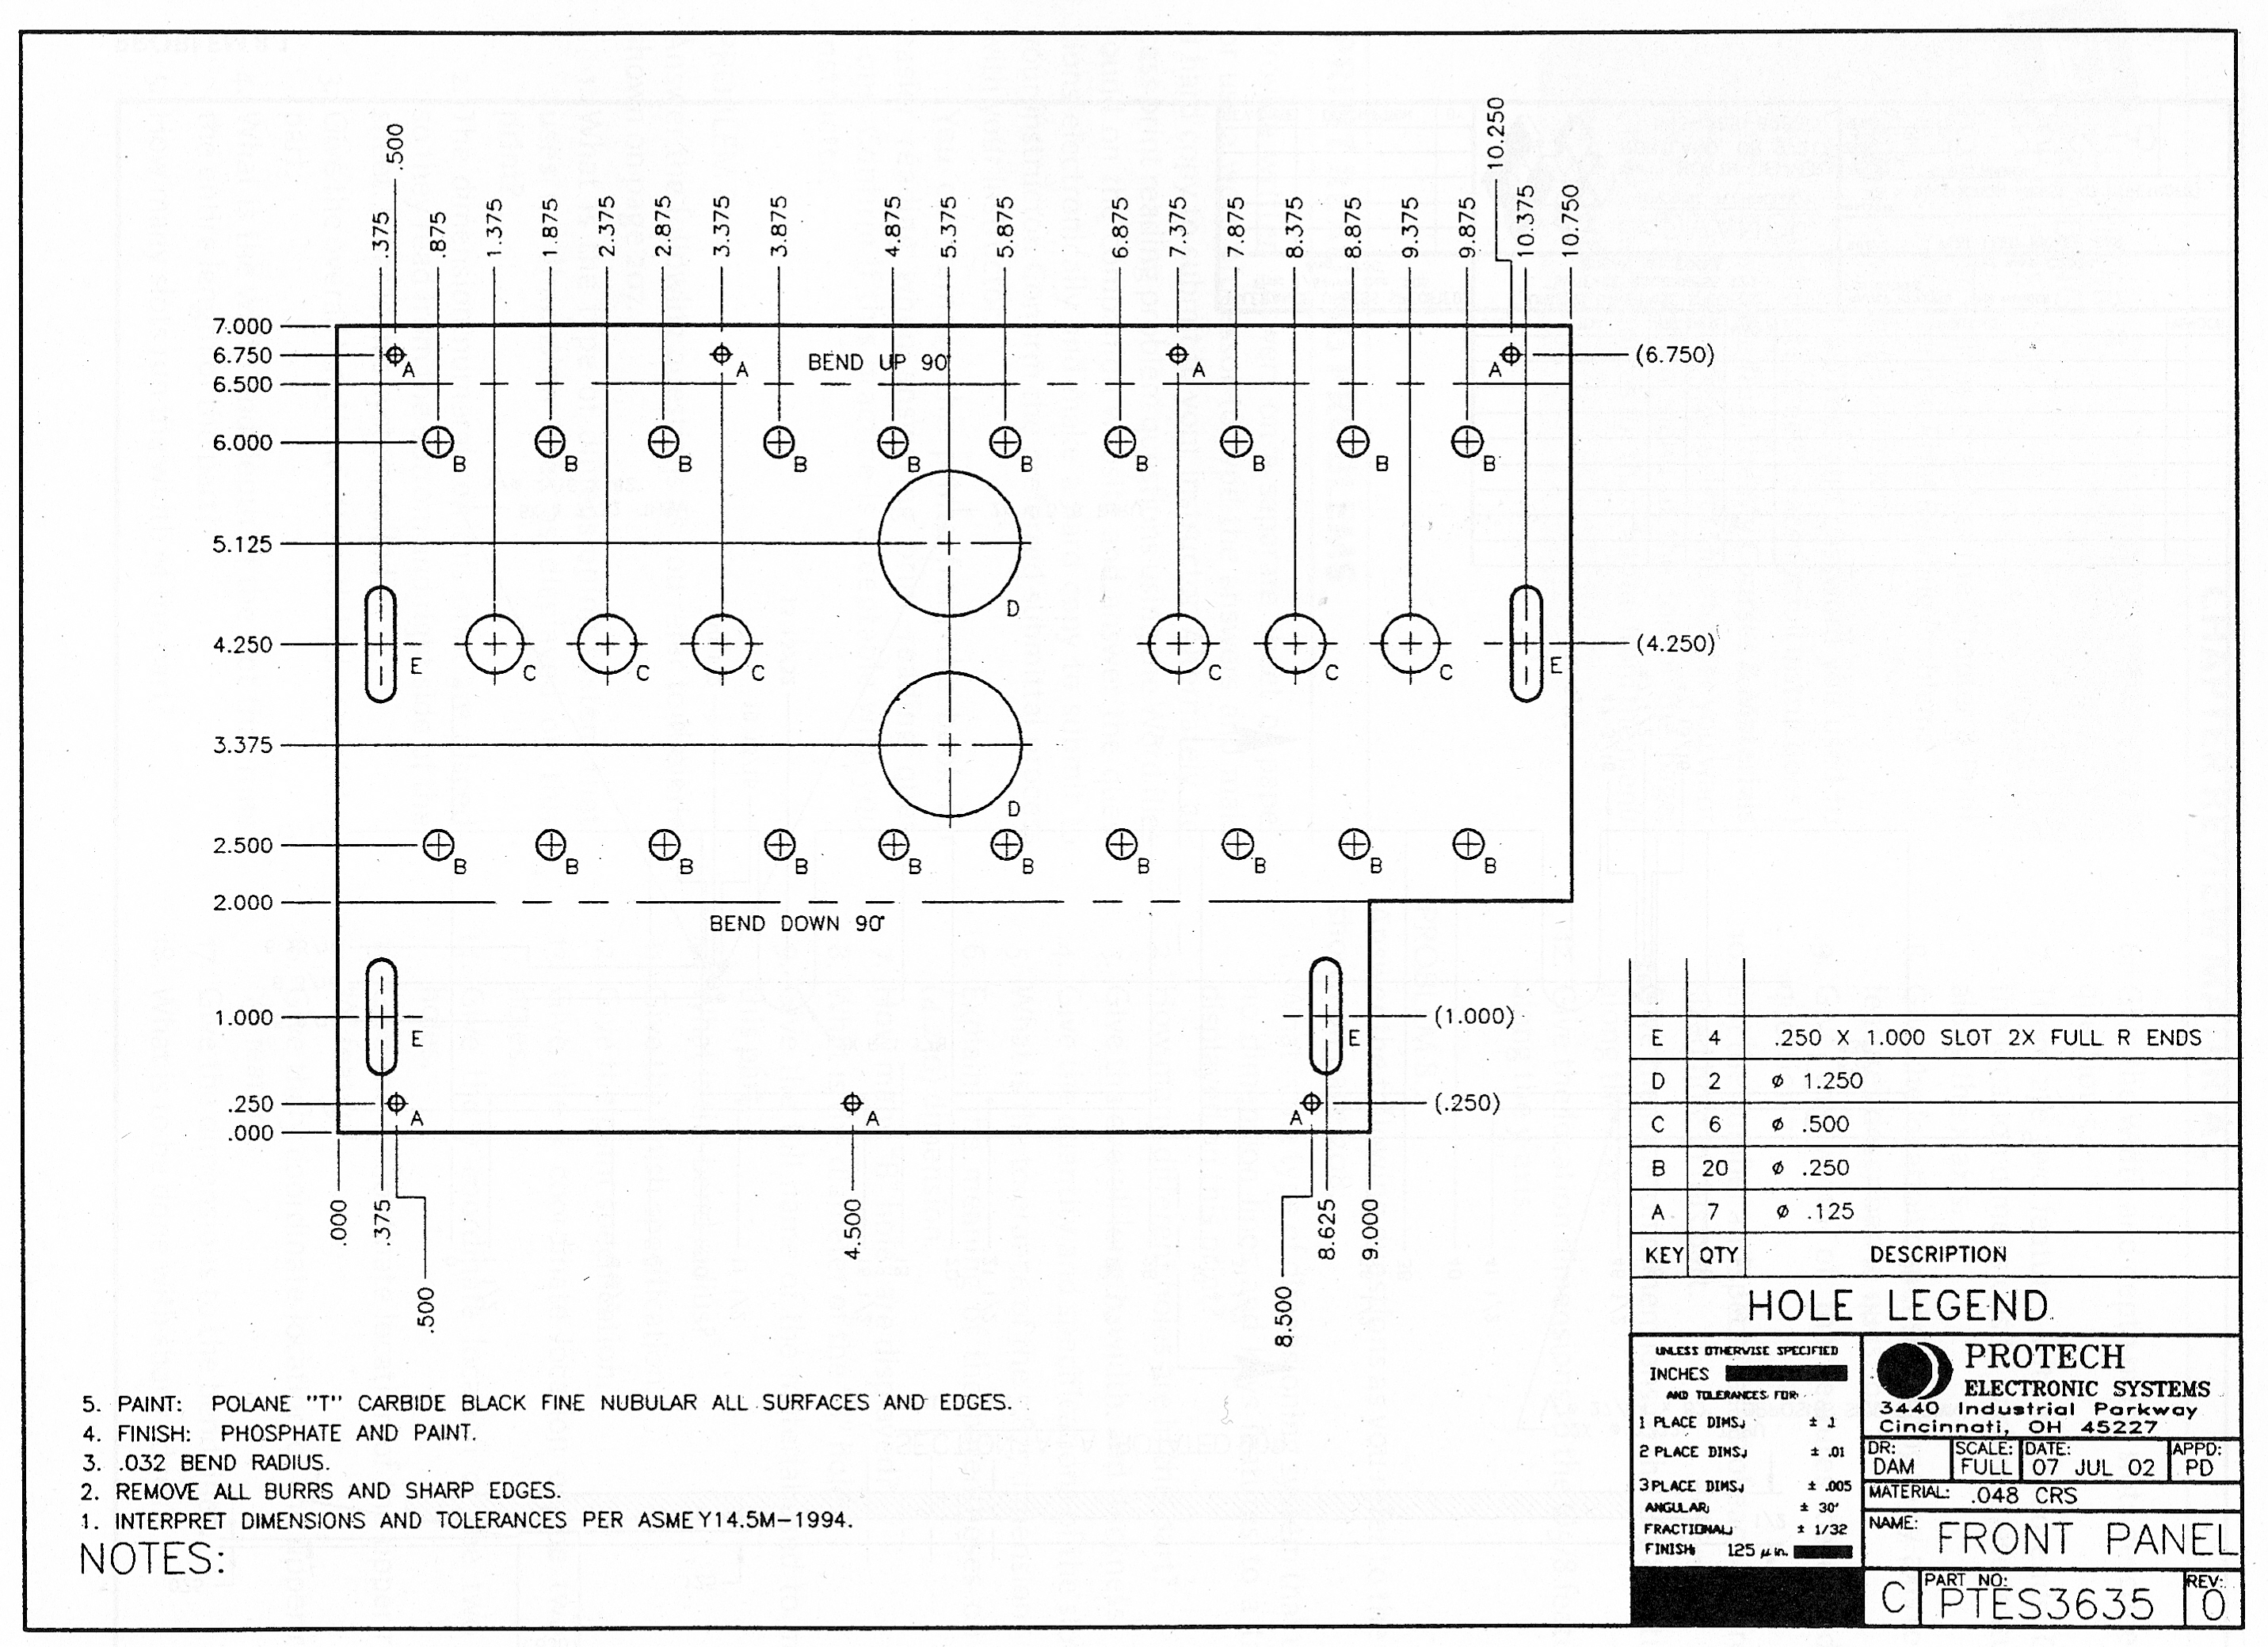
Other Types of Drawings #5
Panel Drawing

Slide 18
Other Types of Drawings #6
P & ID Drawing
Notes:
Stands for Piping & Instrument Diagram or Drawing

Slide 19
Blueprint Reading
2D Models versus 3D Models

Slide 20
2D Models
Drawn on paper or in CADD
Accurate in 2 dimensions
Most common way of representation
Does not convey volume or depth
Good for manufacturing

Slide 21
3D Models
Drawn in CADD
Accurate in 3 dimensions
Most visual method of representation
Can give volume and weight of object
Can show parts interacting in motion
Good for design

Slide 22
Blueprint Reading
Parts of a Drawing

Slide 23
Common Drawing Sizes - Inch
Letter | Size in Inches
A | 8.5” x 11”
B | 11” x 17”
C | 17” x 22”
D | 22” x 34”
E | 34” x 44”
F | 28” x 40”
Notes:
Paper Size Chart For ANSI Series. Digital image. Wikipedia. N.p., n.d. Web. 9 Aug. 2013. <http://en.wikipedia.org/wiki/File:ANSI_size_illustration.svg>.
Note that each size bigger is double the previous size.

Slide 24
Common Drawing Sizes - MM
Letter | Size in Inches
A0 | 84mm x 1189mm
A1 | 594mm x 841mm
A2 | 420mm x 594mm
A3 | 297mm x 420mm
A4 | 210mm x 297mm
A5 thru A8 are not common
Notes:
DIN A-Series Format. Digital image. Wikipedia. N.p., n.d. Web. 9 Aug. 2013. <http://en.wikipedia.org/wiki/File:A_size_illustration.svg>.

Slide 25
Basic Drawing
©Todd Rathier 2013
Notes:
Standard A-size drawing with border and titleblock.

Slide 26
Border
Microfilm Alignment Arrows
(Fold Lines)
Format Margin and Zoning
©Todd Rathier 2013
Notes:
Zoning is used to identify where on the drawing a revision occurs or to be used when communicating about the drawing. It is typically read like the game battleship, where the letter is first and the number is second. i.e. Zone A1 indicates it is in row A and column 1. Not so important on an A-size drawing, but necessary on an E-size drawing.
The microfilm alignment marks go back a long way and were used when the primary means of archiving a drawing was to take a picture of it on microfilm. The arrows can also be used to indicate where fold lines should be.

Slide 27
Zoning
Row Indicator
Typically a Letter
Column Indicator
Typically a Number
©Todd Rathier 2013
Notes:
Zoning is used to identify where on the drawing a revision occurs or to be used when communicating about the drawing. It is typically read like the game battleship, where the letter is first and the number is second. i.e. Zone A1 indicates it is in row A and column 1. Not so important on an A-size drawing, but necessary on an E-size drawing.
The microfilm alignment marks go back a long way and were used when the primary means of archiving a drawing was to take a picture of it on microfilm. The arrows can also be used to indicate where fold lines should be.

Slide 28
Zoning #2
B2 | B1
A2 | A1
Notes:
Zoning is used to identify where on the drawing a revision occurs or to be used when communicating about the drawing. It is typically read like the game battleship, where the letter is first and the number is second. i.e. Zone A1 indicates it is in row A and column 1. Not so important on an A-size drawing, but necessary on an E-size drawing.
The microfilm alignment marks go back a long way and were used when the primary means of archiving a drawing was to take a picture of it on microfilm. The arrows can also be used to indicate where fold lines should be.

Slide 29
Title Block – ASME Standard
10. Approvals
1. Company Logo or Design Activity
2. Title
5. Drawing Number
4. CAGE Code
6. Revision
11. Approval 2
12. Approval 3
3. Sheet Size
7. Scale
8. Weight
9. Sheet
Notes:
LOGO: Normally displays the name address and contact information for a company or a design activity
Title: Typically the product assembly name or specific part or assembly name
Sheet size: A, B, C…
The CAGE code is a 5 number code assigned by the United States Defense Logistic Service Center (DLSC) used with Department of Defense Contractors. CAGE stands for Commercial And Government Entity. It used to be known as FSCM or Federal Supply Code for Manufacturers.
Drawing Number: Most companies have their own system but are usually catagorized by nature of drawing, materials used, project or even drawing size.
Revision: A new or original drawing is a (-) dash or a (0) zero, the first time it is revised it changes to an (A). Some companies use numbers for drawings that have not been released to the shop floor (0, 1, 2…) and change it to an (A, B, C…) when it is released for production. The letters I, O, Q, S, X, and Z are not used so they are not confused with numbers.
Scale: Indicates the drawing scale. Typically can be FULL (1:1), HALF (1:2), DBL (2:1) or QTR (1:4), or NONE or NTS to indicate “Not To Scale”.
Weight: Actual or Estimated weight of the part or assembly. Used for design and shipping purposes.
Sheet: Identifies the sheet if the drawing set has more than one sheet to it. Such as 1 of 12.
Approvals 1, 2 & 3: Usually consists of Drafter/Author/Creator, Checker, Engineer, Quality Control, and Manufacturing.

Slide 30
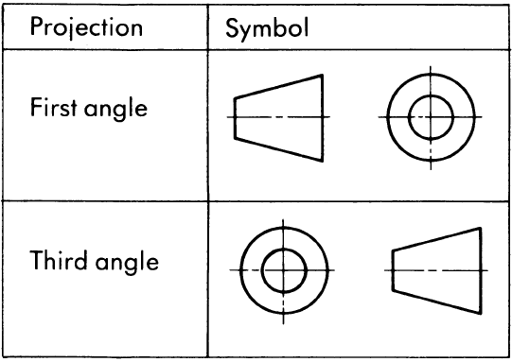
Angle of Projection
Notes:
The USA uses Third Angle projection and the rest of the world uses First Angle projection, more on this later.
You may find this symbol in the title block.

Slide 31
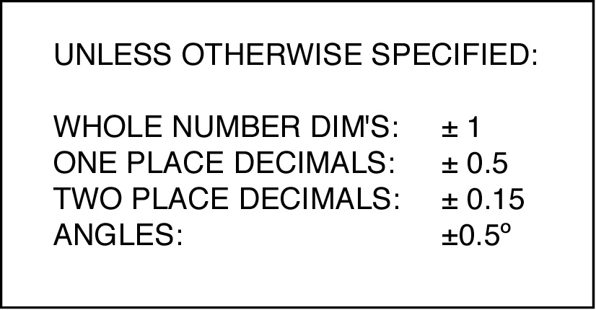
Dimensioning and Tolerance Block
Notes:
Typical simple dimensioning and tolerance blocks. Companies will vary in how they show dimensioning and tolerance blocks. They are “usually” located to the left of the title block and can be as simple or as complex as the company requires.

Slide 32
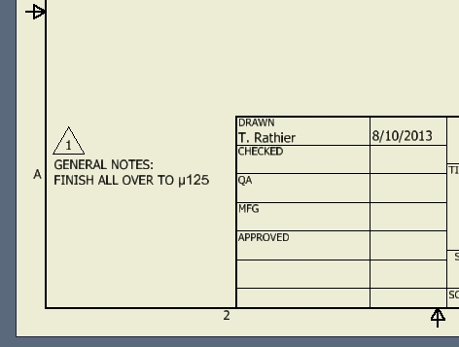
Revisions
Zone (Think Battleship)
Description of Change
Approver
Revision Flag
Current Sheet Revision
Revision Date
Notes:
Revision Block can be located anywhere on the drawing, typically in the lower right to the left of the title block
Revisions are indicated in the field of the drawing by a revision flag. Only the latest revision flags will be shown. Example: if the current revision is “C” then the “A” and “B” flags will have been removed.
The drawing above shows a revision block and revision flag for a drawing that has not been released to the shop floor. Revision “1” indicates it is the first revision of the drawing and because it is not a letter, it has not been released to the shop floor.

Slide 33
Revision Status of Sheets
0 | 0 | C | A | C | REV | REV STATUS
5 | 4 | 3 | 2 | 1 | SH
HORIZONTAL SHEET BLOCK
Notes:
Commonly found on multi-sheet drawings or projects to indicate the status of each sheet in the package

Slide 34
Revision Status of Sheets #2
REV STATUS
REV | SH
C | 1
A | 2
C | 3
0 | 4
0 | 5
VERTICAL SHEET BLOCK
Notes:
Commonly found on multi-sheet drawings or projects to indicate the status of each sheet in the package

Slide 35
Credits
Unless indicated otherwise all images are from Madsen, David A., and David P. Madsen. Print Reading for Engineering and Manufacturing Technology. Clifton Park, NY: Delmar, Cengage Learning, 2013. Print.

