Slide 1
Blueprint Reading
Section II - Sketching

Slide 2
Disclaimer
The AMMQC program is an Equal Opportunity program. Adaptive equipment is available upon request for individuals with disabilities. http://creativecommons.org/licenses/by/3.0 This work is licensed under a Creative Commons Attribution 3.0 Unported License [http://creativecommons.org/licenses/by/3.0] This project is sponsored by a $15.9 million grant from the U.S. Department of Labor, Employment and Training Administration. The AMMQC program is an Equal Opportunity program. Adaptive equipment is available upon request for individuals with disabilities. This workforce product was funded by a grant awarded by the U.S. Department of Labor’s Employment and Training Administration. The product was created by the grantee and does not necessarily reflect the official position of the U.S. Department of Labor. The U.S. Department of Labor makes no guarantees, warranties, or assurances of any kind, express or implied, with respect to such information, including any information on linked sites and including, but not limited to, accuracy of the information or its completeness, timeliness, usefulness, adequacy, continued availability, or ownership.

Slide 3
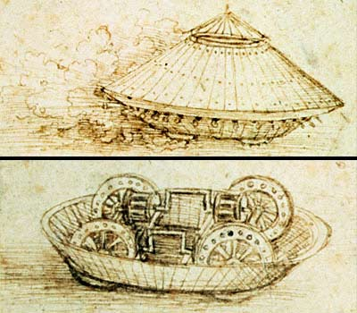
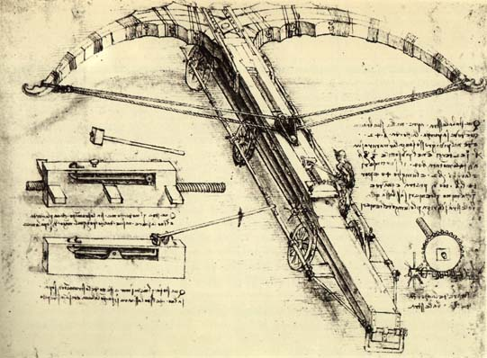
Why Sketching?
Known as the “Universal Language”
Fast, Visual Communication
Pictures are worth a thousand words
Documentation
Notes:
Design for a Giant Crossbow - Leonardo Da Vinci. Digital image. Wikipaintings.org. N.p., n.d. Web. 9 Aug. 2013. <http://www.wikipaintings.org/en/leonardo-da-vinci/design-for-a-giant-crossbow-1482#supersized-artistPaintings-225127>.
Sketches can be considered the “Universal Language” because a sketch in Japanese can still be interpreted fairly well by an American.
Tank Sketch - Leonardo Da Vinci. Digital image. Bbc.com.uk. N.p., n.d. Web. 9 Aug. 2013. <http://www.bbc.co.uk/history/worldwars/wwone/images/tank_image1.jpg>.
Sketches do not have to be “perfect”, just quick and clear. Small job shops sometimes use sketches as the formal production drawing.
Sketches can document existing conditions for use in reports or be used to illustrate ideas and concepts.
Shown are Leonardo da Vinci’s crossbow and tank designs

Slide 4
Sketching Techniques
Sketching a straight line

Slide 5
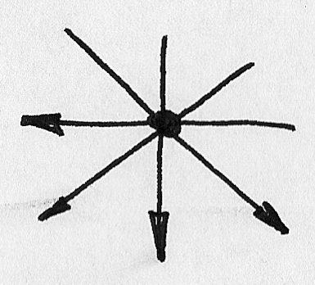
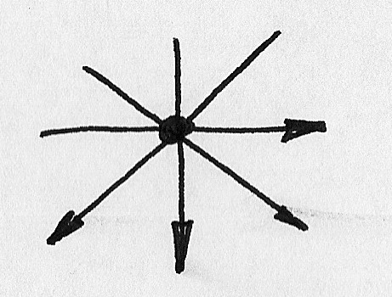
Drawing Direction
To the right and down – right handed
To the left and down – left handed
Left Handed
Right Handed

Slide 6
2 Methods – Straight Line
Light, Short Strokes
Dot to Dot
Long Strokes Cause Problems
Notes:
Two methods to draw a straight line
Light short strokes 2 to 3 inches long then darken it in
Dot to Dot
If you try to draw a long stroke it will typically cause the line to curve

Slide 7
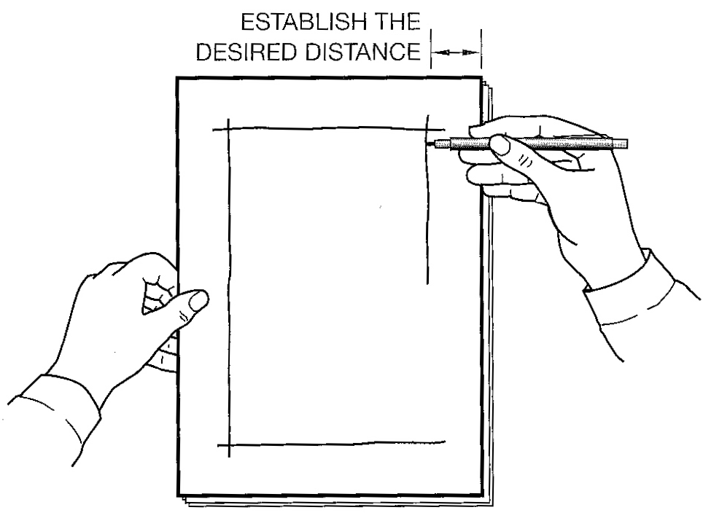
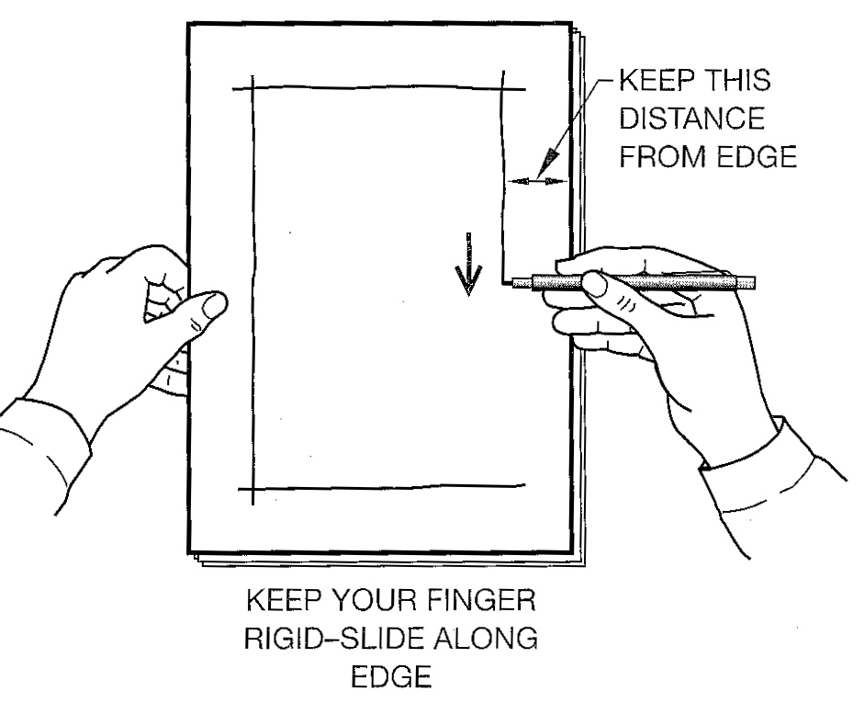
Use an Edge
Try using the edge of the paper

Slide 8
Practice! Practice!
Practice drawing a series of lines of different lengths vertically 1” through 6” in approximately 1” increments
Do the same horizontally
Draw a star
Hint: Turn the paper while you draw
Speed does not equal accuracy

Slide 9
Drawing a Circle – Method 1
Lightly draw a square the same size as circle

Slide 10
Drawing a Circle – Method 1 #2
Lightly draw diagonal lines corner to corner
Lightly mark approximately where the radius goes

Slide 11
Drawing a Circle – Method 1 #3
Draw the circle touching each side of the square and passing through each radius point

Slide 12
Drawing a Circle – Method 2
Lightly draw lines as shown,
slightly bigger than the circle

Slide 13
Drawing a Circle – Method 2 #2
Mark radius points as shown

Slide 14
Drawing a Circle – Method 2 #3
Connect the dots

Slide 15
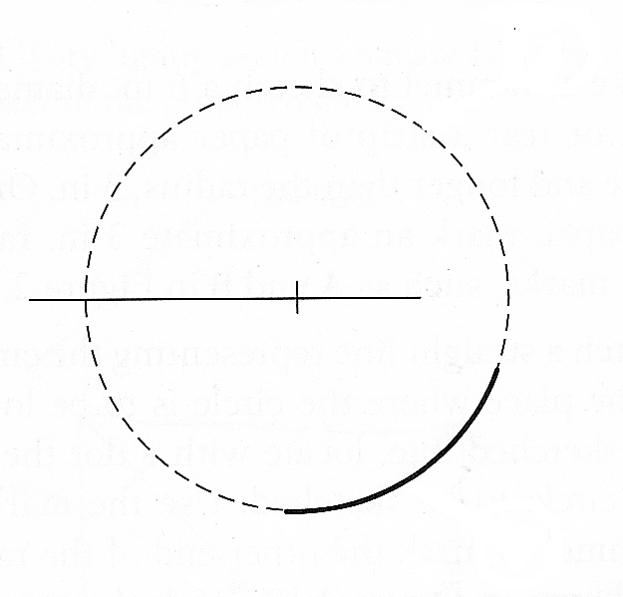
Drawing a Circle – Method 3
Trammel Method
Notes:
Use a piece of paper and mark the radius of the circle (AB)
Lightly draw one centerline
Hold point B and place the pencil tip at point A
Use the piece of paper with the radius as a “compass” and draw the circle lightly
Darken the circle

Slide 16
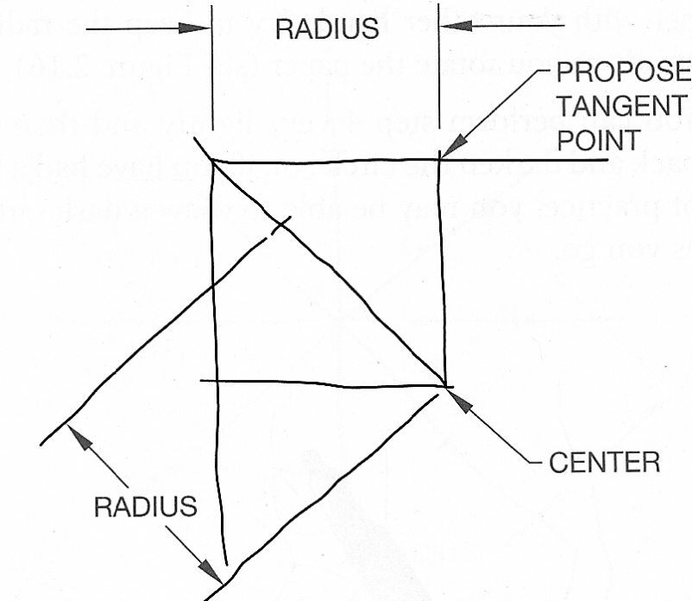
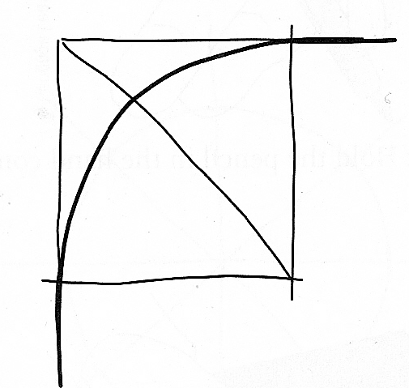
Drawing Arcs
Use the same method as a circle,
except only part of the circle is drawn

Slide 17
Drawing Ellipses
The anatomy of an ellipse

Slide 18
Drawing Ellipses #2
Lightly layout lines as shown

Slide 19
Drawing Ellipses #3
Mark radii

Slide 20
Drawing Ellipses #4
Connect the dots

Slide 21
Practice! Practice!
Practice drawing
A 2” circle using each method
A 2” donut with a 1” center
A wheel with spokes, any size
Two ellipses of different sizes

Slide 22
Measurement Lines
Sketch lines are related by size and direction
For the sketch to be accurate it also needs proportion
Proportion is more important than size
Notes:
Looking at Line 1 and Line 2 ask these questions:
Are the two lines the same length? Obviously not.
If Line 2 is longer than Line 1, how much longer is it? Answer: twice as long. This is proportion.
What is the direction and position of the Lines? Answer: they are parallel.

Slide 23
Measurement Lines #2
Measurement Lines allow you to setup the “Proportion” of the sketch

Slide 24
Measurement Lines #3
This allows a proportional space to be created

Slide 25
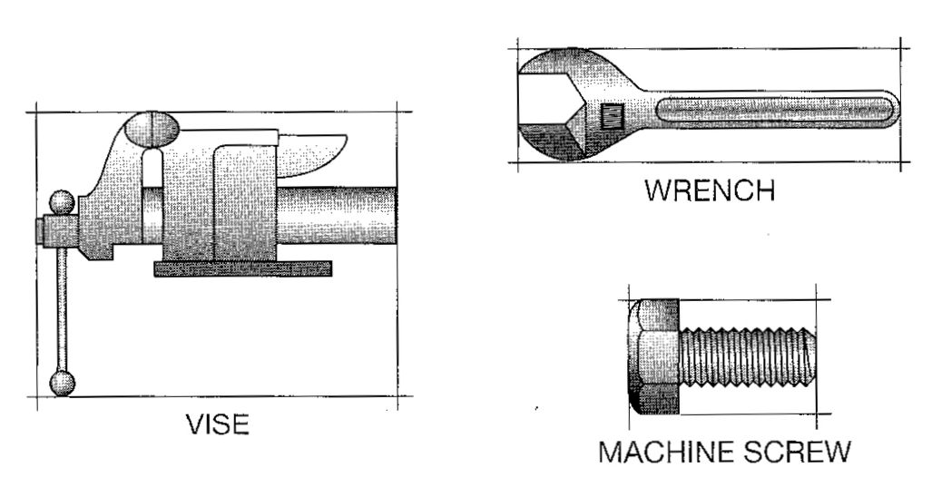
Blocking Technique
“Blocked” sketches
Notes:
The “Block” defines the outline of the sketch and everything is drawn within it. It is drawn as a very light rectangle.

Slide 26
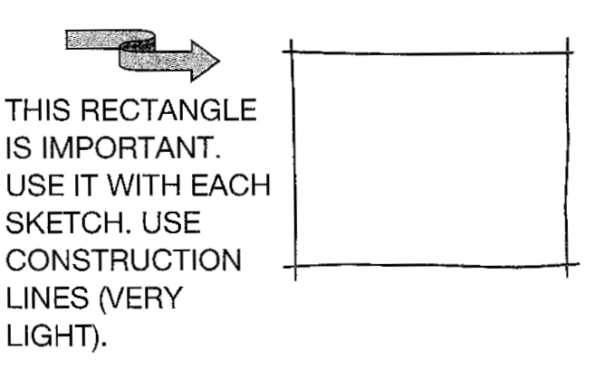
Blocking Technique #2
“Blocked” sketches
Notes:
The object starts with two measurement lines and a rectangular box is sketched in to the right proportion
Then additional light construction lines are added and then cleaned up to be the object

Slide 27
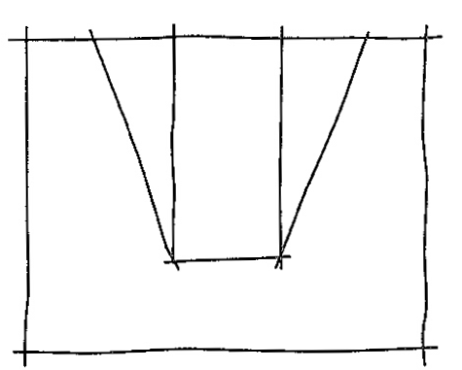
Blocking Technique #3
“Blocked” sketches
Notes:
The object starts with two measurement lines and a rectangular box is sketched in to the right proportion
Then additional light construction lines are added and then cleaned up to be the object

Slide 28
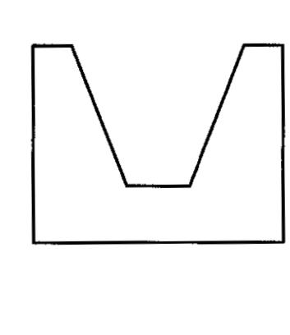
Blocking Technique #4
“Blocked” sketches
Notes:
The object starts with two measurement lines and a rectangular box is sketched in to the right proportion
Then additional light construction lines are added and then cleaned up to be the object

Slide 29
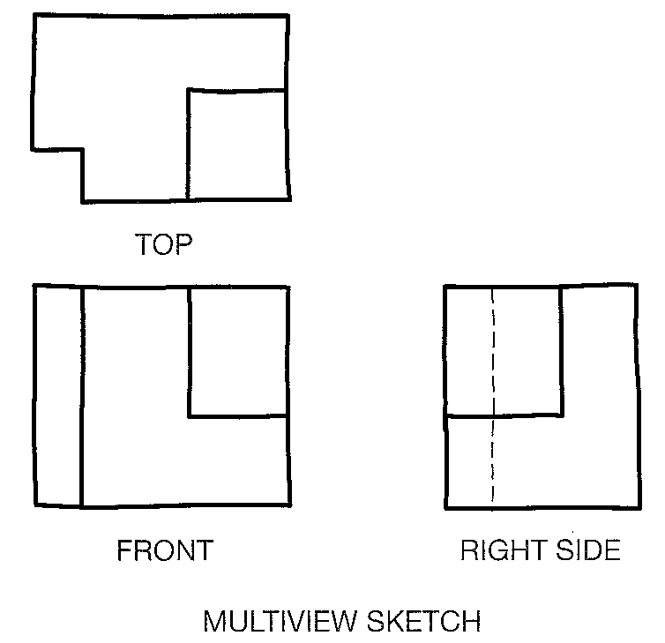
Creating a Multi-View Sketch
Notes:
The pictorial to the left is the given object, it is shown in an isometric view. We want to show the 3 views (orthographic projection) of this object by sketching it. More on orthographic and isometric projection later.

Slide 30
Creating a Multi-View Sketch #2
Notes:
The pictorial to the left is the given object, it is shown in an isometric view. We want to show the 3 views (orthographic projection) of this object by sketching it. More on orthographic and isometric projection later.
Step 1 is to rough in the rectangles for each view as shown
Step 2 is to add all the construction lines
Step 3 is to clean up lines not needed

Slide 31
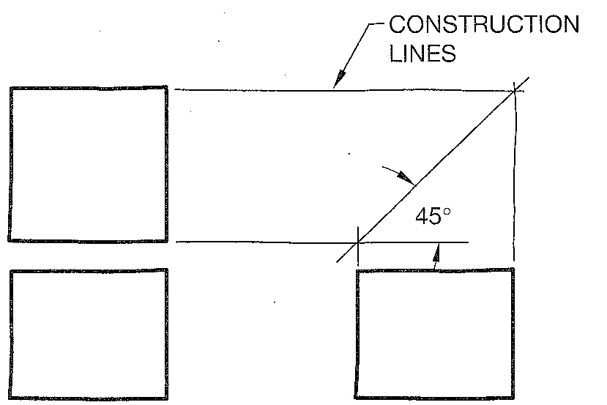
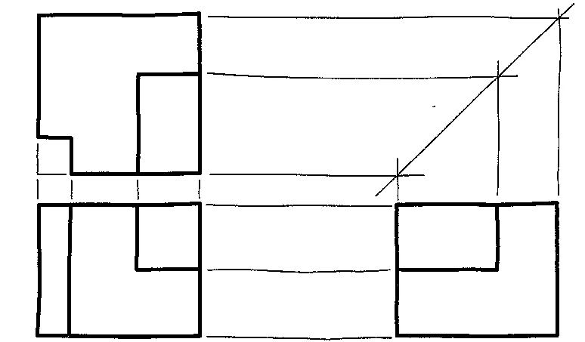
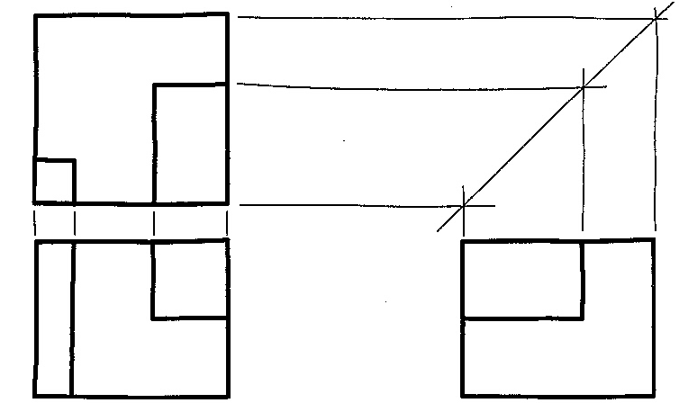
Creating a Multi-View Sketch #3
Step 1
Notes:
The pictorial to the left is the given object, it is shown in an isometric view. We want to show the 3 views (orthographic projection) of this object by sketching it. More on orthographic and isometric projection later.
Step 1 is to rough in the rectangles for each view as shown
Step 2 is to add all the construction lines
Step 3 is to clean up lines not needed

Slide 32
Creating a Multi-View Sketch #4
Step 2
Notes:
The pictorial to the left is the given object, it is shown in an isometric view. We want to show the 3 views (orthographic projection) of this object by sketching it. More on orthographic and isometric projection later.
Step 1 is to rough in the rectangles for each view as shown
Step 2 is to add all the construction lines
Step 3 is to clean up lines not needed

Slide 33
Practice! Practice!
Practice drawing – 15 minutes
Make a front, right and top view of the capital letters E, F, H, I, O, and Z make them approximately 3” high and 2” wide
Notes:
As time permits

Slide 34
Creating a Isometric Sketch
Notes:
Simple Isometric axis shown
Object drawn along the axis looks like this
Notice the 30 degree angle for the corners

Slide 35
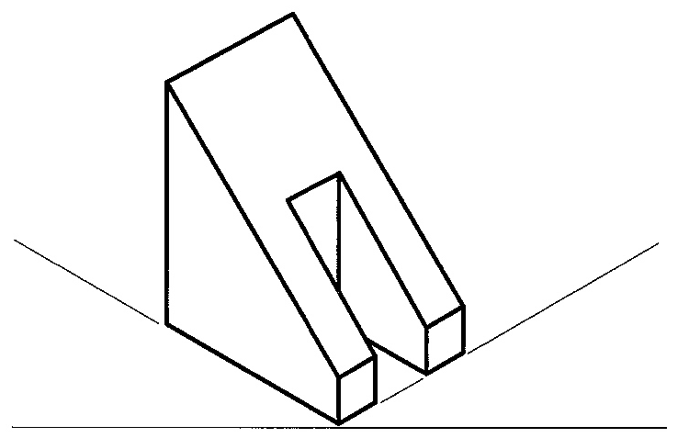
Creating a Isometric Sketch #2
Notes:
Simple Isometric axis shown
Object drawn along the axis looks like this
Notice the 30 degree angle for the corners

Slide 36
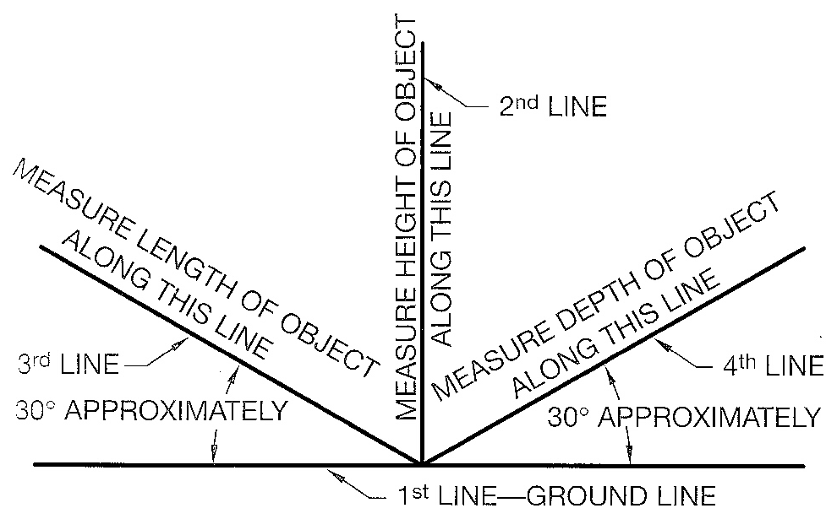
Creating a Isometric Sketch #3
Notes:
Simple Isometric axis shown
Object drawn along the axis looks like this
Notice the 30 degree angle for the corners

Slide 37
Practice! Practice!
Practice drawing – Homework
Make an isometric view of the capital letters E, F, H, I, O, and Z make them approximately 3” high and 2” wide and 1” deep
Notes:
As time permits

Slide 38
Credits
Unless indicated otherwise all images are from Madsen, David A., and David P. Madsen. Print Reading for Engineering and Manufacturing Technology. Clifton Park, NY: Delmar, Cengage Learning, 2013. Print.

