Slide 1
Blueprint Reading
Section III – Scales and Measurement

Slide 2
Disclaimer
The AMMQC program is an Equal Opportunity program. Adaptive equipment is available upon request for individuals with disabilities. http://creativecommons.org/licenses/by/3.0 This work is licensed under a Creative Commons Attribution 3.0 Unported License [http://creativecommons.org/licenses/by/3.0] This project is sponsored by a $15.9 million grant from the U.S. Department of Labor, Employment and Training Administration. The AMMQC program is an Equal Opportunity program. Adaptive equipment is available upon request for individuals with disabilities. This workforce product was funded by a grant awarded by the U.S. Department of Labor’s Employment and Training Administration. The product was created by the grantee and does not necessarily reflect the official position of the U.S. Department of Labor. The U.S. Department of Labor makes no guarantees, warranties, or assurances of any kind, express or implied, with respect to such information, including any information on linked sites and including, but not limited to, accuracy of the information or its completeness, timeliness, usefulness, adequacy, continued availability, or ownership.

Slide 3
Scale definition
A scale is an instrument with a system of ordered marks at fixed intervals used as a reference standard in measurement.
A ruler, on the other hand is a King, Queen, Duke, Duchess, etc. Please note the difference.

Slide 4
Scale Shapes
Notes:
Triangular
Modified triangular with lifting edge
Just another triangular
Weird shaped triangular
Single bevel
Double bevel
Opposite bevel
Quad beveled

Slide 5
Scale Notation
Frequently used scales
Scale Name | Shown As | Ratio
Full Scale | FULL | 1:1
Half Scale | HALF | 1:2
Quarter Scale | QUARTER | 1:4
Twice Scale | DOUBLE | 2:1
Four Times Scale |  | 4:1
Ten Times Scale |  | 10:1

Slide 6
Inch versus Metric
What do these notes mean?
UNLESS OTHERWISE SPECIFIED DIMENSIONS ARE IN INCHES
Or
UNLESS OTHERWISE SPECIFIED DIMENSIONS ARE IN MILLIMETERS
Notes:
ASME Y14.5-2009 Dimensioning and Tolerancing states that the commonly used International System of Units (SI) linear units used on engineering drawings will be the millimeter (mm). U.S. customary measurements are in inches (in)
On drawings where all dimensions are in one system or another, individual unit identification is not required.
All engineering drawings shall have a general note stating:
UNLESS OTHERWISE SPECIFIED DIMENSIONS ARE IN INCHES
Or
UNLESS OTHERWISE SPECIFIED DIMENSIONS ARE IN MILLIMETERS
If only some dimensions in a different unit then the unit prefix needs to be added.

Slide 7
Metric Units
This | Equals this
10 millimeters | 1 centimeter
10 centimeters | 1 decimeter
10 decimeters | 1 meter
10 meters | 1 decameter
10 decameters | 1 kilometer

Slide 8
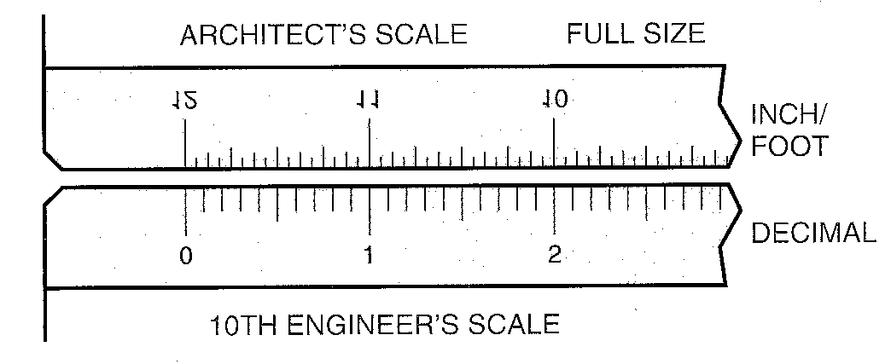
Engineer’s Scale
Notes:
Note that the scale is in 10ths of an inch.
We will cover reading the scales in the Measuring Instruments sessions

Slide 9
Credits
Unless indicated otherwise all images are from Madsen, David A., and David P. Madsen. Print Reading for Engineering and Manufacturing Technology. Clifton Park, NY: Delmar, Cengage Learning, 2013. Print.

