Slide 1
Blueprint Reading
Section IV – Reading Lines and Lettering

Slide 2
Disclaimer
The AMMQC program is an Equal Opportunity program. Adaptive equipment is available upon request for individuals with disabilities. http://creativecommons.org/licenses/by/3.0 This work is licensed under a Creative Commons Attribution 3.0 Unported License [http://creativecommons.org/licenses/by/3.0] This project is sponsored by a $15.9 million grant from the U.S. Department of Labor, Employment and Training Administration. The AMMQC program is an Equal Opportunity program. Adaptive equipment is available upon request for individuals with disabilities. This workforce product was funded by a grant awarded by the U.S. Department of Labor’s Employment and Training Administration. The product was created by the grantee and does not necessarily reflect the official position of the U.S. Department of Labor. The U.S. Department of Labor makes no guarantees, warranties, or assurances of any kind, express or implied, with respect to such information, including any information on linked sites and including, but not limited to, accuracy of the information or its completeness, timeliness, usefulness, adequacy, continued availability, or ownership.

Slide 3
Types of Lines
Visible Lines
Hidden Lines
Centerlines
Extension Lines
Dimension Lines
Leader Lines
Arrowheads
Cutting Plane Lines
Viewing Lines
Section Lines
Break Lines
Phantom Lines
Chain and Stitch Lines
Notes:
Line types are universal. They are the same here as in China, Russia, South America, etc.

Slide 4
Types
Notes:
Quick visual chart. This is known as the alphabet of lines.

Slide 5
Lines in use
Notes:
Quick drawing of the lines in use. We will cover each in detail and come back to this.

Slide 6
Visible lines
Notes:
Also called object lines or outlines.
These describe any visible surface or edge of the object.
They are drawn as THICK lines.

Slide 7
Hidden Lines
Notes:
A hidden line represents an invisible edge of the object.
Hidden lines are half as thick as visible lines.

Slide 8
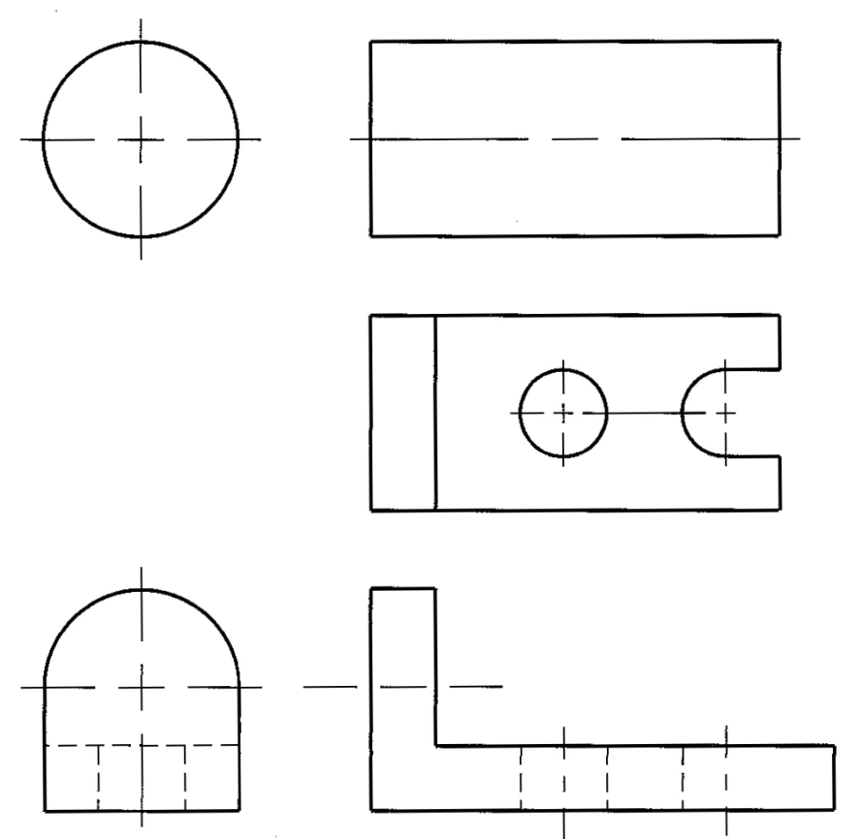
Centerlines
Notes:
Centerlines are used to show and locate the centers of circles, arcs, and ellipses.
They are also used to represent the center axis of a circular, cylindrical or symmetrical form.
Centerlines can be used to show the centers in a bolt circle pattern or the path of motion in a mechanism.
When used in a bolt pattern they may be drawn two ways depending on how it will be dimensioned.
Centerlines are half as thick as object lines.

Slide 9
Centerlines for Symmetry
Notes:
Centerlines can be used to show symmetry.
Two short thick lines perpendicular to the center line indicate that it is an axis of symmetry.

Slide 10
Extension Lines
Notes:
Extension lines are thin lines used to establish the extents of a dimension. (a)
Extensions lines can also be used to show the extension of a surface to a theoretical intersection. (b)
Extension lines begin with a .06 in (1.5mm) space from the object and extend to .125 in (3mm) beyond the last dimension.

Slide 11
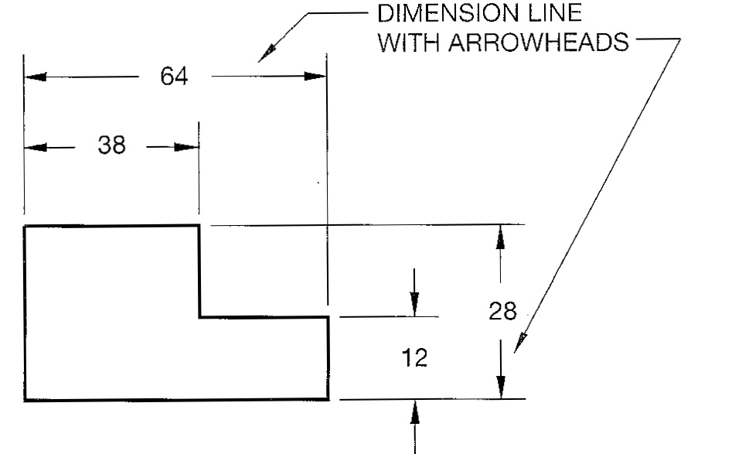
Dimension Lines
Notes:
Dimension lines are thin lines capped on the ends with arrows and broken along their length with a space for the dimension text. Dimension Lines indicate the length of the dimension.
Extension lines may cross but dimension lines SHOULD NOT cross.
Centerlines may be extended to be used as extension lines to terminate a dimension line.

Slide 12
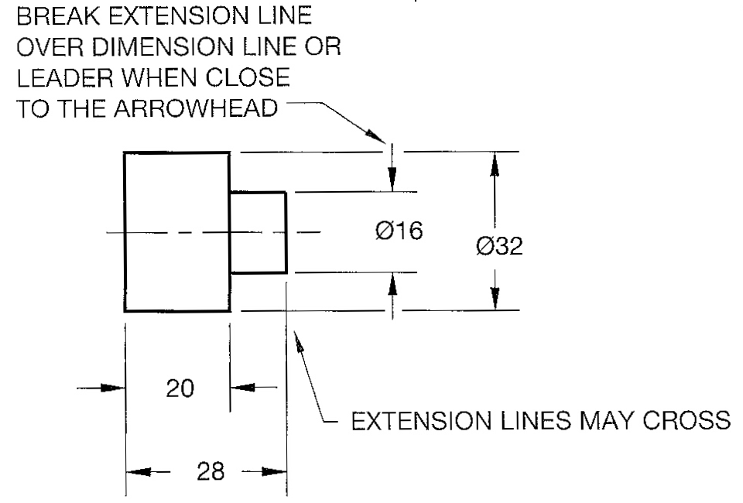
Dimension Lines #2
Notes:
Dimension lines are thin lines capped on the ends with arrows and broken along their length with a space for the dimension text. Dimension Lines indicate the length of the dimension.
Extension lines may cross but dimension lines SHOULD NOT cross.
Centerlines may be extended to be used as extension lines to terminate a dimension line.

Slide 13
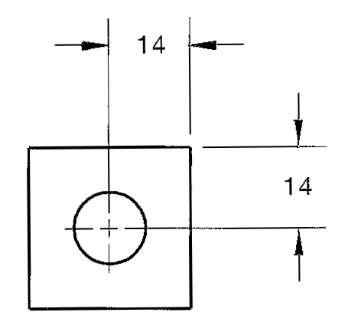
Dimension Lines #3
Notes:
Dimension lines are thin lines capped on the ends with arrows and broken along their length with a space for the dimension text. Dimension Lines indicate the length of the dimension.
Extension lines may cross but dimension lines SHOULD NOT cross.
Centerlines may be extended to be used as extension lines to terminate a dimension line.

Slide 14
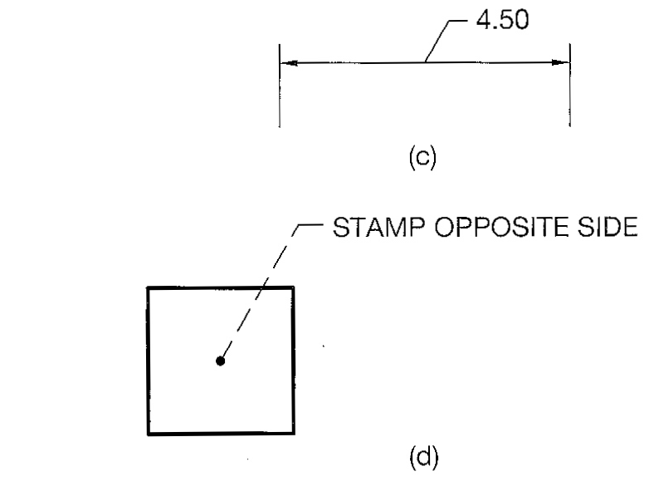
Leader Lines
Notes:
Leader lines, or leaders, are thin lines used to connect a specific note to a feature.
Leader lines are also used to direct dimensions, symbols, item numbers, and part numbers on a drawing.
Leaders usually have a short shoulder at one end and an arrowhead at the other and are usually attached to the center of the text.
If the leader points to the center of an object it is capped with a dot, if it points to a dimension the arrowhead is omitted.
A leader is usually drawn as a thin continuous line but may be shown with a hidden line if the object it is pointing to is hidden.

Slide 15
Arrowheads
Notes:
Arrowheads are used to terminate dimension lines and leader lines and are used on cutting plane lines and viewing plane lines described next.

Slide 16
Cutting / Viewing Plane Lines
Notes:
Cutting Plane and Viewing Plane lines can be represented either way, but are always drawn thick.
Top view shows a Cutting Plane Line which cuts through an object, lower viewer shows a Viewing Plane line which shows a view external to the object.
Alternate method of showing Cutting Plane and Viewing Plane Lines
Simplified method of showing Cutting and Viewing Planes
Note the circular line with the A in the middle of the arrows. This indicates a detail view.

Slide 17
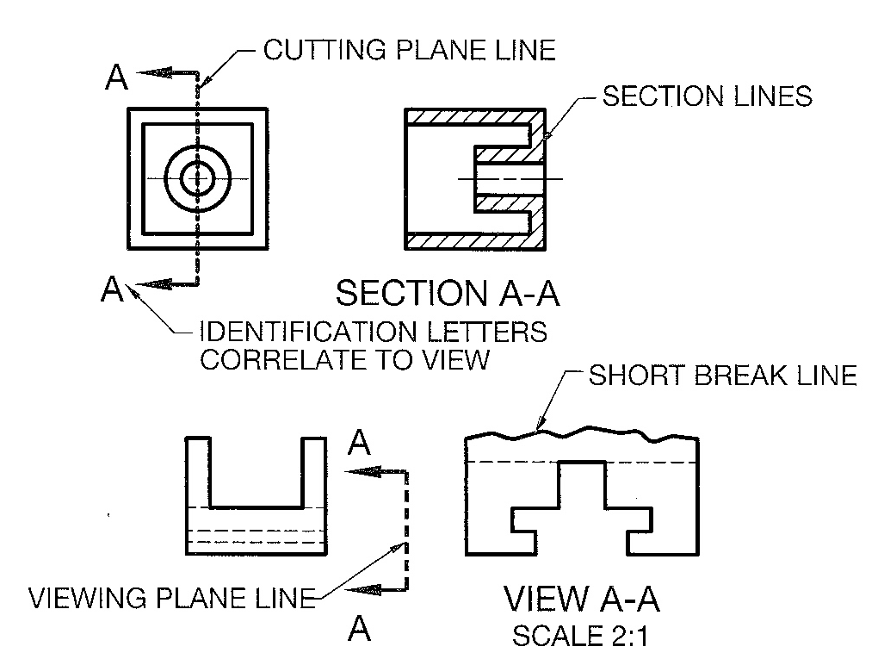
Cutting / Viewing Plane Lines #2
Notes:
Cutting Plane and Viewing Plane lines can be represented either way, but are always drawn thick.
Top view shows a Cutting Plane Line which cuts through an object, lower viewer shows a Viewing Plane line which shows a view external to the object.
Alternate method of showing Cutting Plane and Viewing Plane Lines
Simplified method of showing Cutting and Viewing Planes
Note the circular line with the A in the middle of the arrows. This indicates a detail view.

Slide 18
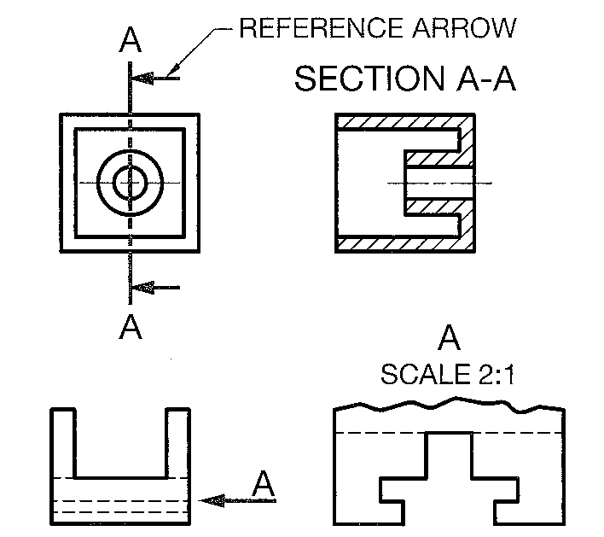
Cutting / Viewing Plane Lines #3
Notes:
Cutting Plane and Viewing Plane lines can be represented either way, but are always drawn thick.
Top view shows a Cutting Plane Line which cuts through an object, lower viewer shows a Viewing Plane line which shows a view external to the object.
Alternate method of showing Cutting Plane and Viewing Plane Lines
Simplified method of showing Cutting and Viewing Planes
Note the circular line with the A in the middle of the arrows. This indicates a detail view.

Slide 19
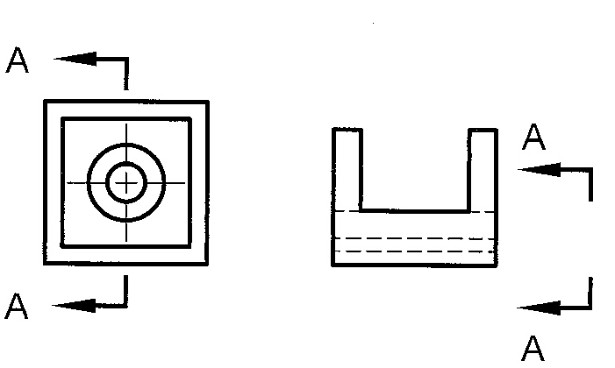
Cutting / Viewing Plane Lines #4
Notes:
Cutting Plane and Viewing Plane lines can be represented either way, but are always drawn thick.
Top view shows a Cutting Plane Line which cuts through an object, lower viewer shows a Viewing Plane line which shows a view external to the object.
Alternate method of showing Cutting Plane and Viewing Plane Lines
Simplified method of showing Cutting and Viewing Planes
Note the circular line with the A in the middle of the arrows. This indicates a detail view.

Slide 20
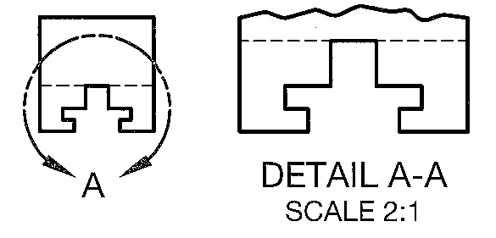
Cutting / Viewing Plane Lines #5
Notes:
Cutting Plane and Viewing Plane lines can be represented either way, but are always drawn thick.
Top view shows a Cutting Plane Line which cuts through an object, lower viewer shows a Viewing Plane line which shows a view external to the object.
Alternate method of showing Cutting Plane and Viewing Plane Lines
Simplified method of showing Cutting and Viewing Planes
Note the circular line with the A in the middle of the arrows. This indicates a detail view.

Slide 21
Section Lines

Slide 22
Section Lines #2

Slide 23
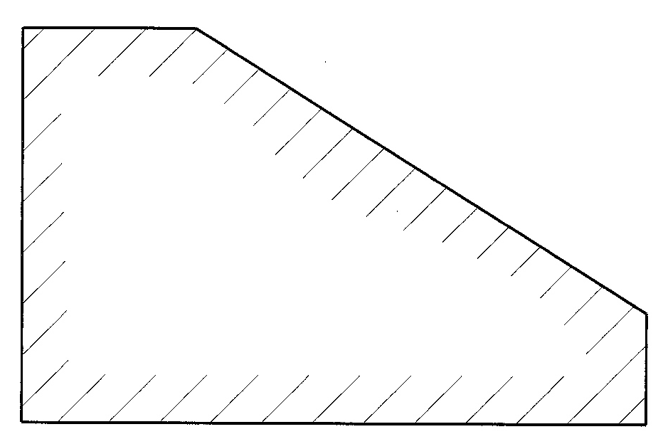
Section Lines #3

Slide 24
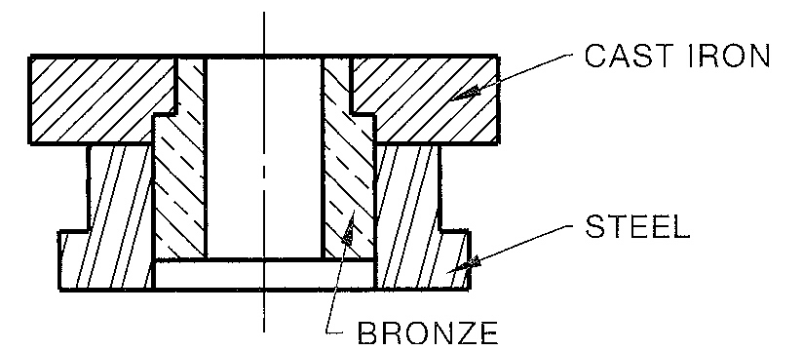
Section Lines - Materials
Notes:
To the left are various material representations and to the right is an assembly showing sectioned materials
When thin parts are shown in section there are no section lines for that part as it makes it easier to see.

Slide 25
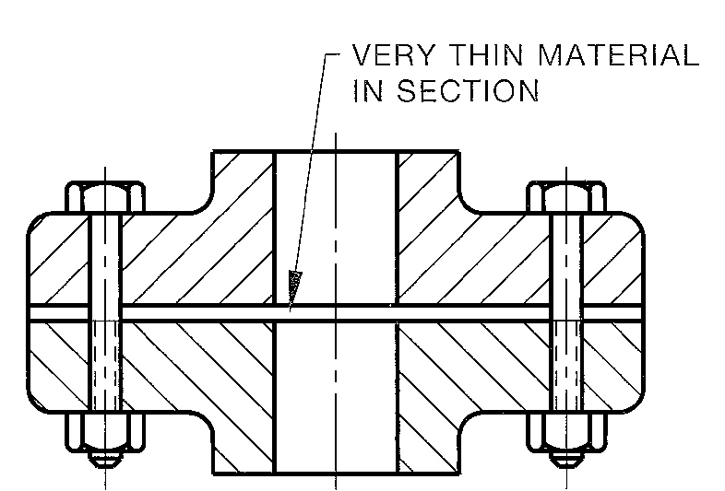
Section Lines – Materials #2
Notes:
To the left are various material representations and to the right is an assembly showing sectioned materials
When thin parts are shown in section there are no section lines for that part as it makes it easier to see.

Slide 26
Break Lines
Notes:
Cylindrical breaks, solid and tube form, only the “cut” portion is sectioned
Short break lines are typically wavy for metal, jagged for wood. The long break symbol is used for items that are, well, long.

Slide 27
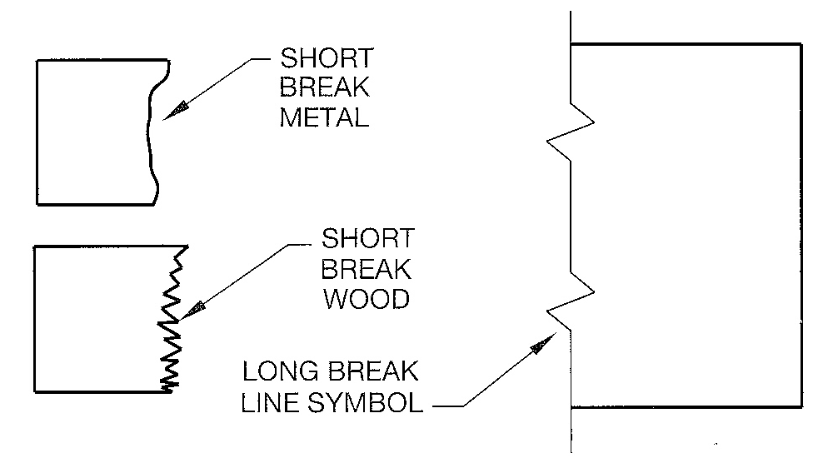
Break Lines #2
Notes:
Cylindrical breaks, solid and tube form, only the “cut” portion is sectioned
Short break lines are typically wavy for metal, jagged for wood. The long break symbol is used for items that are, well, long.

Slide 28
Phantom Lines
Notes:
Top to bottom:
Typical phantom line drawn thin
Used to show a part or assembly’s alternate position or limit of motion
Used to show that a repetition of items occurs. Only one gear tooth is shown.
Used to show the outer limits of a spring and the missing repetitions
Used to show rounded edges in views that otherwise would not show anything

Slide 29
Chain and Stitch Lines
Notes:
Chain lines are thick lines used to indicate a portion of a surface that will receive a treatment of some type.
Stitch lines are thin lines or small dots that indicate where a sewing process takes place

Slide 30
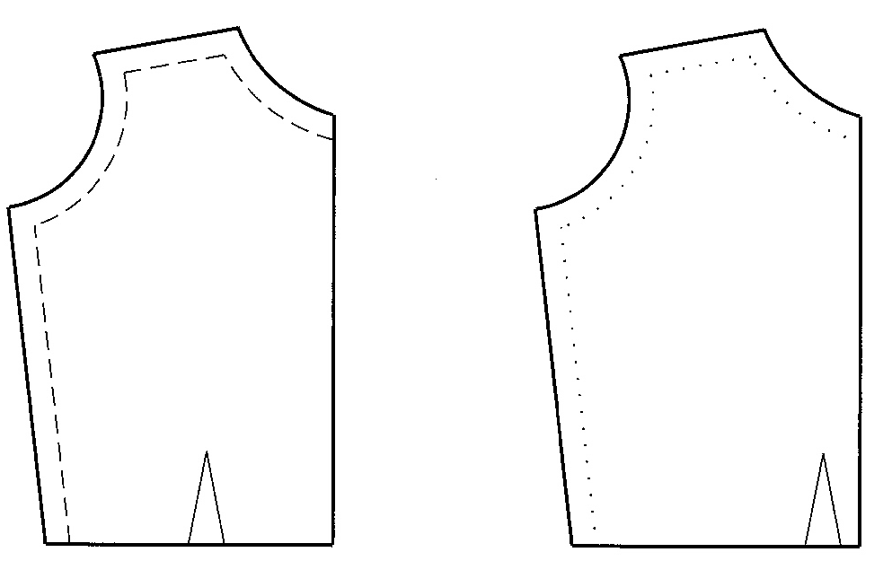
Chain and Stitch Lines #2
Notes:
Chain lines are thick lines used to indicate a portion of a surface that will receive a treatment of some type.
Stitch lines are thin lines or small dots that indicate where a sewing process takes place

Slide 31
Numbers/Letters on Prints
Notes:
Above: Upper case lettering for engineering drawing use
Below: Metric decimals are generally shown with a preceding zero, inch decimals are not

Slide 32
Fractions on Prints
Notes:
Fractions can be shown in aligned format where the fraction portion are full height letters
or
Shown as diagonal format with a hyphen separating the whole number from the fraction

Slide 33
Notes on Drawings
Notes:
Notes on a drawing are either considered GENERAL notes or LOCAL (also called specific) notes.
General notes, as shown, relate information that applies to the whole drawing.
Local or specific notes relate to just a view or a feature.

Slide 34
Credits
Unless indicated otherwise all images are from Madsen, David A., and David P. Madsen. Print Reading for Engineering and Manufacturing Technology. Clifton Park, NY: Delmar, Cengage Learning, 2013. Print.

