Slide 1
Blueprint Reading
Section V – Reading Multiview Drawings

Slide 2
Disclaimer
The AMMQC program is an Equal Opportunity program. Adaptive equipment is available upon request for individuals with disabilities. http://creativecommons.org/licenses/by/3.0 This work is licensed under a Creative Commons Attribution 3.0 Unported License [http://creativecommons.org/licenses/by/3.0] This project is sponsored by a $15.9 million grant from the U.S. Department of Labor, Employment and Training Administration. The AMMQC program is an Equal Opportunity program. Adaptive equipment is available upon request for individuals with disabilities. This workforce product was funded by a grant awarded by the U.S. Department of Labor’s Employment and Training Administration. The product was created by the grantee and does not necessarily reflect the official position of the U.S. Department of Labor. The U.S. Department of Labor makes no guarantees, warranties, or assurances of any kind, express or implied, with respect to such information, including any information on linked sites and including, but not limited to, accuracy of the information or its completeness, timeliness, usefulness, adequacy, continued availability, or ownership.

Slide 3
Orthographic Projection
Notes:
Actual objects are easy to visualize in 3D, however these objects could be very difficult to describe and draw without very extensive detail.
The Drafting industry has historically used a system of two-dimensional views created using orthographic projection.
Picture taking a piece of glass and holding it in front of an object and then just drawing what you can see.

Slide 4
Foreshortened Surface
Notes:
Note that when a surface that is not parallel to the glass is viewed, it is not in true shape. This is called foreshortened.

Slide 5
Glass Box
Notes:
The glass box technique is a visualization method that projects each view onto the side of an imaginary glass box.
When the box is unfolded ….
The standard orthographic views are presented
They reflect the standard three dimensions of Height, Width and Depth

Slide 6
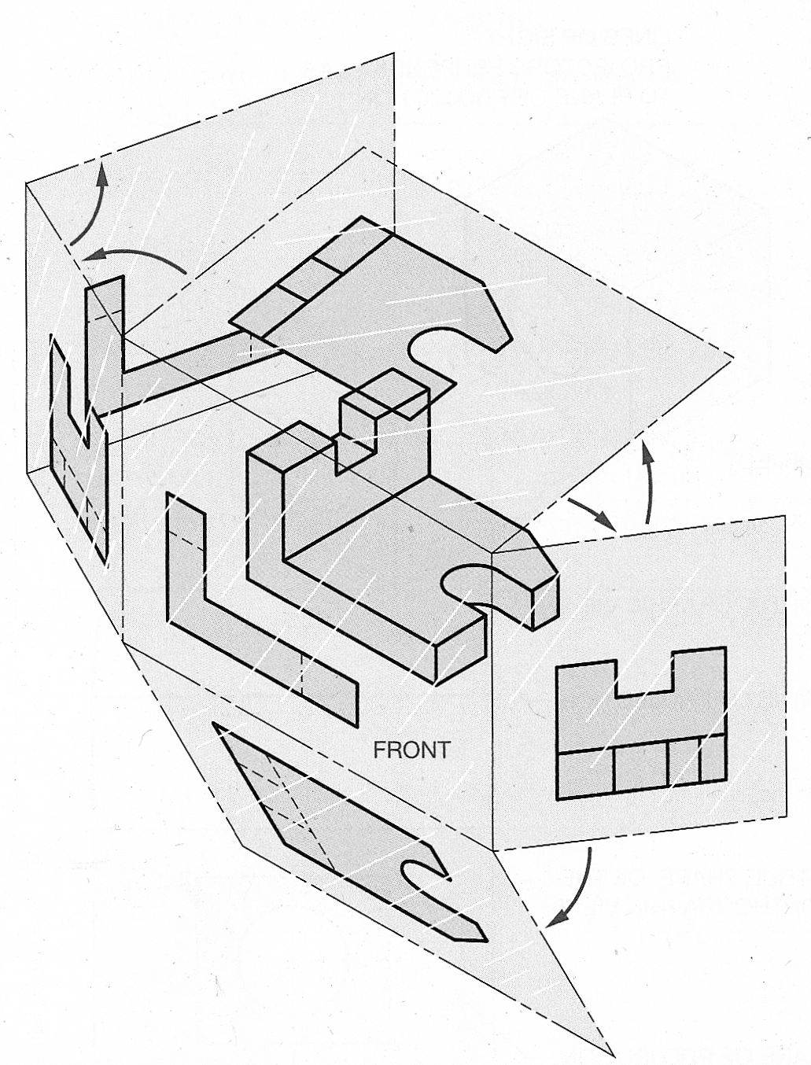
Glass Box #2
Notes:
The glass box technique is a visualization method that projects each view onto the side of an imaginary glass box.
When the box is unfolded ….
The standard orthographic views are presented
They reflect the standard three dimensions of Height, Width and Depth

Slide 7
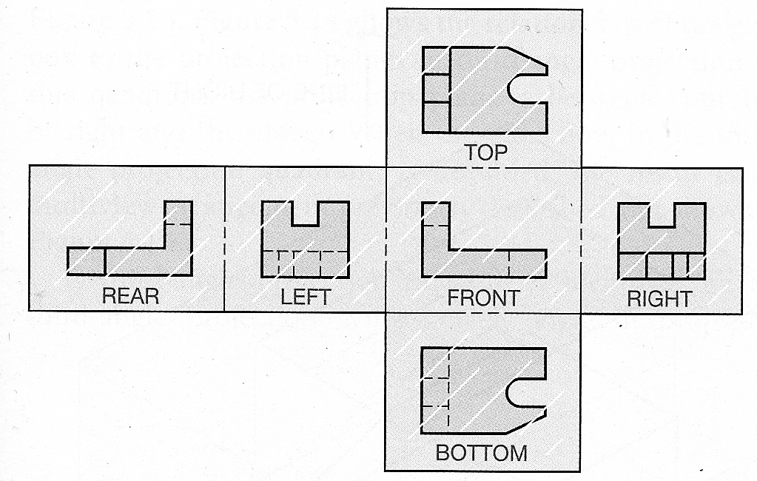
Glass Box #3
Notes:
The glass box technique is a visualization method that projects each view onto the side of an imaginary glass box.
When the box is unfolded ….
The standard orthographic views are presented
They reflect the standard three dimensions of Height, Width and Depth

Slide 8
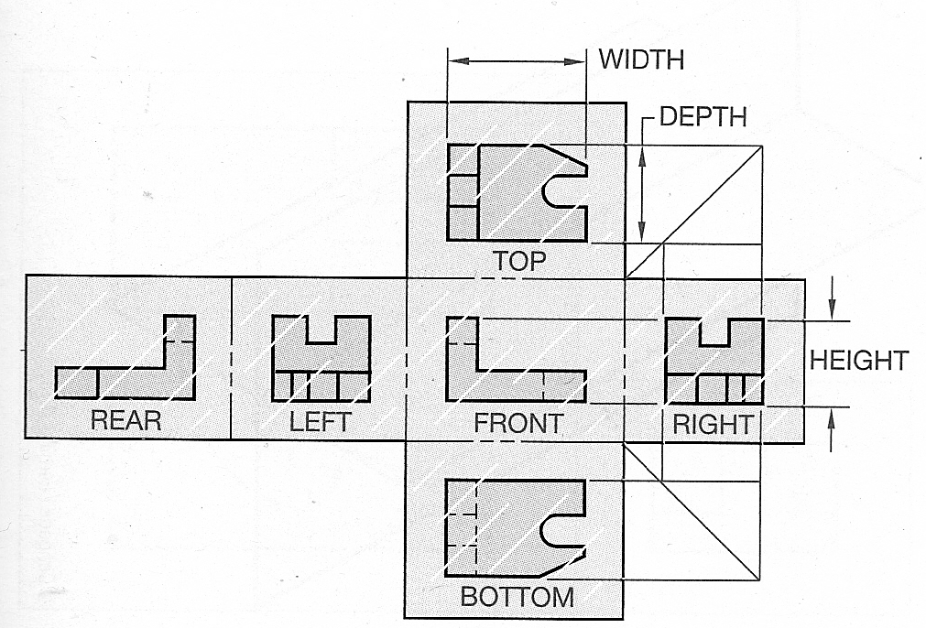
Glass Box #4
Notes:
The glass box technique is a visualization method that projects each view onto the side of an imaginary glass box.
When the box is unfolded ….
The standard orthographic views are presented
They reflect the standard three dimensions of Height, Width and Depth

Slide 9
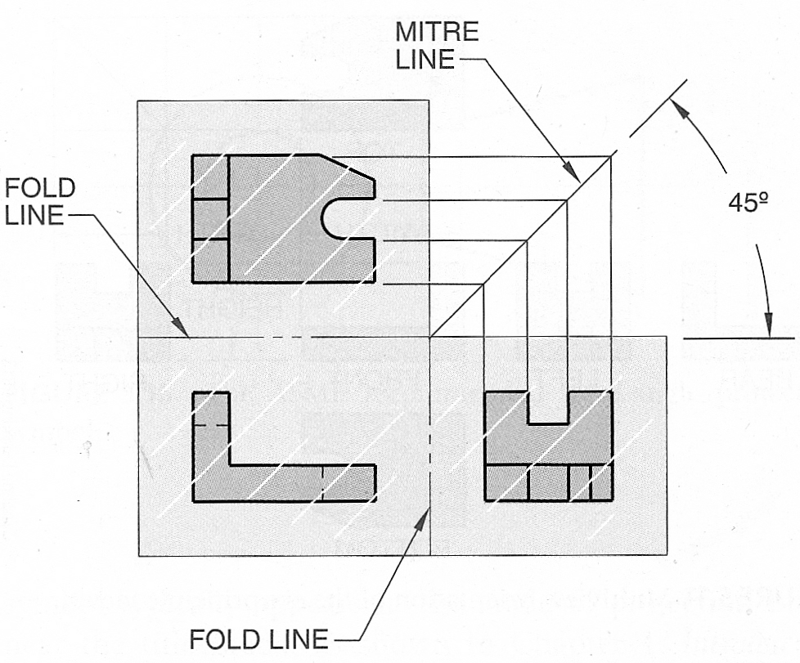
3 Methods of Projection
Notes:
Method 1 is by far the simplest, layout the views and draw a 45 degree line. Lines transfer up/down to horizontal/vertical
Method 2 is similar but uses an arc to transfer the lines
Method 3 uses distances measured from fixed points, useful if you are reverse engineering a part

Slide 10
3 Methods of Projection #2
Notes:
Method 1 is by far the simplest, layout the views and draw a 45 degree line. Lines transfer up/down to horizontal/vertical
Method 2 is similar but uses an arc to transfer the lines
Method 3 uses distances measured from fixed points, useful if you are reverse engineering a part

Slide 11
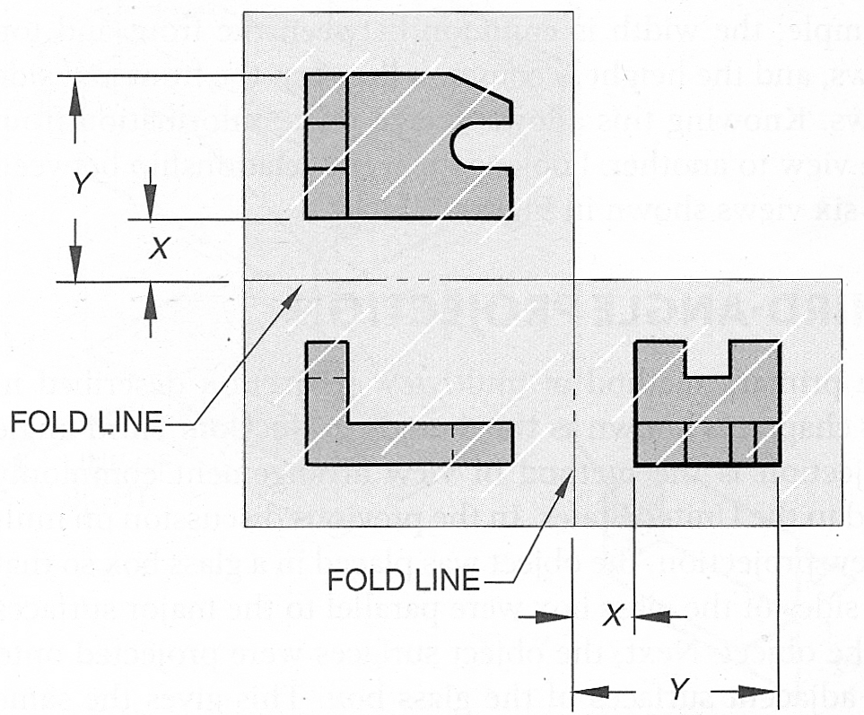
3 Methods of Projection #3
Notes:
Method 1 is by far the simplest, layout the views and draw a 45 degree line. Lines transfer up/down to horizontal/vertical
Method 2 is similar but uses an arc to transfer the lines
Method 3 uses distances measured from fixed points, useful if you are reverse engineering a part

Slide 12
Quick Review of Views

Slide 13
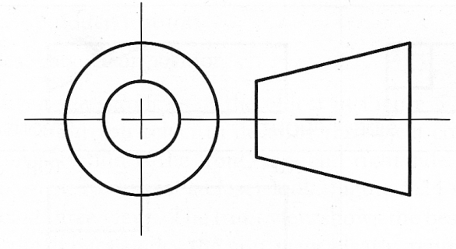
Third-Angle Projection
Notes:
Third-Angle Projection is standard for the US of A. Everybody else uses First-Angle Projection
The line of sight arrows are a little deceiving here. What the picture is trying to get across is that the surfaces project out to the nearest glass box plane.
The symbol in the upper right corner is the ASME standard symbol for third-angle projection.

Slide 14
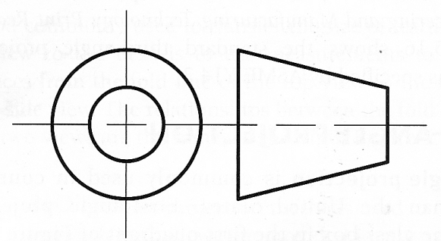
First-Angle Projection
Notes:
Apparently the rest of the world looks at things backwards.
The views are projected to the opposite wall of the glass box.
The result is that if you are used to seeing third-angle projection then all the views will be backwards.

Slide 15
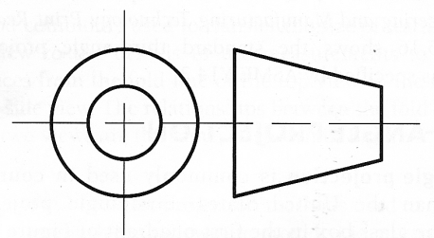
3rd & 1st Comparison
Third-Angle Projection (US)
First-Angle Projection (THEM)
Notes:
Note how the views look the same but they are located differently.

Slide 16
Front View Selection
Notes:
When drawings are created the front view is generally selected first. There is no one right way to select a front view, but it is the view that all other views are based on, so it’s important.
Some guidelines:
Represent the most natural position to use
Provides the best shape description or the most characteristic contours
Has the longest dimension
Has the fewest hidden features
Provides the most stable and natural position

Slide 17
Front View Examples
Notes:
Choose the best 1 or 2 views that would be used for a front view
For A: Views 1 or 2 would work, 3 is not in a natural position
For B: View 3 is actually the best choice as the top and right view would not have hidden lines, View 1 is acceptable

Slide 18
Front View Examples – Cont’d
Notes:
Choose the best 1 or 2 views that would be used for a front view
For C: View 3 is the best choice as 1 is inverted and 2 would make a better top view
For D: View 2 shows the object at it’s longest dimension
For E: View 2 would be the best choice as View 1 would result in the top view upside-down and view 3 is not the longest dimension

Slide 19
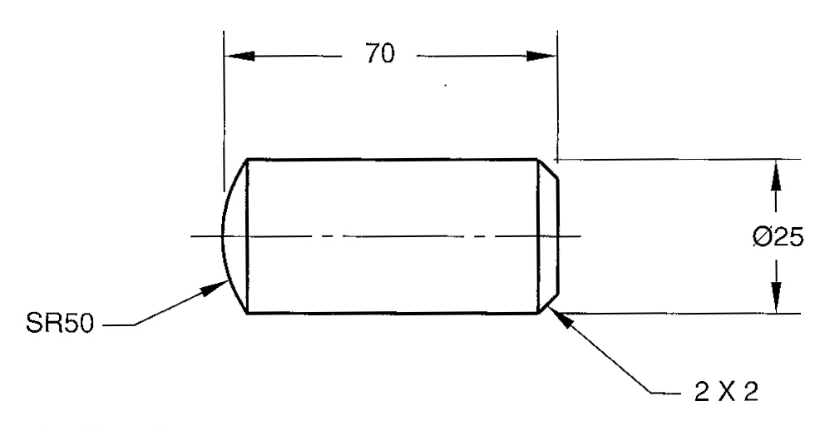
One View Prints
Notes:
Examples of one view drawings. When an object has a uniform shape or thickness then only one view is normally required.

Slide 20
Sample 3 View – See Handout

Slide 21
Partial View
Notes:
A partial view is used when the whole object does not need to be shown, in this case it’s symmetrical.

Slide 22
Detail Views
Notes:
Detail Views are shown when there isn’t enough space to show the whole view at a big enough scale to see a fine detail

Slide 23
Views With Related Parts
Notes:
There are times when it makes it clearer to show a part within the context it will be used. In this case the part shown is the base piece, not the handle.

Slide 24
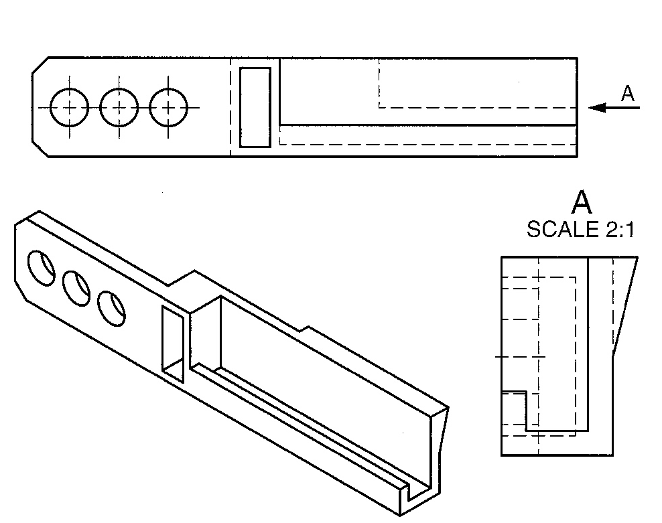
Removed Views
Notes:
A removed view is one that is shown out of normal alignment with other views
One method uses a View Plane Line to indicate the view and the other shows an arrow in the direction you are looking

Slide 25
Breakout View / Runout
Notes:
The image to the left shows a good example of a breakout view with a rotated section through the part
The rectangular cross section on the left results in the rectangular runout where the ends of the edges “curl out” to the tangent point
The elliptical cross section on the right results in the runout where the edges curve in to the tangent point

Slide 26
Line Precedence
Notes:
Line precedence rules are as shown

Slide 27
Credits
Unless indicated otherwise all images are from Madsen, David A., and David P. Madsen. Print Reading for Engineering and Manufacturing Technology. Clifton Park, NY: Delmar, Cengage Learning, 2013. Print.

