Slide 1
Blueprint Reading
Section VI – Manufacturing Processes

Slide 2
Disclaimer
The AMMQC program is an Equal Opportunity program. Adaptive equipment is available upon request for individuals with disabilities. http://creativecommons.org/licenses/by/3.0 This work is licensed under a Creative Commons Attribution 3.0 Unported License [http://creativecommons.org/licenses/by/3.0] This project is sponsored by a $15.9 million grant from the U.S. Department of Labor, Employment and Training Administration. The AMMQC program is an Equal Opportunity program. Adaptive equipment is available upon request for individuals with disabilities. This workforce product was funded by a grant awarded by the U.S. Department of Labor’s Employment and Training Administration. The product was created by the grantee and does not necessarily reflect the official position of the U.S. Department of Labor. The U.S. Department of Labor makes no guarantees, warranties, or assurances of any kind, express or implied, with respect to such information, including any information on linked sites and including, but not limited to, accuracy of the information or its completeness, timeliness, usefulness, adequacy, continued availability, or ownership.

Slide 3
What’s a Manufacturing Process?
Drill
Ream
Bore
Counterbore
Countersink
Counterdrill
Spotface
Boss
Lug
Pad
Chamfer
Fillet
Round
Dovetail
Kerf
Key
Key
Keyset
Keyway
Neck
Spline
Threads
T-Slot
Knurl
Surface Texture
Notes:
A list of common manufacturing processes (by no means all of them).

Slide 4
Drill
Notes:
Probably the most common feature found on a machining drawing.
The tool that forms a hole is called a drill bit.
Holes can be through holes or “blind” holes. Blind holes do not go all the way through.
As a side note, the typical drill bit point is 117 degrees but may vary based on material. Any other angle should be indicated in the note.
The image shown on the left shows a 16mm diameter thru hole (notice the spelling)
The image shown on the right is a blind hole that is 16mm diameter and drilled to 20mm deep.

Slide 5
Ream
Notes:
A hole is reamed to make it more accurate or precise, and is used on a drilled, bored or cored hole.

Slide 6
Bore
Notes:
A hole is bored to typically increase the hole size or to match parts to the same size hole.

Slide 7
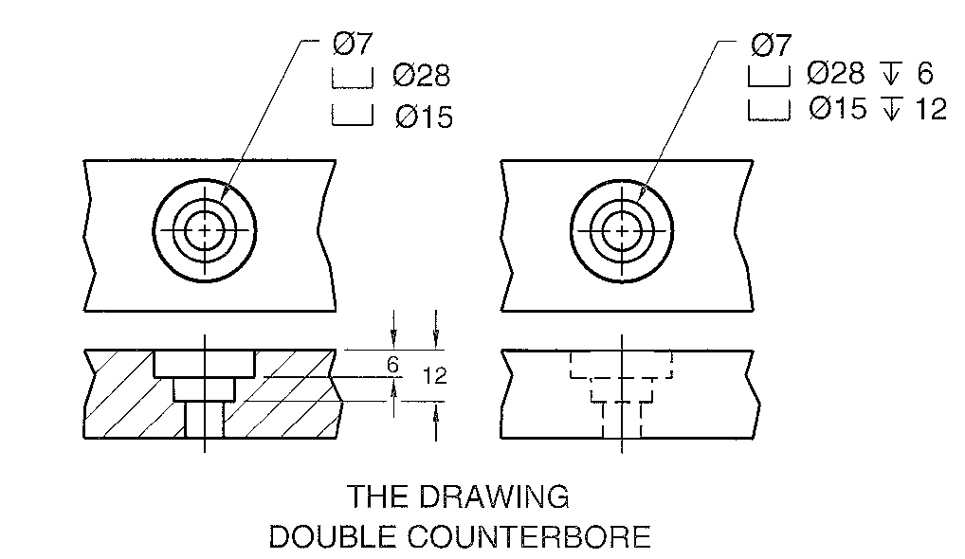
Counterbore
Notes:
Counterbores may be used for a number of reasons. Typical reason may be to allow a bolt or screw to be below the surface of the part for clearance.
The hole is drilled first and then the counterbore is completed using a pilot tool to center it.

Slide 8
Countersink
Notes:
A countersink is cone shaped feature typically used to recess a flat head machine screw below the surface of the part.

Slide 9
Counterdrill
Notes:
A counterdrill is a combination of features. First a hole is drilled, then a second hole is drilled to a certain depth indicated on the drawing.
Typical use is to recess a flat head machine screw to a deeper depth then a countersink allows.

Slide 10
Spotface
Notes:
A spot face is a shallow counterbore generally used to provide a smooth surface for a fastener to seal to. It is typically used with castings or forgings.

Slide 11
Boss
Notes:
A boss a circular pad and is typically found on castings or forgings and they allow a stronger zone for a fastener to attach to. They are typically machined smooth once the casting is complete.

Slide 12
Lug
Notes:
A lug is usually cast or forged in place and is typically used as a hold down or bracket to attach a fastener. They are usually drilled thru and then spotfaced.

Slide 13
Pad
Notes:
A pad is a rectangular raised surface usually cast or forged but can be machined. General use is for mounting of an adjacent part.

Slide 14
Chamfer

Slide 15
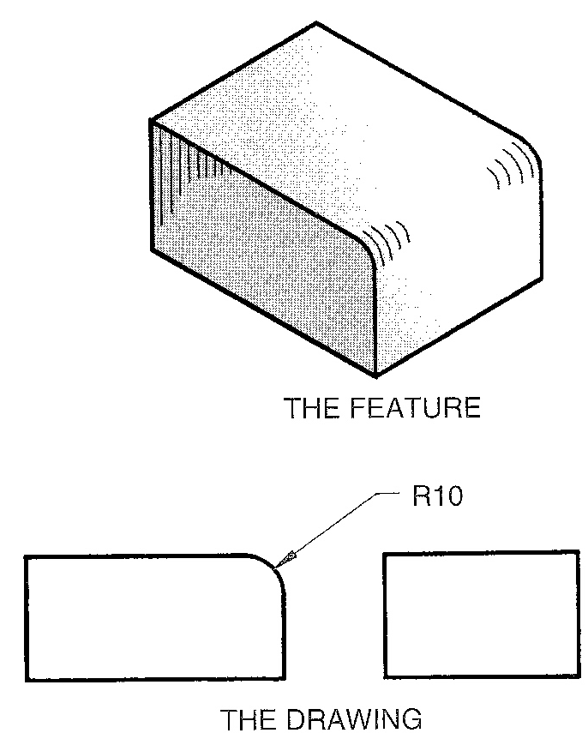
Fillet and Rounds
Notes:
A fillet “fills in” an area of the part. Generally this is because it adds strength to the corner although it can also be because the tool machining the part does not create a perfect corner.
A round is the removing of material to make a feature less sharp.

Slide 16
Dovetail
Notes:
A dovetail is a method of slotting a part with angled sides to allow another part to slide within it.
Think the corner of your furniture drawers.

Slide 17
Kerf
Notes:
A kerf is what is left from a saw cut and will vary based on the width of the saw blade.

Slide 18
Key & Keyway or Keyseat
Notes:
Keys are used to prevent a shaft from turning in a hole. The keyway or keyseat is the slot that the key fits into.

Slide 19
Neck
Notes:
Necking is putting a groove into a shaft. Various neck shapes can be used depending on the part function.

Slide 20
Spline
Notes:
A spline is a gear-like surface on a shaft that generally mates to a similar surface in a hole. It is a stronger method of transmitting torque then a key and keyseat.

Slide 21
Threads
Notes:
Threads can be external (on a shaft) or internal (inside a hole).
External threads are cut using a “die” and internal threads are cut using a “tap”.
Threads that are tapered are usually pipe threads and are used to tighten the part for a good seal.

Slide 22
T-Slot
Notes:
T-Slots are common in machining as many tooling jigs that hold parts in place for machining are designed to fit a T-Slot.

Slide 23
Knurl
Notes:
Parts are usually knurled to create a texture that makes it easier to crab. Typical knurls are diamond or straight.

Slide 24
Surface Texture or Finish
Parts may be finished to a particular smoothness or roughness
For the U.S. the lower the finish number the smoother the finish

Slide 25
Credits
Unless indicated otherwise all images are from Madsen, David A., and David P. Madsen. Print Reading for Engineering and Manufacturing Technology. Clifton Park, NY: Delmar, Cengage Learning, 2013. Print.
©Todd Rathier 2013

