Slide 1
Blueprint Reading
Section VII – Reading Dimensions

Slide 2
Disclaimer
The AMMQC program is an Equal Opportunity program. Adaptive equipment is available upon request for individuals with disabilities. http://creativecommons.org/licenses/by/3.0 This work is licensed under a Creative Commons Attribution 3.0 Unported License [http://creativecommons.org/licenses/by/3.0] This project is sponsored by a $15.9 million grant from the U.S. Department of Labor, Employment and Training Administration. The AMMQC program is an Equal Opportunity program. Adaptive equipment is available upon request for individuals with disabilities. This workforce product was funded by a grant awarded by the U.S. Department of Labor’s Employment and Training Administration. The product was created by the grantee and does not necessarily reflect the official position of the U.S. Department of Labor. The U.S. Department of Labor makes no guarantees, warranties, or assurances of any kind, express or implied, with respect to such information, including any information on linked sites and including, but not limited to, accuracy of the information or its completeness, timeliness, usefulness, adequacy, continued availability, or ownership.

Slide 3
Some Basics
Dimensions supply size and shape descriptions
Size dimensions are placed directly on a feature or as a note attached to it
Location dimensions locate an feature in relation to another feature

Slide 4
What’s a feature?
A feature is the general term applied to describe a physical portion of a part or object, such as a surface, slot, tab, pin, keyseat, or hole.

Slide 5
Fundamental Rules
Each dimension has a tolerance
Dimensioning and tolerancing must be complete to fully understand each feature
Each necessary dimension of an end product must be shown. Limit reference dimensions.

Slide 6
Fundamental Rules II
Dimensions must not be subject to more than one interpretation
The drawing should define the part without specifying the manufacturing process.
Dimensions should be arranged for maximum readability

Slide 7
Fundamental Rules III
A 90 degree angle is assumed where centerlines and lines displaying features at right angles are displayed.
Unless otherwise specified all dimensions and tolerances are at 68 degrees F

Slide 8
Dimensioning Components
Notes:
Dimension Line – indicates the length of the dimension
Angular Dimension Line – is an arc, the center is at the vertex of the angle
Dimension Text – Displays the dimension value, normally is centered
Leader Line – Thin line used to connect a specific note to a feature
Arrowheads – cap dimension lines and leader ends
Extension Lines – establish the extent of a dimension

Slide 9
Dimensioning Symbols

Slide 10
More Dimensioning Symbols

Slide 11
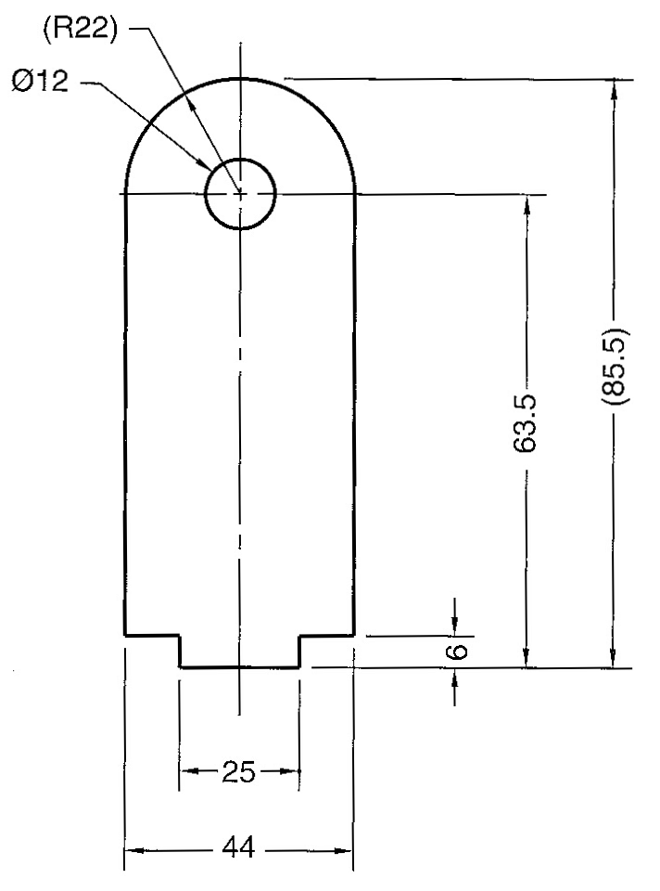
Dimensioning Systems
Unidirectional
Aligned
Notes:
Unidirectional is commonly used in mechanical manufacturing. All dimensions read from one direction.
Aligned is commonly used for architectural and structural drafting. Dimensions read in the direction they go in.

Slide 12
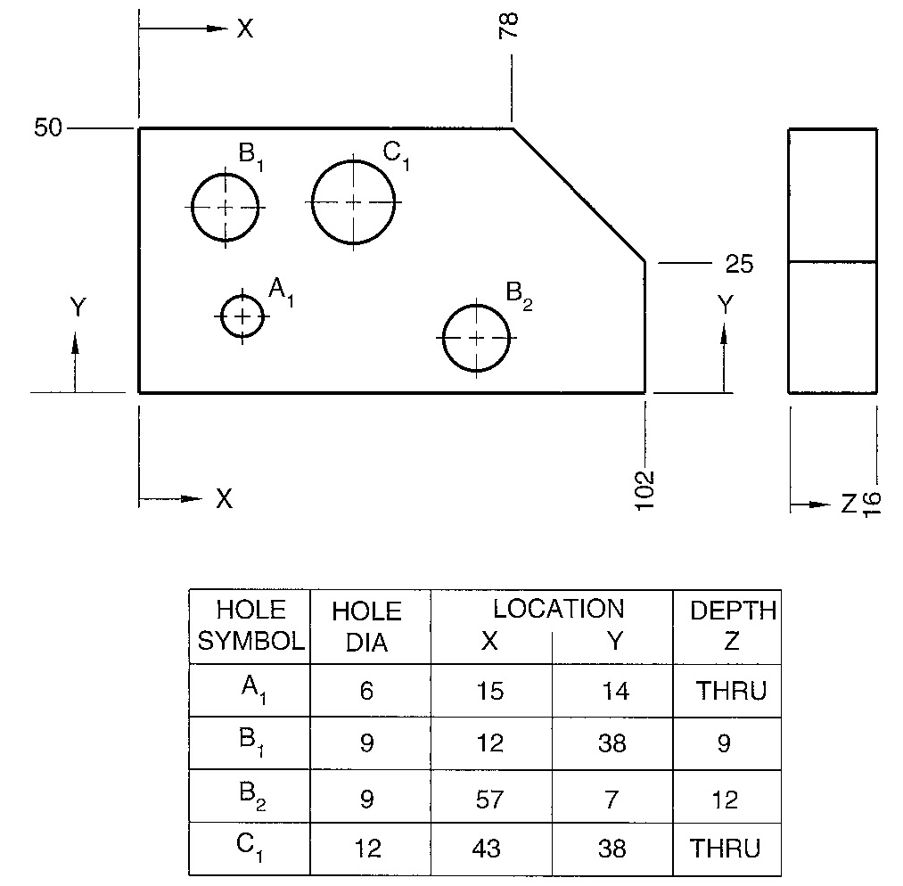
Dimensioning Systems #2
Rectangular Coordinate
Tabular Dimensioning

Slide 13
Chart Drawing
Notes:
Typically used in catalogs or on websites

Slide 14
Chain Dimensioning
Notes:
Chain dimensioning also known as point-to-point dimensioning is used to dimension from one feature to the next. It’s drawback is that tolerance stacking can happen.

Slide 15
Baseline Dimensioning
Notes:
Baseline dimensioning is commonly used to prevent tolerance stacking by having each dimension originate from a common surface, axis or center plane.

Slide 16
Baseline Dimensioning #2
Notes:
Using centerplane (top)
Using symmetry line (bottom)

Slide 17
Tolerance Accumulation I
Notes:
Least amount of tolerance accumulation

Slide 18
Tolerance Accumulation II
Notes:
Chain dimensioning results in the most accumulation

Slide 19
Tolerance Accumulation III
Notes:
Baseline Dimensioning gives the best results for the least amount of tolerance accumulation

Slide 20
Reference Dimensions
Notes:
Dimensions should not be duplicated. Therefore where a dimension would conflict it is placed in parenthesis.

Slide 21
Cylindrical Shapes
Notes:
Diameters on cylindrical shapes are commonly shown with the diameter symbol in front of the dimension. The abbreviation DIA should not be used.
Square stock may be dimensioned in a similar fashion by using the square symbol.

Slide 22
Chamfers - Dimensioned
Notes:
Chamfers may also be called out as a note

Slide 23
Chamfers - Notes
Notes:
Chamfers may also be called out as a note

Slide 24
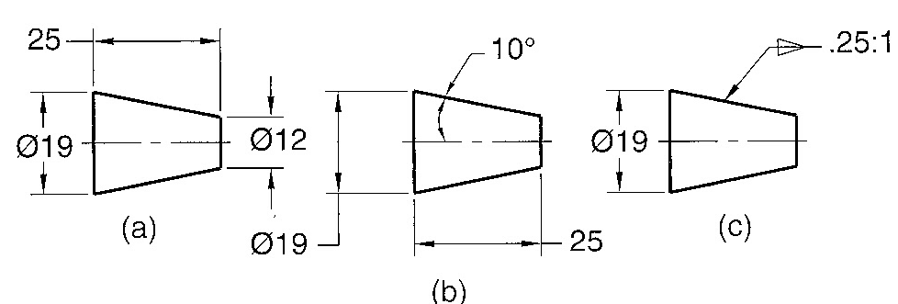
Conical Features
Notes:
Any method works

Slide 25
Polygon Stock
Notes:
Typically is dimensioned across the flats of the shape when in true view

Slide 26
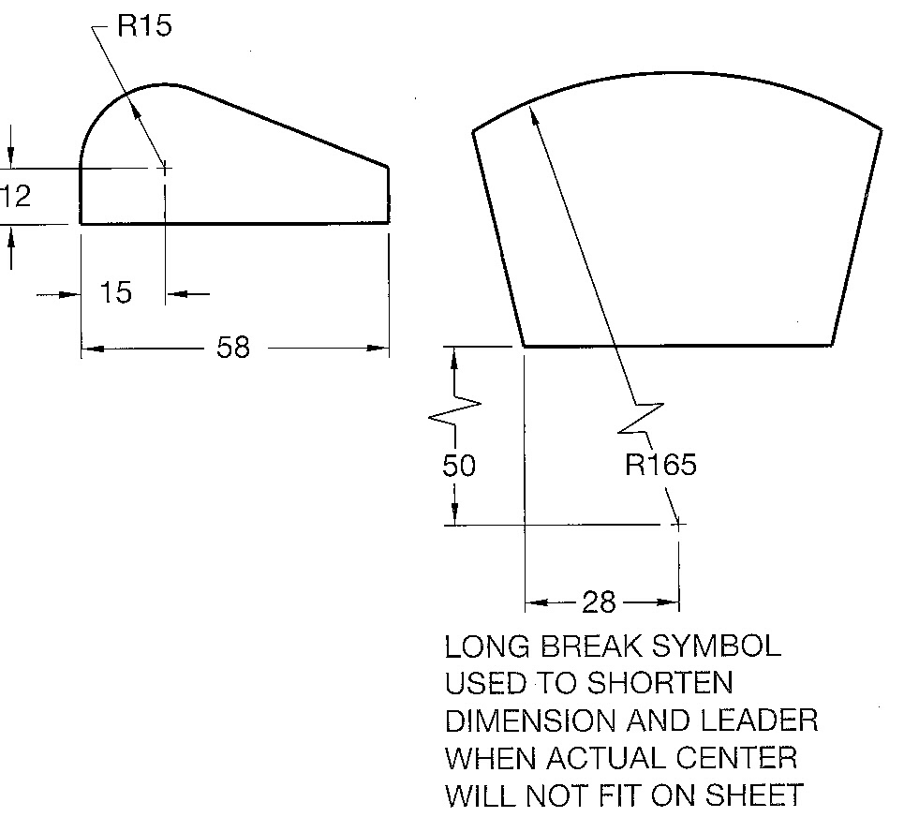
Arcs

Slide 27
Arcs and Spheres
Notes:
From left to right in the top image:
Point-to-Point dimensioned
Dimension indicates the arc length along the arc
Angle defines the arc
Below, SR indicates a spherical radius. Think of it like a dome.

Slide 28
Continuous Curve
Notes:
The R22 and R15 radii do not need the centers located as they are assumed to be tangent to the adjoining geometry. Although some machine shops may request it.

Slide 29
Point Location - Extension

Slide 30
Leader Location
Notes:
Center the leader shoulder at the beginning or end of the note text.

Slide 31
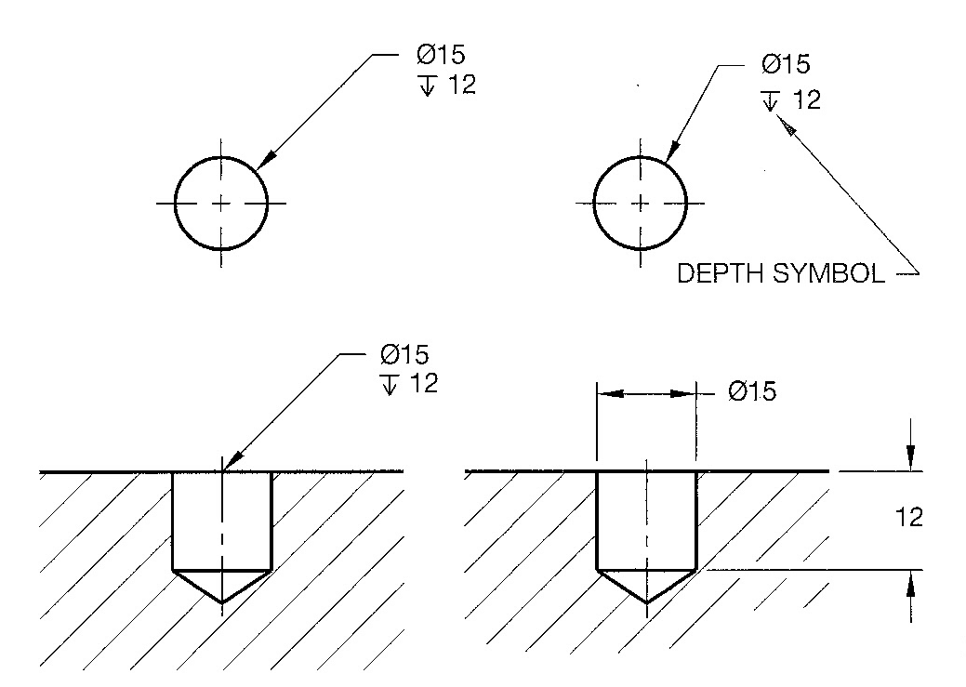
Hole Diameters
Notes:
Note the use of THRU as well as the spelling
Note the indicator for the depth symbol. Old school method is to use the word DEEP or TO DEPTH.

Slide 32
Counterbores

Slide 33
Stacked Counterbores
Notes:
Case on the left has counterbore depths given as dimensions
Case on the right has depths given in the note
Both are correct.

Slide 34
Spotface Notes

Slide 35
Countersink and Counterdrill

Slide 36
Multiple Features
Notes:
Notice the 2X indicating quantity of 2 holes, 4X means 4 holes

Slide 37
Keyseats and Keyways

Slide 38
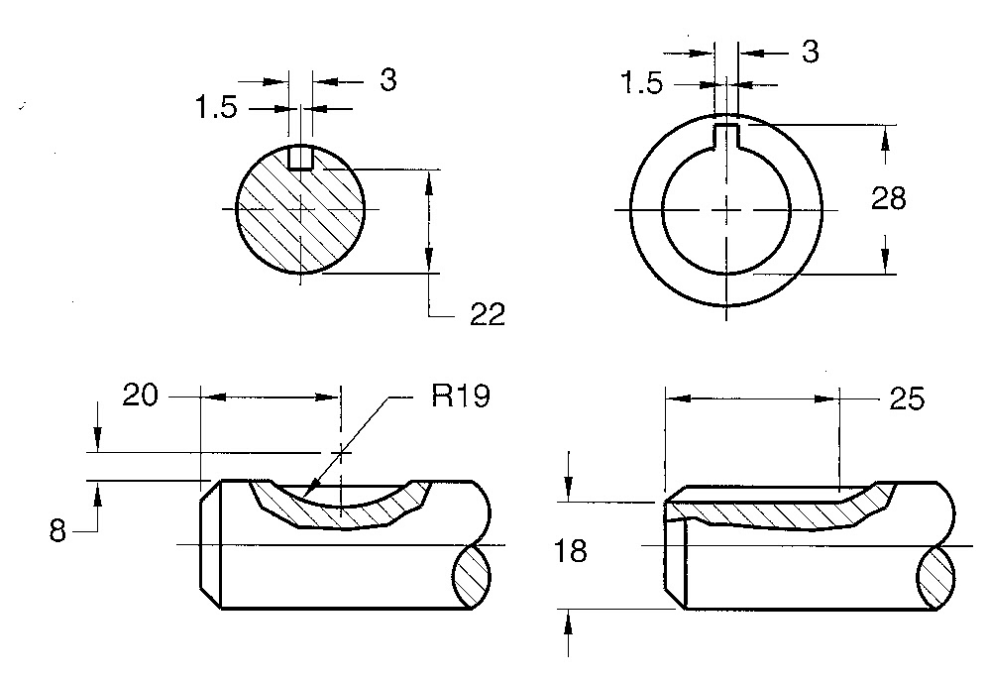
Keyseats and Keyways #2

Slide 39
Necks and Grooves

Slide 40
Rectangular Coordinate

Slide 41
Polar Coordinates

Slide 42
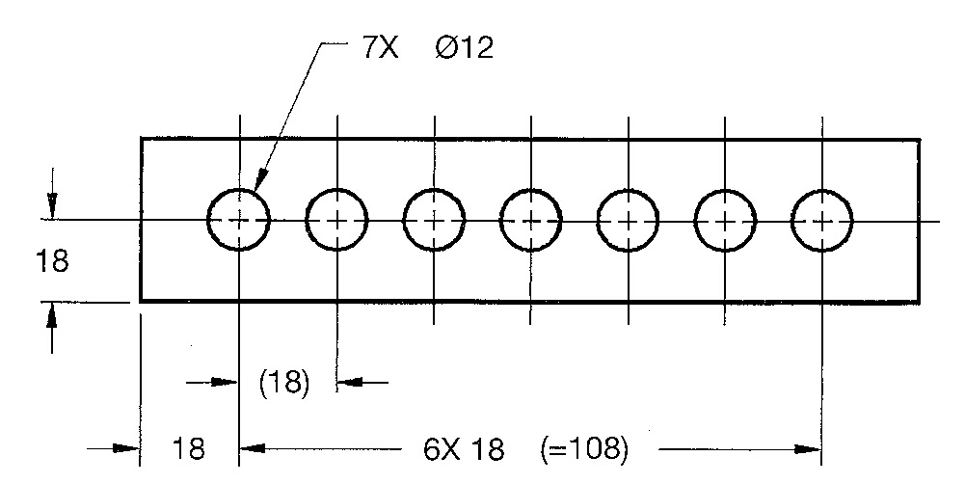
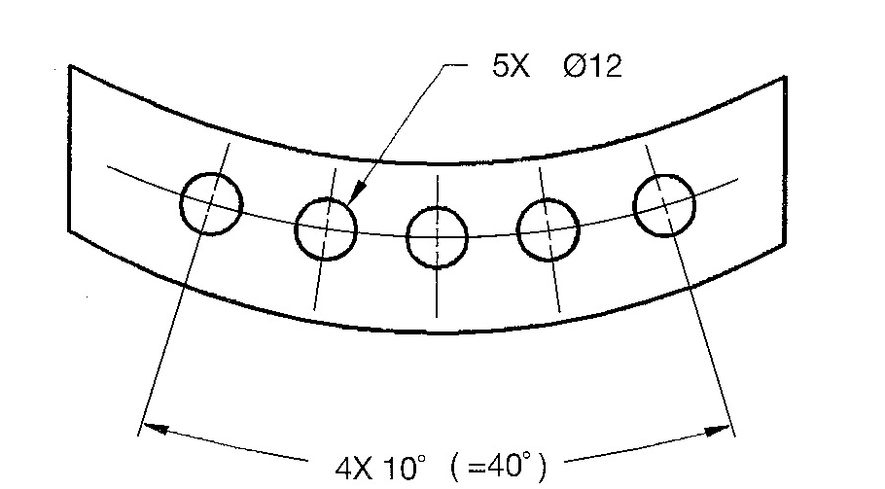
Repetitive Features

Slide 43
Repetitive Features - Lugs

Slide 44
Dimension Origin Symbol
Notes:
The origin tells you where to measure from.

Slide 45
General Notes - Titleblock

Slide 46
General Notes - Drawing
Notes:
A delta or flag note has a matching delta or flag somewhere on the drawing where the note applies. The dimension it applies to will have a flag right next to it.

Slide 47
Tolerances
Single Limit tolerances can be applied to chamfers, fillets, rounds, hole depths, and thread lengths.
They are indicated by a MAX or MIN

Slide 48
Specified / Unspecified
Notes:
Unspecified tolerances apply to dimensions that do not already have a tolerance attached to them. In that case the general notes cover what the tolerance will be.

Slide 49
Types of Tolerances
Notes:
Example showing the various forms a tolerance can take.

Slide 50
Types of Tolerances #2
Basic Dimension
Limits
Notes:
Basic Dimensions are used in conjunction with geometric tolerancing and datums
Limits Tolerances indicate the maximum and minimum value a dimension can be. Machinist like these because they don’t have to do the math.

Slide 51
Types of Tolerances #3
Deviation
Symmetrical
Nominal Dimension
Notes:
Deviation Tolerances indicate a plus value and a minus value that the dimension can vary. If one of the values is zero then it is called a unilateral tolerance.
Symmetrical is a form of deviation tolerance but the plus and minus are the same value
A nominal dimension is a dimension with an unspecified tolerance

Slide 52
Credits
Unless indicated otherwise all images are from Madsen, David A., and David P. Madsen. Print Reading for Engineering and Manufacturing Technology. Clifton Park, NY: Delmar, Cengage Learning, 2013. Print.

