Slide 1
Blueprint Reading
Section IX – Geometric Dimensioning and Tolerancing (GD & T)

Slide 2
Disclaimer
The AMMQC program is an Equal Opportunity program. Adaptive equipment is available upon request for individuals with disabilities. http://creativecommons.org/licenses/by/3.0 This work is licensed under a Creative Commons Attribution 3.0 Unported License [http://creativecommons.org/licenses/by/3.0] This project is sponsored by a $15.9 million grant from the U.S. Department of Labor, Employment and Training Administration. The AMMQC program is an Equal Opportunity program. Adaptive equipment is available upon request for individuals with disabilities. This workforce product was funded by a grant awarded by the U.S. Department of Labor’s Employment and Training Administration. The product was created by the grantee and does not necessarily reflect the official position of the U.S. Department of Labor. The U.S. Department of Labor makes no guarantees, warranties, or assurances of any kind, express or implied, with respect to such information, including any information on linked sites and including, but not limited to, accuracy of the information or its completeness, timeliness, usefulness, adequacy, continued availability, or ownership.

Slide 3
Datum Feature Symbol
Notes:
Geometric Dimensioning and Tolerancing (GD & T) is almost an art, it is certainly a science. Entire graduate level college courses are devoted to using and understanding what the symbols and numbers mean as well as how they are applied. You can actually earn a college certificate in GD & T.
We won’t get that complicated. You only need to recognize what the symbols mean in a general fashion.
Let’s start with Datums. Datums make up the references from which geometry is measured from.
The symbols look as shown.

Slide 4
Locating the Datum Symbol

Slide 5
Locating the Datum Symbol #2

Slide 6
Datum Plane Location

Slide 7
Datum Plane on Surface A

Slide 8
Actually Means This…

Slide 9
Datum References
Notes:
Datum Planes are typically located perpendicular to each other

Slide 10
Datum Features – Part vs Print
Notes:
Relate
Datum A = Primary Datum
Datum B = Secondary Datum
Datum C = Tertiary Datum

Slide 11
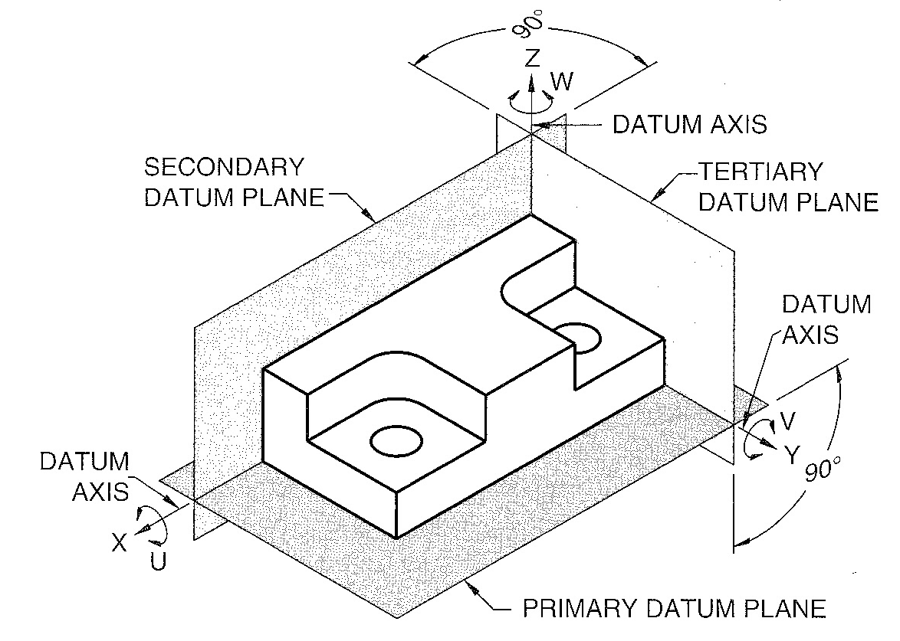
Datum Features – Part vs Print #2
Notes:
Relate
Datum A = Primary Datum
Datum B = Secondary Datum
Datum C = Tertiary Datum

Slide 12
Datums – Target Points/Areas
Notes:
Datums may apply to a point or an area

Slide 13
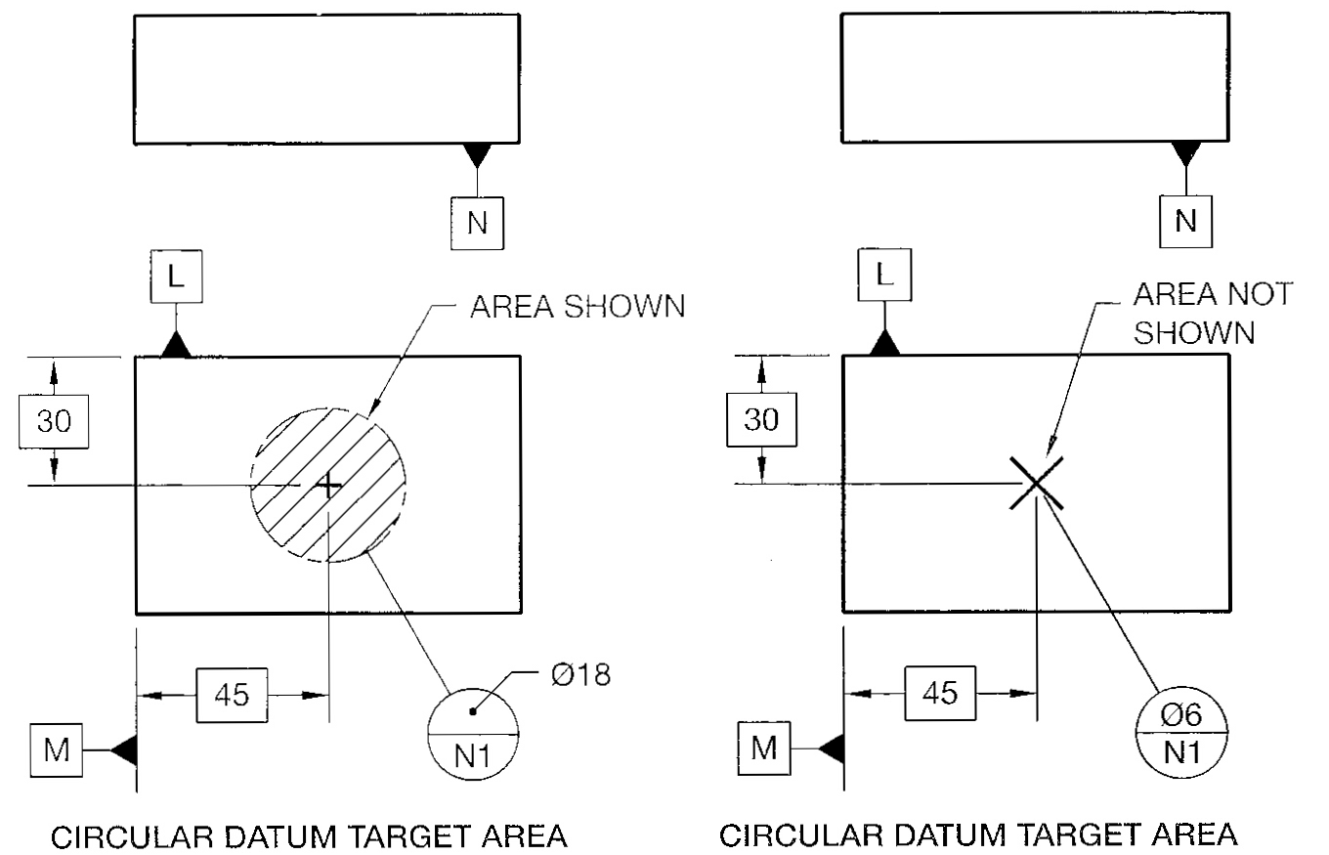
Datums – Target Points/Areas #2
Notes:
Datums may apply to a point or an area

Slide 14
Datum Target Line

Slide 15
Datum Rectangular Area

Slide 16
Datum Axis
Notes:
Notice Datum B is pointing to the outside round surface of the part. This actually means that everything is measured from the axis that passes through point X,Y

Slide 17
Visual of Datum Axis

Slide 18
Methods of Indicating an Axis
Notes:
Each of these methods results in an axis running through the center of the cylinder or hole.

Slide 19
Methods of Indicating an Axis #2
Notes:
Each of these methods results in an axis running through the center of the cylinder or hole.

Slide 20
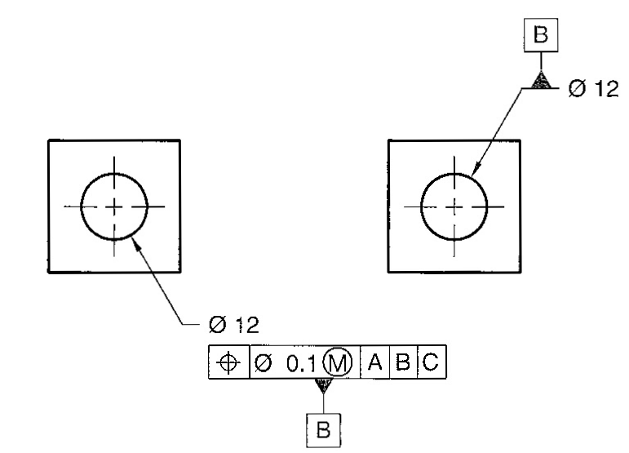
Methods of Indicating an Axis #3
Notes:
Each of these methods results in an axis running through the center of the cylinder or hole.

Slide 21
Symbols
Notes:
The basic geometric symbols
They are broken up into 5 groups depending on function of the tolerance.

Slide 22
Simple GD & T Block
Notes:
This is a basic geometric dimensioning and tolerancing (gd & T) block.

Slide 23
A Little More Complicated…
Notes:
Once you understand what each section of the block stands for, it is just a matter of interpreting the tolerance.

Slide 24
Order of Elements

Slide 25
Additional Symbols
Notes:
Here are some additional symbols you may encounter. We won’t be covering these as they are not that common.

Slide 26
Flatness
Notes:
Flatness refers to how flat one surface is when as compared to a given datum surface. Typically used with flat stock that must be brought to within a certain tolerance level.
MMC means Maximum Material Condition
LMC means Least Material Condition
This is that most material or least material that can exist and still be within tolerances.

Slide 27
Circularity
Notes:
Typically used with round stock to insure it is not too big or too small in diameter for the application required.

Slide 28
Circularity Applied to a Cone
Notes:
This means at any point along the conical surface you must fall within the tolerance zone.
This is NOT a plus or minus number but a total tolerance number.

Slide 29
An O-Ring
Notes:
Circularity as applied to an o-ring

Slide 30
Cylindricity
Notes:
This means that if a hole that was EXACTLY 60.25 inches in diameter existed this cylinder would be able to pass through it. It also means that no point on the cross section of the cylinder can be less than 60mm - .25mm or 59.75mm.

Slide 31
Parallelism
Notes:
Parallelism means that the surface has to be parallel to the given datum within a certain zone.

Slide 32
Parallelism – Tangency
Notes:
Another way to specify parallelism is to make a theoretical flat surface that touches the high points of the part. That surface would have to fall within the tolerance given.

Slide 33
Perpendicularity
Notes:
Notice that perpendicularity is not measured as an angle, but as a zone of tolerance the surface can be off.

Slide 34
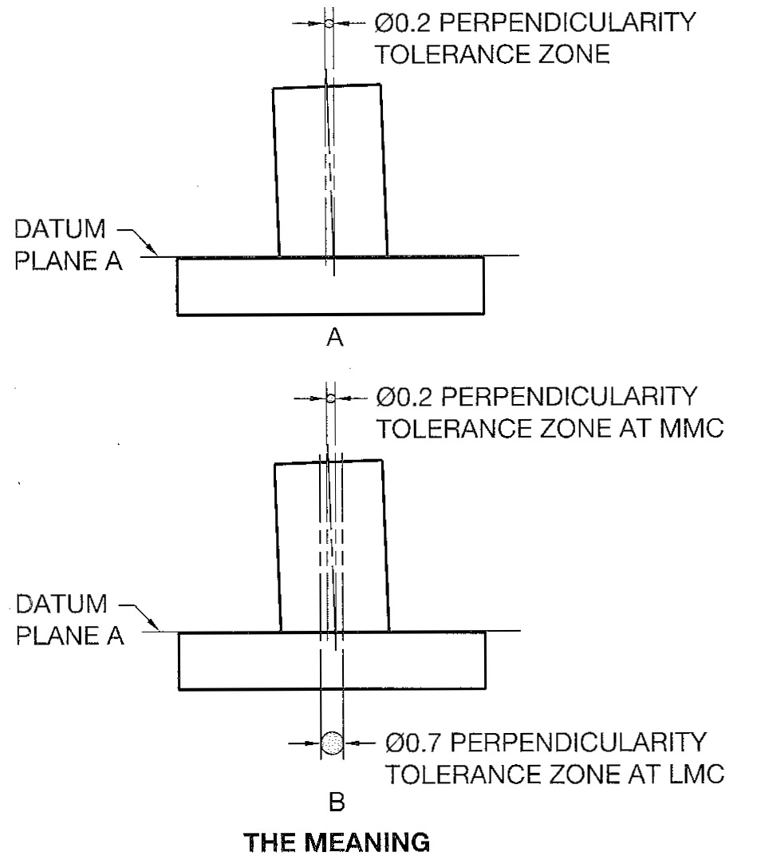
Perpendicularity – Act II
Notes:
Used when a cylindrical feature needs to be perpendicular to a flat surface, this is fairly common.

Slide 35
Angularity
Notes:
Again notice that it is not a plus or minus tolerance on the angle but the angle sets the surface plane it is measured from.

Slide 36
Positional Tolerance
Notes:
The positional symbol is in the left-most box of the block

Slide 37
Example Positional Tolerance

Slide 38
Means…
Notes:
Yep all of that….

Slide 39
Rectangular Coordinates
Notes:
Positional Tolerancing can be used with rectangular coordinate dimensioning.

Slide 40
Polar Coordinates
Notes:
It can also be used with circular or polar patterns and polar coordinate dimensioning.

Slide 41
Concentricity
Notes:
Concentricity means that one cylindrical surface is parallel to another cylindrical surface.

Slide 42
Symmetry
Notes:
Symmetry means that features of an object have a center plane relationship. In other words, the are the same on both sides of an established datum plane within a certain tolerance.

Slide 43
Profile of a Line - Drawing

Slide 44
Profile of a Line - Meaning

Slide 45
All Around Symbol
Notes:
The tolerance applied all the way around the profile. Saves on having to call out each separate surface.

Slide 46
Profile as it Applies to Angles

Slide 47
Profile for a Cone

Slide 48
Runout - Symbols
Notes:
Runout is a combination of geometric tolerances used to control the relationship of one or more features to the datum axis.

Slide 49
Circular Runout
Notes:
Circular Runout provides control of circular elements of a surface.
It usually controls circularity and coaxiality.
Coaxility is a condition where two or more features share a common axis.
Basically it can be used to control wobbling motion.

Slide 50
Total Runout
Notes:
Total Runout provides a combined control of surface elements.
It can be used to control wobble and flatness with respect to the datum axis.
It can also be used to control concavity and convexity for surfaces perpendicular to the axis. In this example it is the flat tip.

Slide 51
Credits
Unless indicated otherwise all images are from Madsen, David A., and David P. Madsen. Print Reading for Engineering and Manufacturing Technology. Clifton Park, NY: Delmar, Cengage Learning, 2013. Print.

