Slide 1
Blueprint Reading
Section X – Working Drawings

Slide 2
Disclaimer
The AMMQC program is an Equal Opportunity program. Adaptive equipment is available upon request for individuals with disabilities. http://creativecommons.org/licenses/by/3.0 This work is licensed under a Creative Commons Attribution 3.0 Unported License [http://creativecommons.org/licenses/by/3.0] This project is sponsored by a $15.9 million grant from the U.S. Department of Labor, Employment and Training Administration. The AMMQC program is an Equal Opportunity program. Adaptive equipment is available upon request for individuals with disabilities. This workforce product was funded by a grant awarded by the U.S. Department of Labor’s Employment and Training Administration. The product was created by the grantee and does not necessarily reflect the official position of the U.S. Department of Labor. The U.S. Department of Labor makes no guarantees, warranties, or assurances of any kind, express or implied, with respect to such information, including any information on linked sites and including, but not limited to, accuracy of the information or its completeness, timeliness, usefulness, adequacy, continued availability, or ownership.

Slide 3
Working Drawing - Monodetail
Notes:
Working drawings are a set of drawings that supply all the information necessary to manufacture any given product.
A set of working drawings includes all the information and instructions needed for the purchase or manufacture of parts and the assembly of those parts into a product.
This part is shown as a monodetail or single part drawing.

Slide 4
Working Drawing - Multidetail
Notes:
A multidetail drawing shows more than one part on a single drawing.
It is saves paper to have several parts drawn on a single sheet.

Slide 5
Assembly Drawing – Single View
Notes:
Assembly drawings are generally multiview drawings but can be shown as a single view (as shown), an exploded view, an isometric view, a cutaway view.

Slide 6
Broken-Out Assembly (Cut away)
Notes:
It is sometimes easier to show sections of the assembly cut out to show parts that would otherwise be hidden.

Slide 7
General Assembly
Notes:
Shown is a generally assembly drawing.
Notice the process note that applies to this assembly
Notice the parts list, also known as a bill of material. The minimum requirement is a part identifier (PID) such as 1, 2, 3 etc.. The part number, a description and quantity.

Slide 8
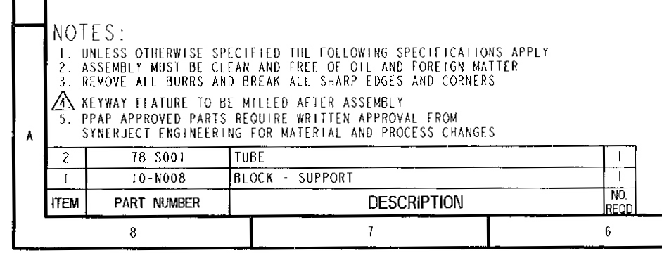
General Assembly #2
Notes:
Shown is a generally assembly drawing.
Notice the process note that applies to this assembly
Notice the parts list, also known as a bill of material. The minimum requirement is a part identifier (PID) such as 1, 2, 3 etc.. The part number, a description and quantity.

Slide 9
Full Section Assembly
Notes:
Note, the section lines are omitted for clarity

Slide 10
Layout Assembly
Notes:
In this case the illustration indicated the possible movement of the front bucket assembly on this tractor.

Slide 11
One-Off or Limited Production
Notes:
Occasionally a company requires a product for a limited production run. The entire set of parts and assembly can be shown on a single drawing. This becomes the working drawing.

Slide 12
Detail Assembly
Notes:
Shown is an example detail assembly drawing that shows the parts assembled with some basic dimensions.
There is not enough information shown to produce the individual parts.
Typical use is for a catalog drawing or website.

Slide 13
Subassembly With Parts List

Slide 14
Pictorial Assembly
Notes:
A 3D solid assembly model. Also known as a virtual model.
New research and development techniques can make 3D prints of objects based off the model.

Slide 15
Matching 2D Assembly
Notes:
This 2D assembly drawing was created by referencing the 3D model.

Slide 16
Exploded Iso
Notes:
Shown is an exploded isometric assembly drawing. Used in catalogs and product assembly instructions. The isometric view makes it easier to visualize the product assembly.

Slide 17
Balloon Arrows
Notes:
Part identification balloons may use various types of leaders to point out parts and sub-assemblies.
Most typical method, usually points to a parts edge
More common in illustrations
The dot indicates a part by pointing to the surface not an edge.
Alternate method for number 1, based on company preference

Slide 18
Balloon Alignment
Notes:
Assembly drawing with parts list, notice the balloon alignment.

Slide 19
External Parts List
Notes:
Not all drawings have the parts lists shown on the drawing. Some companies or applications require the parts list to be a separate document. It is sometimes generated by software.

Slide 20
ECN or ECO or CO
Notes:
Drawings may require changes.
This is commonly done through an Engineering Change Notice (ECN) filed by an engineer.
It can also be called an Engineering Change Order or just Change Order.
Closeup of top
Closeup of bottom

Slide 21
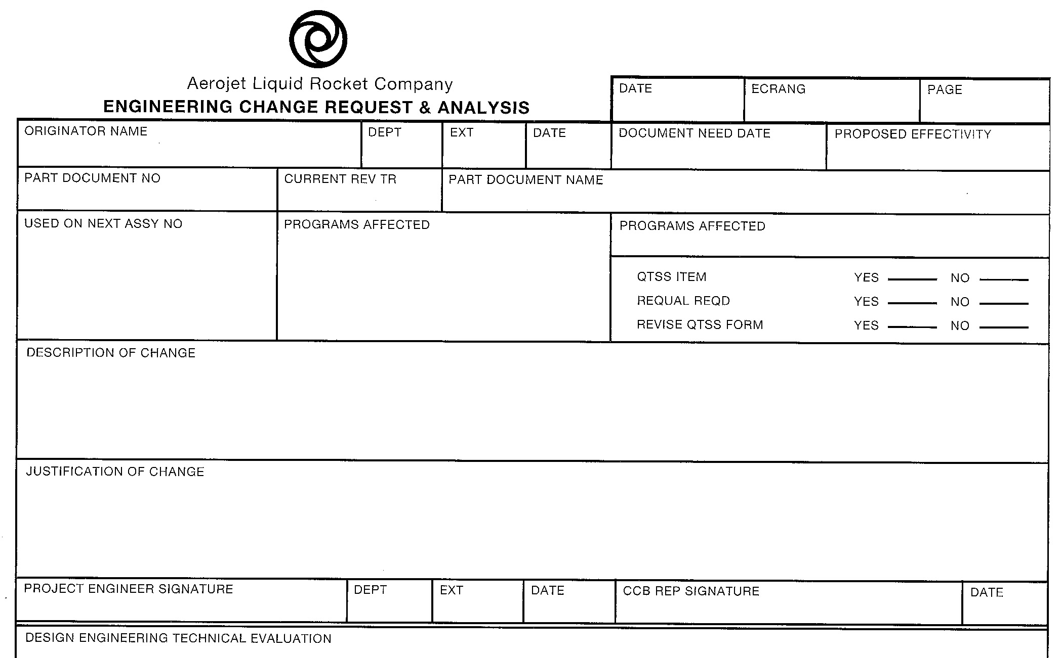
ECN or ECO or CO #2
Notes:
Drawings may require changes.
This is commonly done through an Engineering Change Notice (ECN) filed by an engineer.
It can also be called an Engineering Change Order or just Change Order.
Closeup of top
Closeup of bottom

Slide 22
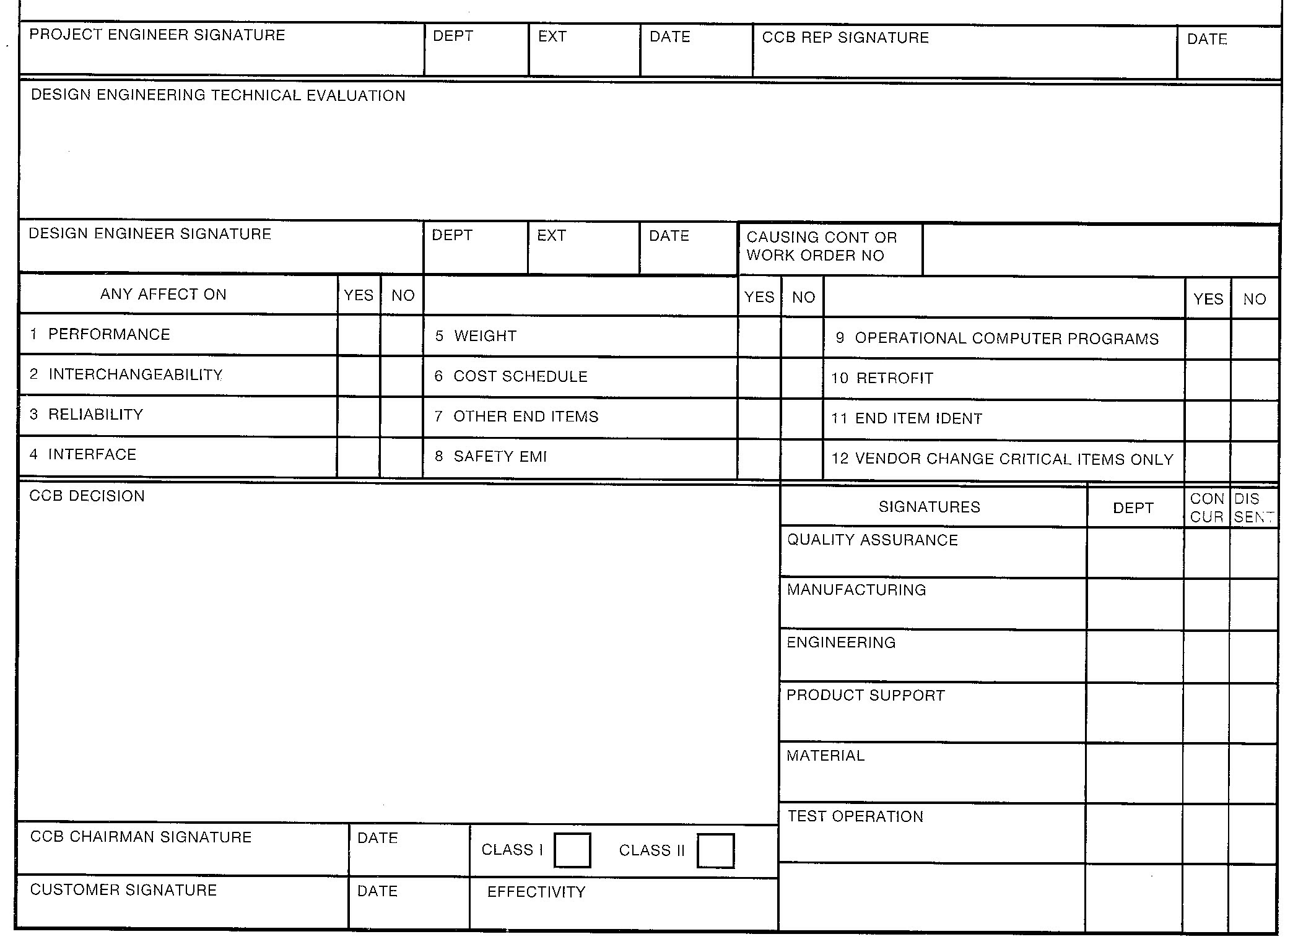
ECN or ECO or CO #3
Notes:
Drawings may require changes.
This is commonly done through an Engineering Change Notice (ECN) filed by an engineer.
It can also be called an Engineering Change Order or just Change Order.
Closeup of top
Closeup of bottom

Slide 23
Credits
Unless indicated otherwise all images are from Madsen, David A., and David P. Madsen. Print Reading for Engineering and Manufacturing Technology. Clifton Park, NY: Delmar, Cengage Learning, 2013. Print.

