Slide 1
Timing and
Position

Slide 2
The AMMQC program is an Equal Opportunity program.
Adaptive equipment is available upon request for individuals with disabilities.
http://creativecommons.org/licenses/by/3.0 This work is licensed under a Creative Commons Attribution 3.0 Unported License [http://creativecommons.org/licenses/by/3.0]
This project is sponsored by a $15.9 million grant from the U.S. Department of Labor, Employment and Training Administration.
The AMMQC program is an Equal Opportunity program. Adaptive equipment is available upon request for individuals with disabilities. This workforce product was funded by a grant awarded by the U.S. Department of Labor’s Employment and Training Administration. The product was created by the grantee and does not necessarily reflect the official position of the U.S. Department of Labor. The U.S. Department of Labor makes no guarantees, warranties, or assurances of any kind, express or implied, with respect to such information, including any information on linked sites and including, but not limited to, accuracy of the information or its completeness, timeliness, usefulness, adequacy, continued availability, or ownership.

Slide 3
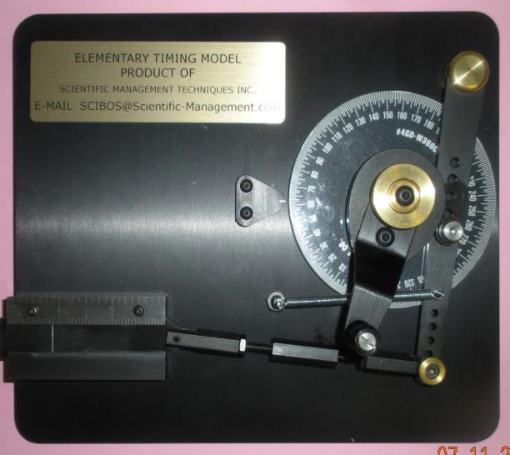
COMPONENTS OF A MACHINE

Slide 4
POSITION, STROKE & TIMING
Position - Where a component is located any point in time,
relative to a starting position
Stroke
- The linear distance traveled by the slider in one
direction from its starting position
Timing
- When an action takes place in time, relative to a set
start time

Slide 5
ADJUSTMENTS

Slide 6
POSITION ADJUSTMENT

Slide 7
POSITION AND STROKE AJUSTMENT
Relocating Clevis to Point 1 or 3 will change the Stroke and Position of the Slider

Slide 8
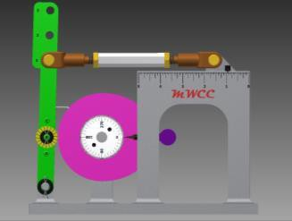
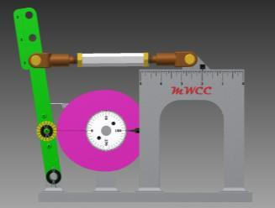
POSITION AND STROKE ADJUSTMENT
Turn-buckle Clevis at Adjustment No. 1
At 0˚ angle (start position) Position = 61/64”
At 180˚ angle (end position)
Position = 1 – 62/64”
Stroke = (1-62/64”) – 61/64” = 2-1/64”

Slide 9
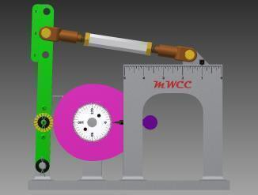
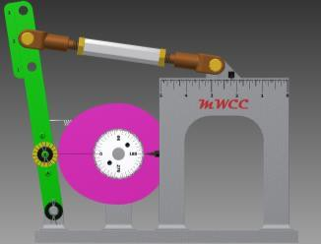
POSITION AND STROKE ADJUSTMENT
Turn-buckle Clevis at Adjustment No. 2
At 0˚ angle (start position) Position = 1”
At 180˚ angle (end position)
Position = 2 – 7/32”
Stroke = (2-7/32”) – 1” = 1-7/32”

Slide 10
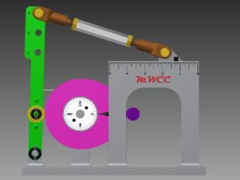
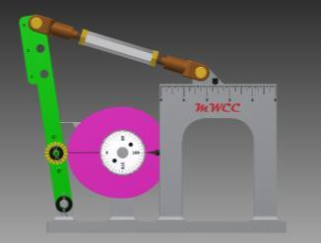
POSITION AND STROKE ADJUSTMENT
Turn-buckle Clevis at Adjustment No. 3
At 0˚ angle (start position) Position = 1-13/64”
At 180˚ angle (end position)
Position = 2 – 40/64”
Stroke = (2-40/64”) – 1-13/64” = 1-27/64”

Slide 11
POSITION, STROKE AND TIMING

Slide 12
POSITION, STROKE AND TIMING
Cam Follower on Pin B
At 0˚ angle (start position) Position = 61/64”
At 180˚ angle (end position)
Position = 1 – 62/64”
Stroke = (1-62/64”) – 61/64” = 1-1/64”

Slide 13
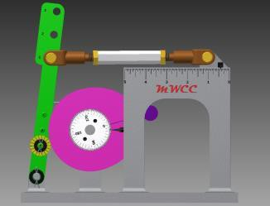
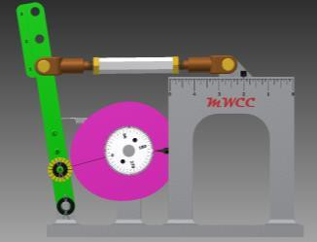
POSITION, STROKE AND TIMING
Cam Follower on Pin A
15.5˚ angle (start position) Position = 26/64”
195.5˚ angle (end position)
Position = 1 – 62/64”
Stroke = (1-62/64”) – 26/64” = 1-36/64” = 1-9/16

Slide 14
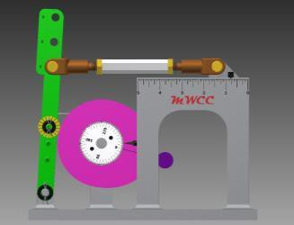
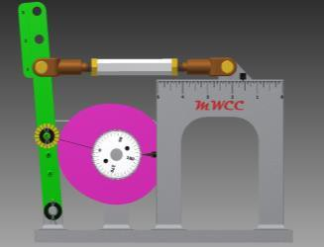
POSITION, STROKE AND TIMING
Cam Follower on Pin C
345˚ angle (start position) Position = 50/64”
165˚ angle (end position)
Position = 1 – 37/64”
Stroke = (1-37/64”) – 50/64” = 51/64”

Slide 15
CAM LIFT AND DWELL

