Slide 1
Direct and Alternating Current

Slide 2
Disclaimer
The AMMQC program is an Equal Opportunity program.
Adaptive equipment is available upon request for individuals with disabilities.
http://creativecommons.org/licenses/by/3.0 This work is licensed under a Creative Commons Attribution 3.0 Unported License [http://creativecommons.org/licenses/by/3.0]
This project is sponsored by a $15.9 million grant from the U.S. Department of Labor, Employment and Training Administration.
The AMMQC program is an Equal Opportunity program. Adaptive equipment is available upon request for individuals with disabilities. This workforce product was funded by a grant awarded by the U.S. Department of Labor’s Employment and Training Administration. The product was created by the grantee and does not necessarily reflect the official position of the U.S. Department of Labor. The U.S. Department of Labor makes no guarantees, warranties, or assurances of any kind, express or implied, with respect to such information, including any information on linked sites and including, but not limited to, accuracy of the information or its completeness, timeliness, usefulness, adequacy, continued availability, or ownership.

Slide 3
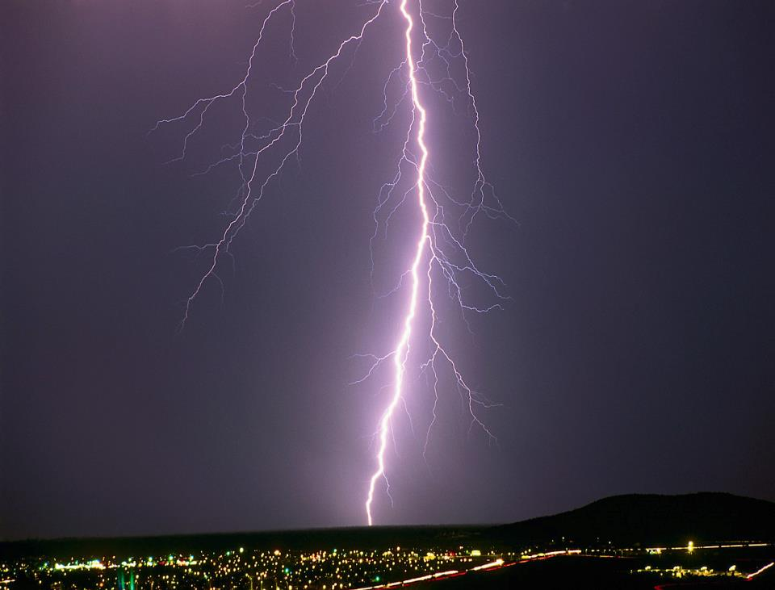
ELECTRICITY

Slide 4
DIRECT CURRENT

Slide 5
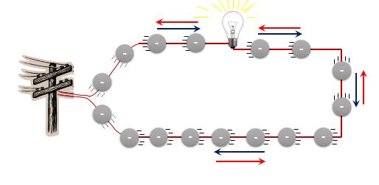
ALTERNATING CURRENT

Slide 6
DC - VOLTAGE
Voltage remains constant
Volts +
0
Time (sec.)

Slide 7
AC - CYCLES
Voltage fluctuates
Volts +
1 cycle
0
Time (sec.)
Volts -
AC DC Video

Slide 8
AC - FREQUENCY
Volts +
1 cycle
0
Time (sec.)
Volts -
Frequency = number of cycles per second
Measured in Hertz (Hz)
1_{Hz} = 1 cycle per second

Slide 9
AC - PEAK VOLTAGE - V₀
Volts +
1 cycle
Peak (+) voltage
0
Peak to Peak voltage
Peak (-) voltage
Volts -
Peak Voltage (V₀) = highest voltage value in either + or - direction

Slide 10
AC - RMS VOLTAGE - V_{rms}
Volts +
Peak (+) voltage
RMS voltage
0
Peak (-) voltage
Volts -
Root Mean Square voltage (V_{rms}) is an average voltage
V_{rms} = V₀ / √2 = V₀ x .707

Slide 11
FLOW OF CURRENT VS ELECTRONS
Current is considered to flow from + to –
This convention was adopted prior to fully understanding the atom and the flow of electrons

Slide 12
INTRO VIDEO
https://www.youtube.com/watch?v=EJeAuQ7pkpc

