Slide 1
Resistance

Slide 2
Disclaimer
The AMMQC program is an Equal Opportunity program.
Adaptive equipment is available upon request for individuals with disabilities.
http://creativecommons.org/licenses/by/3.0 This work is licensed under a Creative Commons Attribution 3.0 Unported License [http://creativecommons.org/licenses/by/3.0]
This project is sponsored by a $15.9 million grant from the U.S. Department of Labor, Employment and Training Administration.
The AMMQC program is an Equal Opportunity program. Adaptive equipment is available upon request for individuals with disabilities. This workforce product was funded by a grant awarded by the U.S. Department of Labor’s Employment and Training Administration. The product was created by the grantee and does not necessarily reflect the official position of the U.S. Department of Labor. The U.S. Department of Labor makes no guarantees, warranties, or assurances of any kind, express or implied, with respect to such information, including any information on linked sites and including, but not limited to, accuracy of the information or its completeness, timeliness, usefulness, adequacy, continued availability, or ownership.

Slide 3
Resistance Defined
- Opposition to electron flow.
Resistance is the opposition that a substance offers to the flow of electric current. It is represented by the uppercase letter R. The standard unit of resistance is the ohm, sometimes written out as a word, and sometimes symbolized by the uppercase Greek letter omega. Ω
When an electric current of one ampere passes through a component across which a potential difference (voltage) of one volt exists, then the resistance of that component is one ohm.

Slide 4
DEFINED
Resistors are devices that turn electrical current into heat energy. This is valuable when we would like to limit current flow to another portion of a circuit.
- Increase in temperature will also increase resistance.
-Resistance is measured in Ohms (Ω)
-Resistance sounds like a bad thing but we tend to use it to our advantage in most circuits.

Slide 5
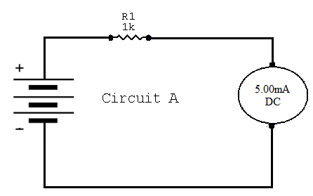
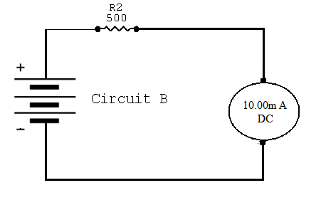
THEORY
Notice
as the resistance
increases the current
decreases.
Thus anytime
current needs to
be limited in a circuit,
a resistor can be added.

Slide 6
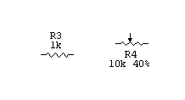
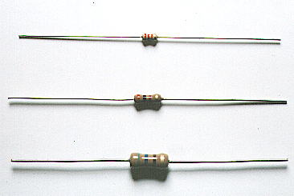
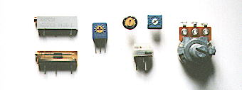
RESISTORS
There are two main types of resistors, fixed and variable. The variable resistor may also be called a potentiometer.
Schematics
The schematic symbols for each type are on the right. The arrow is used to denote variable.
How can we tell what the value is of a resister? There are two ways, measuring with a meter or on a fixed resistor you can read the color code.
Fixed Resistors
Potentiometers

Slide 7
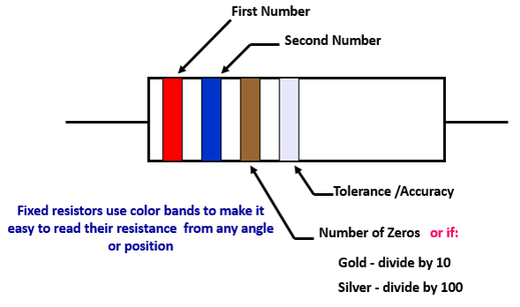
Resistance Color Code

Slide 8
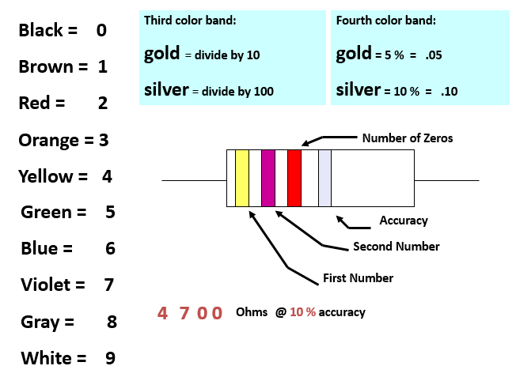
Resistor Codes #1

Slide 9
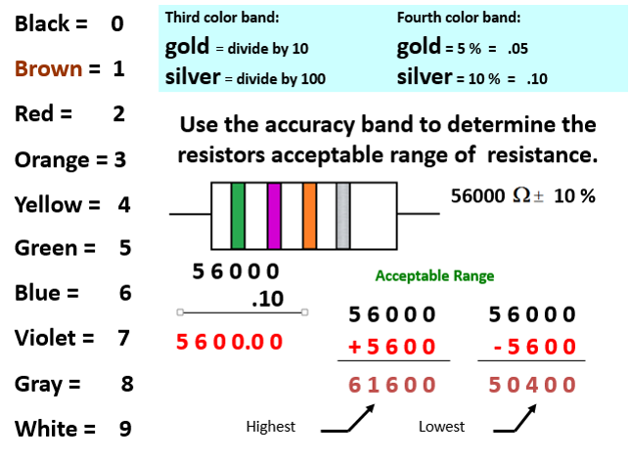
Resistor Codes #2

