Slide 1
Scientific and Engineering Notation

Slide 2
Prefixes and Conversions
Prefixes : Are used to eliminate zeros from a given value.
Conversions : Changes the numeric value of a measurement from one prefix’s value to another prefix’s value.

Slide 3
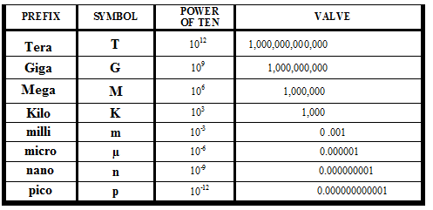
Prefixes and Conversions

Slide 4
Prefixes and Conversions
Whole Values are: VOLTS, AMPS, OHMS, FARAD, HERTZ etc.
Whole Values have all of the zeros or decimal places in their number value: 3000 volts 1000 amps
5,000,000 ohms 0.000001 farads
560,000 hertz
Prefixes are added to whole value electrical measurements to eliminate zeros or decimal places:
3 K volts 1 K amps
5 M ohms 1 u farad
560 K Hertz

Slide 5
Prefixes and Whole Values

Slide 6
Conversions: Example 1

Slide 7
Conversions: Example 2

Slide 8
Disclaimer
The AMMQC program is an Equal Opportunity program.
Adaptive equipment is available upon request for individuals with disabilities.
http://creativecommons.org/licenses/by/3.0 This work is licensed under a Creative Commons Attribution 3.0 Unported License [http://creativecommons.org/licenses/by/3.0]
This project is sponsored by a $15.9 million grant from the U.S. Department of Labor, Employment and Training Administration.
The AMMQC program is an Equal Opportunity program. Adaptive equipment is available upon request for individuals with disabilities. This workforce product was funded by a grant awarded by the U.S. Department of Labor’s Employment and Training Administration. The product was created by the grantee and does not necessarily reflect the official position of the U.S. Department of Labor. The U.S. Department of Labor makes no guarantees, warranties, or assurances of any kind, express or implied, with respect to such information, including any information on linked sites and including, but not limited to, accuracy of the information or its completeness, timeliness, usefulness, adequacy, continued availability, or ownership.

