Slide 1
Lean Manufacturing
Presentation by David O. Hunt, PE

Slide 2
The AMMQC program is an Equal Opportunity program. Adaptive equipment is available upon request for individuals with disabilities. http://creativecommons.org/licenses/by/3.0 This work is licensed under a Creative Commons Attribution 3.0 Unported License [http://creativecommons.org/licenses/by/3.0] This project is sponsored by a $15.9 million grant from the U.S. Department of Labor, Employment and Training Administration. The AMMQC program is an Equal Opportunity program. Adaptive equipment is available upon request for individuals with disabilities. This workforce product was funded by a grant awarded by the U.S. Department of Labor’s Employment and Training Administration. The product was created by the grantee and does not necessarily reflect the official position of the U.S. Department of Labor. The U.S. Department of Labor makes no guarantees, warranties, or assurances of any kind, express or implied, with respect to such information, including any information on linked sites and including, but not limited to, accuracy of the information or its completeness, timeliness, usefulness, adequacy, continued availability, or ownership.

Slide 3
OBJECTIVES
Describe the history of Lean Manufacturing and how Lean Manufacturing differs from traditional assembly lines.
Explain the rationale for and effectiveness of the Lean approach, and how it reduces waste.
Use and interpret a value stream map.
Recognize and understand the language of and some key tools of Lean Manufacturing, including Gemba, Poke Yoke, 5W-2H, 5S, Kaizen, the Seven Wastes.
Through videos and exercises, “learn to see” where waste is in a process.
Describe the DMAIC process and how it relates to reducing waste.

Slide 4
Lean: What is it?
Lean is a process of continually improving how you do things to be more efficient, lower cost, and faster
Lean is about maximizing operations the customer will pay for, and minimizing or eliminating everything else
Lean is far, far more than just saving money
Lean is not a “flavor of the month” program to be implemented willy-nilly
Lean is a philosophy that needs to be rooted in the corporate culture and led/promoted from the top
Or it just won’t work

Slide 5
Why Implement Lean?
Companies compete on four axes:
Cost
Quality
Function
Speed / Agility

Slide 6
Why Implement Lean? (continued)
Reduce costs
Improve quality
Become efficient
Rapidly respond to customers
Increase profits

Slide 7
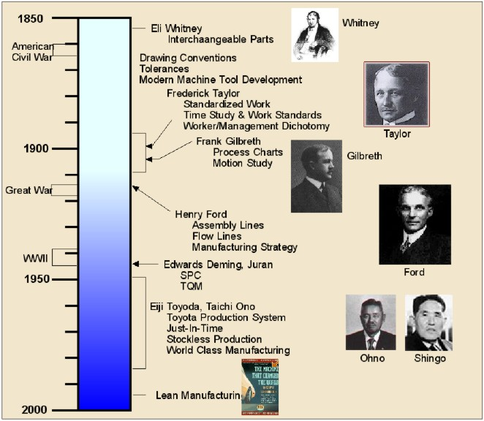
A Brief History
Source: http://www.strategosinc.com/lean_manufacturing_history.htm

Slide 8
From Ben Franklin…
'Buy what thou hast no need of, and ere long thou shalt sell thy necessaries.‘ (Poor Richard’s Almanac)
Translation: Don’t buy – or do – what you don’t need to do.
This, really, is the heart of Lean:
Maximize operations that the customer is willing to pay for
Minimize (or eliminate) everything else

Slide 9
Henry Ford and others
Ford standardized many processes
The assembly line required standardized (and interchangeable) parts
Was still a “push process” not a “pull process”
What is the difference? Let’s go to a video…
https://www.youtube.com/watch?v=DoXE_lX3Zzo

Slide 10
Concept: Push vs. Pull
Push:
Making parts to a scheduled or predicted demand, not to an actual demand
Not very adaptive to shifts in demand mix
Pull:
Making product only when demanded by the customer
Build to order & ship
When demand / mix are stable and even
Build to replenish stock when orders are shipped
When demand / mix are unstable

Slide 11
More History
Toyota Production System
Post WWII Japan
Recognized that work should be based on orders, not pre-determined targets
I.e., PULL not PUSH
Taichii Ohno, Shigeo Shingo were the main players at Toyota
Ohno actually watched Ford’s assembly lines to learn
Deming, Juran, Ishikawa – look them up
Many good materials on-line
Added in a focus on quality and employee involvement

Slide 12
Modern Day
James Womack
Book: “The Machine that Changed the World”, 1990
Many companies try
Not as many succeed
Why?
Lean is a culture, not a program-of-the-month
It must come from the top, who show their commitment
It requires involvement of hourly employees
It requires trust, going both ways
It’s the mentality… not the raw dollars (A study in tea)

Slide 13
Mindset, Not Just Dollars: Tea Time
At Toyota, two cafeteria workers noticed they were discarding a lot of tea after lunch
They gathered data
Recorded waste amounts, which tables, when occupied, etc.
Ran experiments testing their theories
Discovered:
Tables nearer windows were more popular
Filled carafes accordingly
Virtually eliminated wasted tea
Result: Awarded Toyota’s highest honor
“Mind the pennies and the dollars will take care of themselves”

Slide 14
Lean: Not Utopia
There is no “cookie cutter” approach to Lean
One size does not fit all
Guidelines are just that – guidelines
Must be customized / adapted to the circumstance
Always keep in mind:
The leaner you get the more susceptible to “Murphy” you become. (He’s out there, and he’s an SOB.)
Any Lean program must be balanced against the customer’s Pissed-Off Factor (POF)

Slide 15
And So It Begins…
First, a video
This video highlights many of the wastes that Lean combats
This is a two-fer:
Once before you’ve learned anything
Then again afterwards
You must learn to see
Test_ExportFile_IRT_Master_2016_Industry Readiness Training Post-Test.zip

Slide 16
Discussion
What wastes did you see?

Slide 17
The Seven Wastes
There is an acronym: TIM WOOD
T: Transportation
I: Inventory
M: Motion
W: Waiting
O: Overprocessing
O: Overproduction
D: Defects

Slide 18
TIM WOOD – Transportation
Moving parts hither and yon
For example, one functional area (molding), to another (assembly)
Instead of flowing on a product-focused layout
But this, too, can be taken to an extreme
Moving things into and out of inventory / storage
Moving things to get them out of the way
Not using transportation’s capacity (e.g., a half-filled large truck)
Not for nothing are drawings of material flow in a facility often called a “spaghetti diagram”

Slide 19
TIM WOOD – Inventory
Inventory is a carried cost; money is paid but revenue not yet realized
Building to inventory means you’re building things that haven’t been sold yet
Minimize inventory – does not mean eliminate inventory
Remember the customer’s POF
Ties up space that could be used

Slide 20
TIM WOOD – Motion
Motion itself is necessary
What is not necessary
Looking for things
Handling something multiple times
Going to get something you should have readily available
Having to look for instructions on how to do a task

Slide 21
TIM WOOD – Waiting
Waiting for parts or tools needed to do your job
Waiting idle while a machine cycles
Waiting for approvals
Or for repairs
Or an answer to a question
Or for the computer to catch up with you
This does not need to be a person waiting
Machines can be idle too
Critical if this is a constraint (bottleneck) operation

Slide 22
TIM WOOD – Overprocessing
Simply put: Doing more than necessary
Overengineering a product
Unnecessary / unwanted features
Processing for longer than necessary

Slide 23
TIM WOOD – Overproduction
Making more than is needed
This actually impacts almost every other kind of waste!
Has to be stored
Ties up money
Defects require more sorting
Has to be moved around more

Slide 24
TIM WOOD – Defects
Cost of scrapped material & labor
Waste of a constraint operation
Rework costs labor $
And if done by production people diverts them from production!
Slows reaction time to the customer
Repair areas require additional (unnecessary) tools

Slide 25
Toast!
Now that we’ve gone over TIM WOOD, let’s revisit… TOAST!
https://www.youtube.com/watch?v=CJSZj9bShAI
What did you see this time?

Slide 26
Seeing Again
Here’s another video
https://www.youtube.com/watch?v=dLhWoa-TmJY
The video showed types of waste
Did you see any other wastes that weren’t mentioned?
Did you notice something at the end?

Slide 27
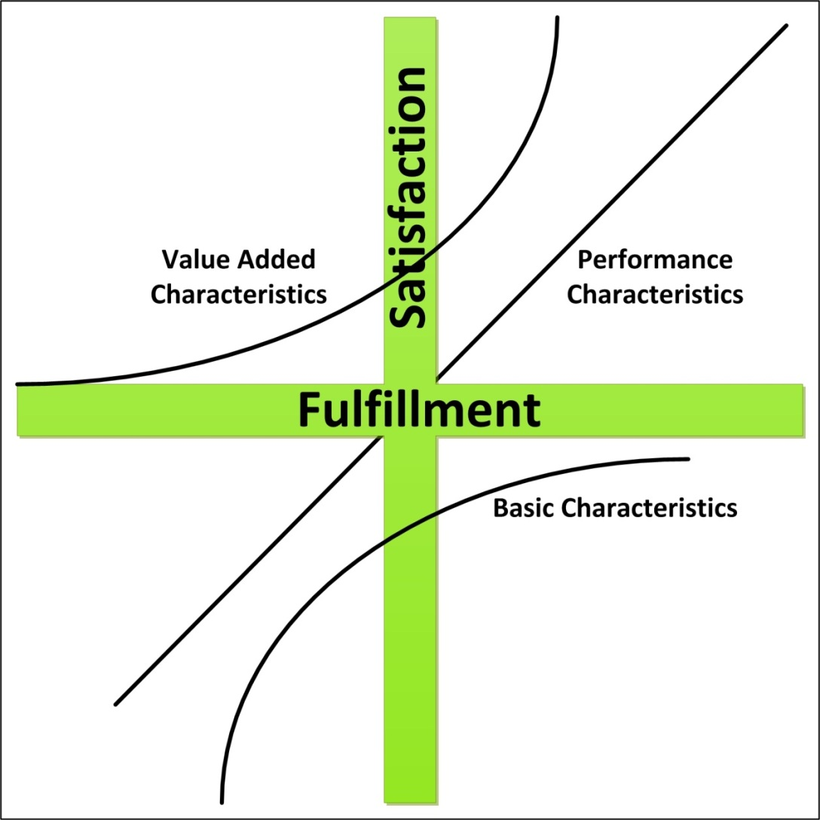
The Kano Quality Model

Slide 28
Kano Quality Levels (1 of 3)
Basic characteristics: the minimum required
Presence is expected
Absence is noticed
For example: A New Car
Starts
No squeaks / rattles
All the gizmos work

Slide 29
Kano Quality Levels (2 of 3)
Performance Characteristics
“More is better”
E.g., a new car
Fast power windows
Really good sound system
Good gas mileage

Slide 30
Kano Quality Levels (3 of 3)
Value-Added Characteristics
“Surprise and delight”
E.g., a new car
Voice-actuated climate control
Twin sun visors
Often these can be amazing, but…
New and different can also backfire

Slide 31
Why does the Kano Model Apply?
If you’re buying, you want you to compete purely on cost
If you’re selling, you want to compete on function and quality and speed
Being able to provide extra value to the customer enables differentiation

Slide 32
Glossary
Autonomation or Jidoka
Benchmarking
Blitz
Cycle Time
Five S (5S)
Flow
Gemba
Genchi Genbutsu
Heijunka
Just-in-Time (JIT)
Kaikaku
Kaizen
Lead Time
Muda
Mura
Muri
Pokayoke
Pull
Push
Takt Time
Value
Value Stream Map

Slide 33
Tools: 5S
5S is a series of “S” words used to help streamline an area
It’s not just about housekeeping
Though neatness and organization counts
It’s about processes and discipline
Done by the workers themselves
Instills pride

Slide 34
What are the 5 S’s?
Sort: Sort out & separate that which is needed & not needed in the area.
Straighten: Arrange items that are needed so that they are ready & easy to use. Clearly identify locations for all items so that anyone can find them & return them once the task is completed.
Shine: Clean the workplace & equipment on a regular basis in order to maintain standards & identify defects.
Standardize: Revisit the first three of the 5S on a frequent basis and confirm the condition of the Gemba using standard procedures.
Sustain: Keep to the rules to maintain the standard & continue to improve every day.

Slide 35
5S: A Practical Example
Let’s go to a video
https://www.youtube.com/watch?v=hagc33G0oOg
What did you see?
Was this practical advice you can use?

Slide 36
Taking the First Step
Before you know how to get somewhere…
You need to know where you are
In Lean Manufacturing, this means creating a Value Stream Map
A Value Stream Map is a map of what happens now
It requires an honest assessment of the present reality
It requires a multiplicity of eyes with different perspectives

Slide 37
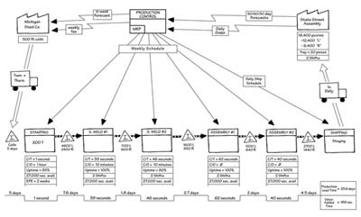
What does it look like?

Slide 38
How to do one?
Start by examining your product volumes
Classify them into families, e.g.:
Large products
Small products
Pick a “typical” representative of each family
Walk the product from soup to nuts
From when a customer places an order…
To when it’s loaded on a truck

Slide 39
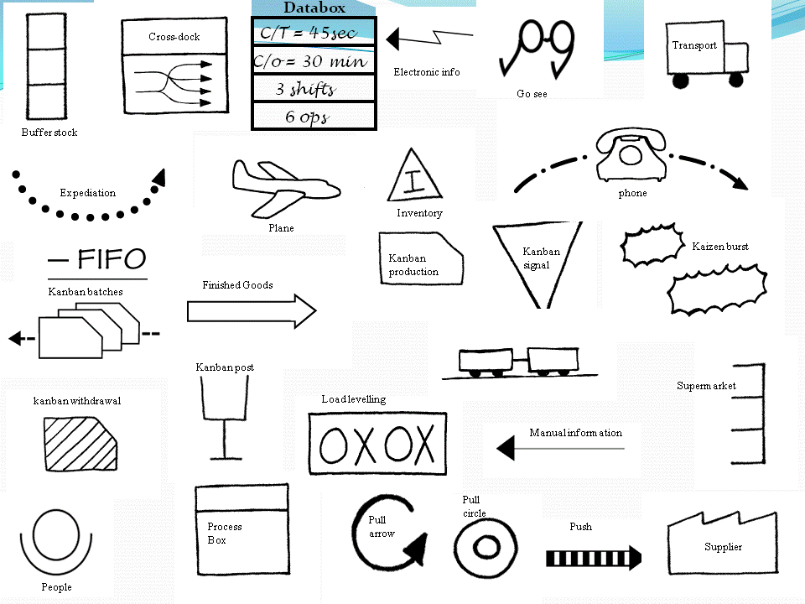
And Start Drawing: Symbols

Slide 40
Step By Step
Map the actual process
Thinking high-level (at least at first)
Danger: Can get caught in the weeds
Follow the parts through from beginning to end
Can go forward or backwards through the flow
Take notes. Lots of notes.
This is an application of “go and see”, or Genchi Genbutsu
Get real data, nothing preprocessed
Critical: Talk with the workers!

Slide 41
VSMs: There will be pushback
Doing a VSM is not a trivial exercise
Lots of time on the floor not doing “what you should be doing”
Lots of disturbing/distracting with many questions
Lots of poking around
Lots of information gathering
Doing it right is a pain in the you-know-where

Slide 42
Add In Process Data
Inventory amounts
Cycle time (time taken to make one product)
Change over time (from last good piece to first good piece)
Up-time (on-demand machine utilization)
Number of operators
Shifts worked
Net available working time
Scrap rate
Pack size/pallet sizes
Batch Size
TAKT time

Slide 43
Look for Inventory & WIP
Inventory and WIP and commonplace
Neither cannot be totally eliminated
But is all that WIP really necessary?
Inventory and WIP are often used as a cushion to hide problems
Inventory and overproduction are two wastes
Balance WIP minimization against the POF

Slide 44
Add In Timelines
How long are parts waiting to be moved?
How long does it take them to travel to where they are used?
How long are they stored waiting to be processed?
How long does the cycle time take?
Lather, rinse, repeat through the whole chain, operation to operation, to the end

Slide 45
Take Notes, Talk with People
Take notes on what you see
Take lots of notes
Talk with people
What pisses them off?
What prevents them from being more efficient?
Look for PITAs (Pains In The A--)
Ask open-ended questions… WHY, WHERE, WHAT, WHO, WHEN, HOW
As a team develop a stock slate of questions

Slide 46
Analyze the VSM
Questions to ask include:
How much time is spent idle vs. being processed?
How long do parts sit in inventory?
Cycle times vs. TAKT times?
Poor quality – being hidden by WIP?
Long set-up times?
Is this step adding value?
One thing a VSM is NOT…
A physical flow of material through the facility

Slide 47
Don’t Be Afraid to Sit & Stare
Once a VSM is done and everyone’s happy…
Invite people to look at it
Get them to write down their observations
And suggestions for improvement
Not just office people, but floor personnel
Don’t rule out just sitting and staring at it
Your subconscious is very powerful

Slide 48
Now… Create the Future
TIM WOOD
Analyze / ask about each step
Be systematic
You want to nitpick
Create lots of potential projects
Think “What if…” and “If only…”
Imagination first, then figure out how to implement

Slide 49
The VSM Process is…
Iterative
You will not be able to make all the changes you seek at once
Focus on “low hanging fruit”
Start small; small wins encourage more effort
Successes build on successes – success is contagious
A learning process
Don’t be discouraged if things don’t go as planned
“Either I win or I learn” – proverb from the internet

Slide 50
The LEGO Game
We’re going to do an exercise
You are the production and supervisory personnel
You will be producing assemblies
The first time will be a “push” process
Then… you get to make suggestions on improving the process

Slide 51
LEGO Game: Take 1
Just do it!

Slide 52
The LEGO Game: Debrief
What did you observe?
Let’s walk through TIM WOOD on the board
Transportation
Inventory
Movement
Waiting
Overproduction
Overprocessing
Defects

Slide 53
The LEGO Game (Again)
Brainstorm suggestions to improve

Slide 54
LEGO Game: Take 2
Just do it!

Slide 55
LEGO Game Debrief
Discuss results
What did you observe?
Were things better? Faster?
TIM WOOD – how’d he do?

Slide 56
Process, Not Goal
Lean focuses on processes, not goals
Get the process right, the goals will take care of themselves
Process improvements do include goals
E.g., losing weight / getting fit
Those who set a goal (e.g., lose 20 pounds) will almost surely backslide
Those who change their lifestyle (process) will be more successful

Slide 57
Tools: Kaizen / Kaizen Blitz
Kaizen: Continuous Improvement
Always be tweaking
Always be looking for new ways to do things
Small changes are easier to make
Constant churn of ideas
Kaizen blitz: Improving a specific thing with an intense focused effort
Specific
Targeted
https://www.youtube.com/watch?v=su9CulCZTBg

Slide 58
Other Tools: SMED
Single Minute Exchange of Dies
What does this really mean?
Rapid changeover from one product to another
Reduced set-up times
Facilitates smaller batch sizes
Lowers inventory
But… it takes discipline

Slide 59
DMAIC
Define: Describe the problem, who will work on it, and what the goals are
Measure: Go out and measure what’s happening now
Analyze: Crunch the data, understand WHY
Improve: Make changes, check results
Control: Maintain the gain

Slide 60
Creating a Lean Enterprise (1 of 4)
The customer is the starting and ending point.
Think simplicity.
Reduce or remove waste.
Think in terms of process.
Increase visibility and transparency wherever possible.

Slide 61
Creating a Lean Enterprise (2 of 4)
Encourage routine and standardization.
Make flow as constant and smooth as possible.
Pull at the customer’s rate, rather than pushing product through.
Get the timing right.
Be proactive and preventative rather than reactive.

Slide 62
Creating a Lean Enterprise (3 of 4)
Keep production and process timelines as short as possible.
Make continuous improvement a priority for everyone.
Encourage internal and external players to be partners rather than competitors.
Create a supply chain that creates value.
Remember Gemba.

Slide 63
Creating a Lean Enterprise (4 of 4)
Reduce variation where possible.
Encourage participation and accountability from all employees.
When making changes, start with the smallest component and build up.
Build trust internally and externally.
Build and distribute knowledge throughout the organization.

Slide 64
Summing Up
Lean Manufacturing is about competition
Speed
Quality
Cost
Companies that improve will survive
Companies that don’t… won’t

