Slide 1
The Many Uses of 3D Printing
CAD 262

Slide 2
Two Avenues for 3D Printing
Industrial
Consumer
Medical
Jewelry
Autoracing
Animation
Fix household items
Paper weight miniatures
Cheap prosthetics
Custom brackets

Slide 3
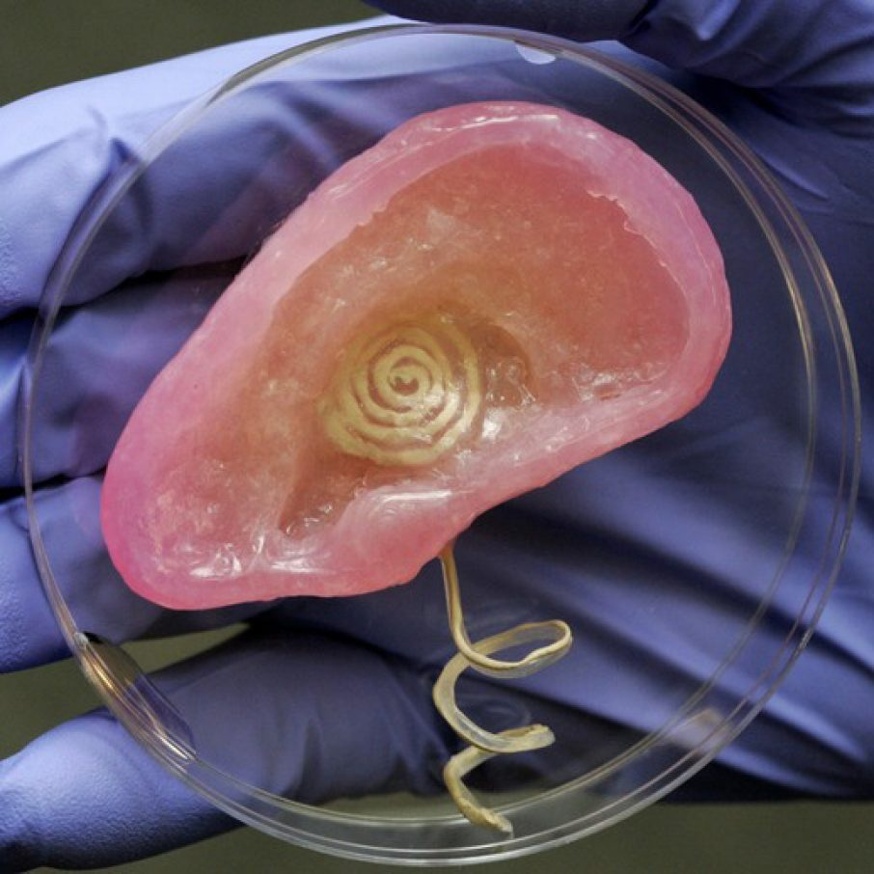
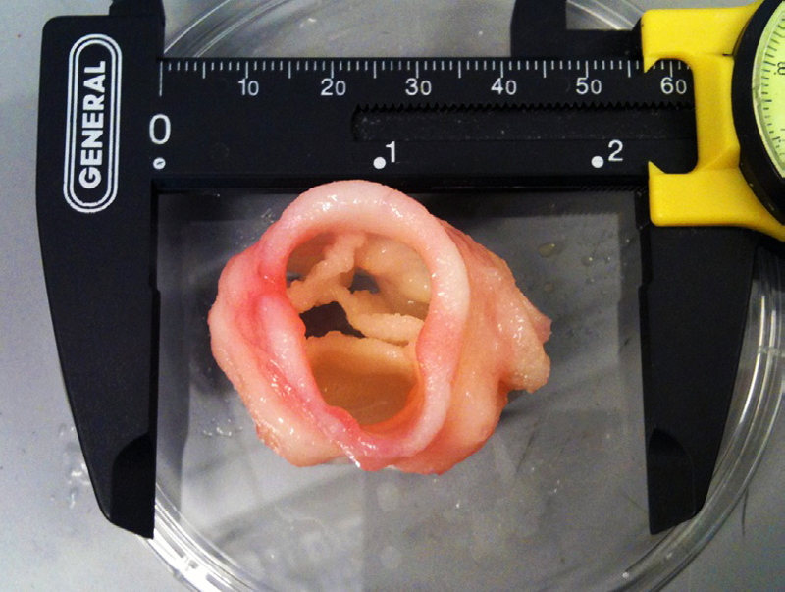
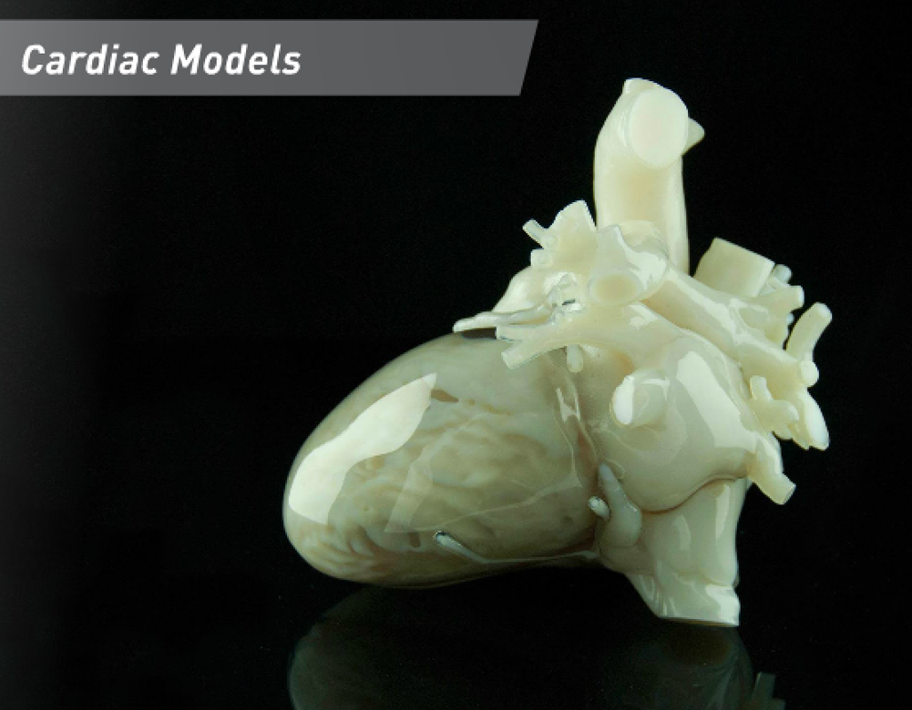
Medical Printing
Notes:
Attribution: Bertalan Meskó, 12 Things We Can 3D Print in Medicine Right Now, 3dprintingindustry.com, February 26, 2015, https://3dprintingindustry.com/news/12-things-we-can-3d-print-in-medicine-right-now-42867/
Reference https://3dprintingindustry.com/news/12-things-we-can-3d-print-in-medicine-right-now-42867/
3D Printed Bionic Ear. Digital image. 12 Things We Can 3D Print in Medicine Right Now. 3D Printing Industry, 2016. Web. 06 Dec. 2016. <https://3dprintingindustry.com/news/12-things-we-can-3d-print-in-medicine-right-now-42867/>.
Butcher, Jonathan T. A 3-D Print of an Artificial Heart Valve. Digital image. Creating Valve Tissue. ASME, n.d. Web. 06 Dec. 2016. <https://www.asme.org/engineering-topics/articles/bioengineering/creating-valve-tissue-using-3d-bioprinting>.
A 3D Printed Heart. Digital image. 12 Things We Can 3D Print in Medicine Right Now. 3D Printing Industry, n.d. Web. 06 Dec. 2016. <https://3dprintingindustry.com/news/12-things-we-can-3d-print-in-medicine-right-now-42867/>.

Slide 4
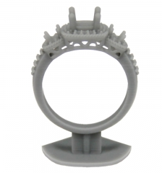
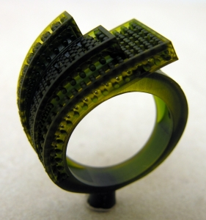
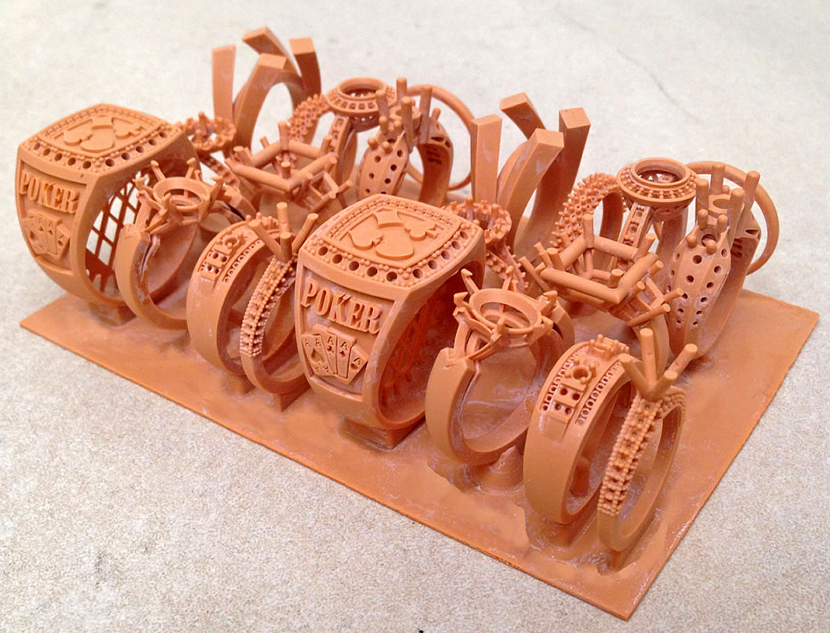
Jewelry Printing
Notes:
Reference https://envisiontec.com/3d-printing-industries/professional/jewelry/ http://www.shapeways.com/marketplace/jewelry/
QView. Digital image. QView. EnvisionTEC, n.d. Web. 06 Dec. 2016. <https://envisiontec.com/3d-printing-materials/perfactory-materials/qview/>.
EPIC. Digital image. EPIC. EnvisionTEC, n.d. Web. 06 Dec. 2016. <https://envisiontec.com/3d-printing-materials/perfactory-materials/epic/>.
RC90. Digital image. RC90. EnvisionTEC, n.d. Web. 06 Dec. 2016. <https://envisiontec.com/3d-printing-materials/perfactory-materials/rc90/>.

Slide 5
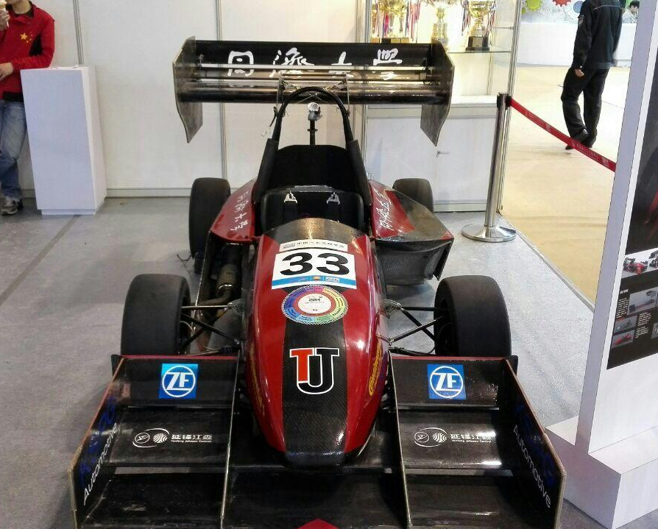
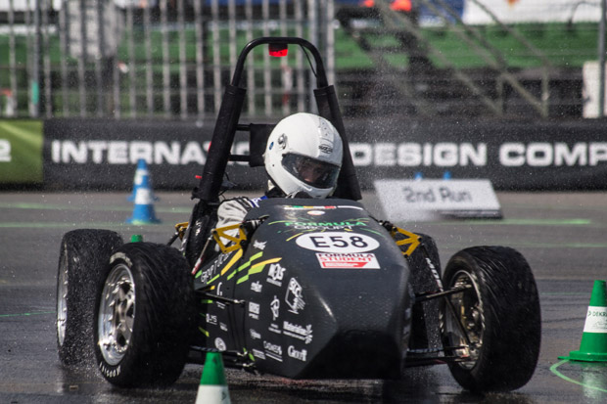
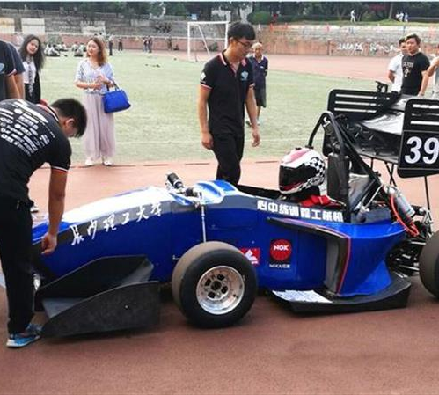
Auto Racing Printing
Notes:
Reference http://www.materialise.com/cases/the-areion-by-formula-group-t-the-world-s-first-3d-printed-race-car
https://3dprint.com/60515/3d-printed-racecars/ http://www.3ders.org/articles/20160920-chinese-students-use-metal-3d-printing-to-build-80mph-fnx-16-racing-car.html
The Areion by Formula Group T. Digital image. The Areion by Formula Group T: The World’s First 3D Printed Race Car. Materialise, 2016. Web. 06 Dec. 2016. <http://www.materialise.com/cases/the-areion-by-formula-group-t-the-world-s-first-3d-printed-race-car>.
Carchin1.jpg. Digital image. Race Car With Over 360 3D Printed Parts on Display at Chinese Expo. 3D Print.com, n.d. Web. 06 Dec. 2016. <https://3dprint.com/60515/3d-printed-racecars/>.
3D printed metal race car. Digital image. Chinese Students Use Metal 3D Printing to Build 80mph FNX-16 Racing Car. Www.3ders.org, n.d. Web. 06 Dec. 2016. <http://www.3ders.org/articles/20160920-chinese-students-use-metal-3d-printing-to-build-80mph-fnx-16-racing-car.html>.

Slide 6
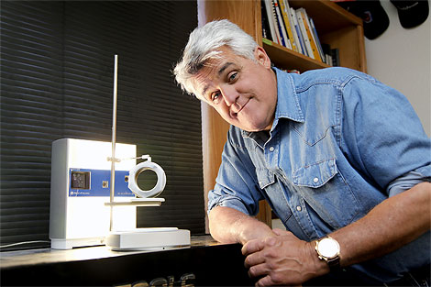
Jay Leno’s Garage
Watch the Video Here
Notes:
NextEngine's 3D Scanner - Jay Leno's Garage. Perf. Jay Leno. YouTube.com. Jay Leno's Garage, 20 July 2016. Web. 06 Dec. 2016. <https://www.youtube.com/watch?v=7ZrJsrTT4EA>.

Slide 7
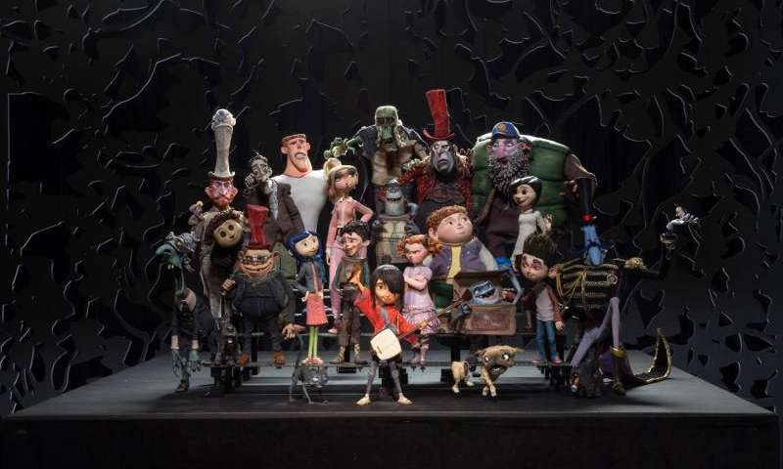
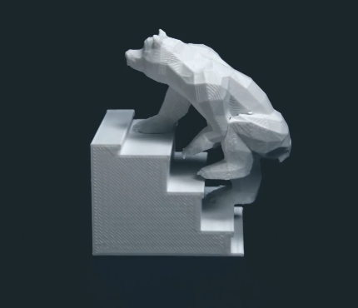
Animation Printing
Notes:
Reference https://vimeo.com/91711011 http://phys.org/news/2016-06-animation-studio-3d.html
https://3dprint.com/57088/3d-printed-animated-film/
BEARS ON STAIRS. Perf. DBLG. BEARS ON STAIRS. Vimeo, 11 Apr. 2014. Web. 06 Dec. 2016. <https://vimeo.com/91711011>.
"How an Animation Studio Uses 3D Printing." Phys.org - News and Articles on Science and Technology. PHYSORG, 1 June 2016. Web. 06 Dec. 2016. <http://phys.org/news/2016-06-animation-studio-3d.html>.
Animator Creates a 3D Printed Film Using 2,500 3D Printed Pieces. Digital image. Animator Creates a 3D Printed Film Using 2,500 3D Printed Pieces. 3Dprint.com, 14 Apr. 2015. Web. 06 Dec. 2016. <https://3dprint.com/57088/3d-printed-animated-film/>.

Slide 8
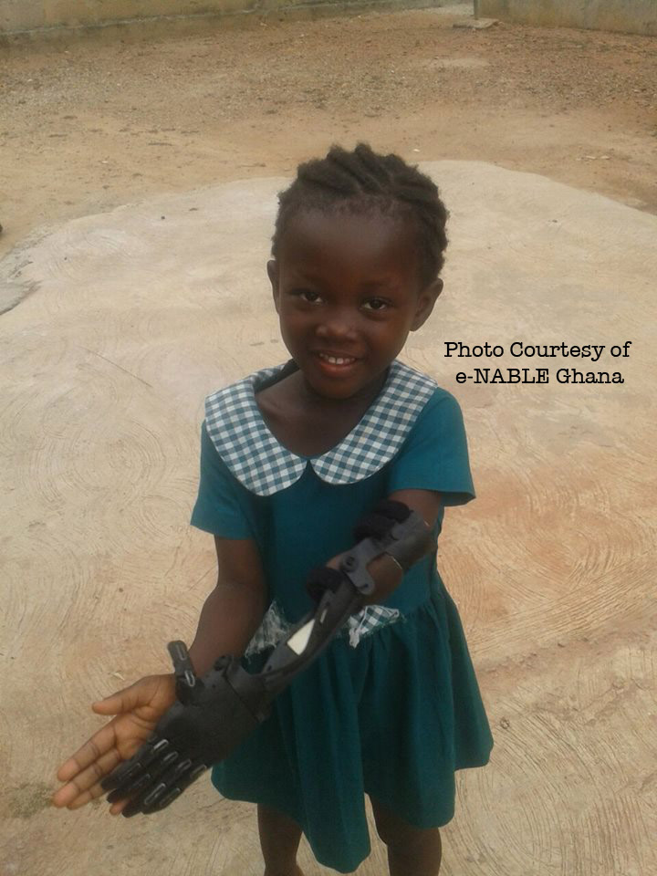
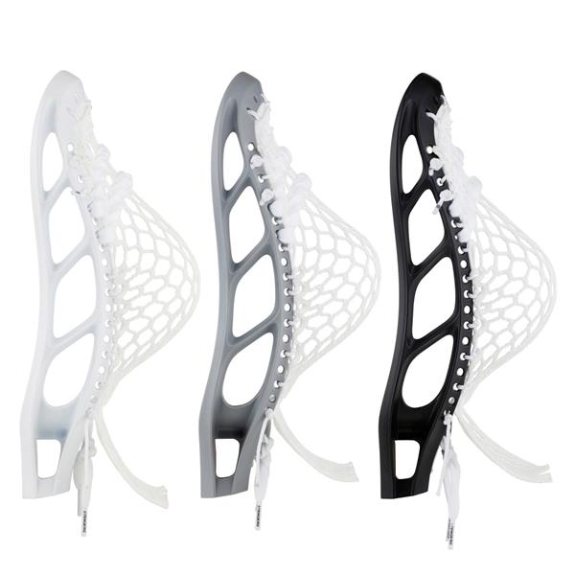
Consumer Printing
Notes:
Reference http://www.openhandproject.org/
http://makezine.com/2015/11/17/how-to-design-and-3d-print-your-own-custom-gaming-miniatures/
http://enablingthefuture.org/tag/3d-printed-prosthetics/
http://www.3ders.org/articles/20161117-stringking-calls-on-lacrosse-players-to-up-their-game-with-3d-printed-heads.html
E-NABLING Ghana. Digital image. E-NABLING Ghana. Enablingthefuture.org, 24 July 2016. Web. 06 Dec. 2016. <http://enablingthefuture.org/2016/07/24/e-nabling-ghana/>.
Mark 1 Head. Digital image. StringKing Calls on Lacrosse Players to up Their Game with 3D Printed Heads. 3ders.org, 17 Nov. 2016. Web. 06 Dec. 2016. <http://www.3ders.org/articles/20161117-stringking-calls-on-lacrosse-players-to-up-their-game-with-3d-printed-heads.html>.

