Slide 1
3D Printing!
CAD 262

Slide 2
What are the origins of 3D Printing?

Slide 3
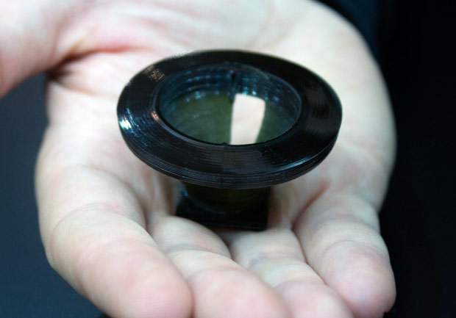
Stereolithography (SLA)
Lens. Digital image. Roots of a High-Tech Revolution. The Wall Street Journal, 26 Aug. 2014. Web. 08 Dec. 2016. <http://www.wsj.com/articles/roots-of-a-high-tech-revolution-1409066696>.
Notes:
Reference http://www.wsj.com/articles/roots-of-a-high-tech-revolution-1409066696
Lens. Digital image. Roots of a High-Tech Revolution. The Wall Street Journal, 26 Aug. 2014. Web. 08 Dec. 2016. <http://www.wsj.com/articles/roots-of-a-high-tech-revolution-1409066696>.

Slide 4
Printing Techniques
Stereolithography (SLA)
Digital Light Processing (DLP)
Fused deposition modeling (FDM)
Selective Laser Sintering (SLS)
Selective laser melting (SLM)
Electronic Beam Melting (EBM)

Slide 5
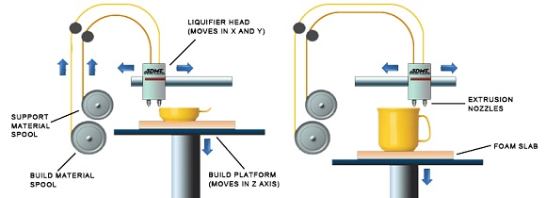
FDM Printers
Layering Process. Digital image. Different Types of 3D Printers(I). Linkedin, 10 May 2016. Web. 08 Dec. 2016. <https://www.linkedin.com/pulse/different-types-3d-printers-elva-wu>.
Notes:
Reference https://www.linkedin.com/pulse/different-types-3d-printers-elva-wu

Slide 6
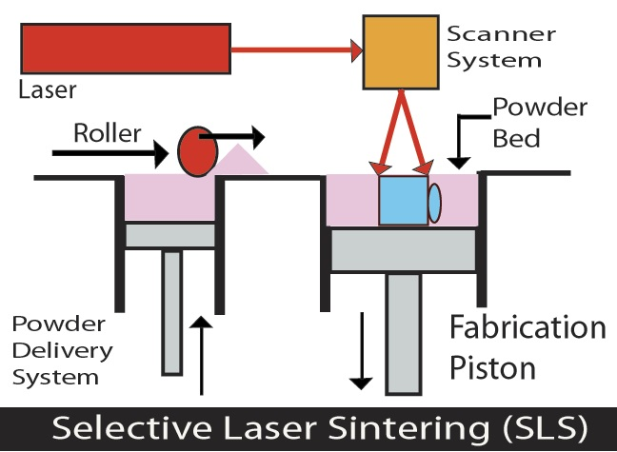
SLS Printers
Selective Laser Sintering. Digital image. Different Types of 3D Printers(I). Linkedin, 10 May 2016. Web. 08 Dec. 2016. <https://www.linkedin.com/pulse/different-types-3d-printers-elva-wu>.
Notes:
Reference https://www.linkedin.com/pulse/different-types-3d-printers-elva-wu
Selective Laser Sintering. Digital image. Different Types of 3D Printers(I). Linkedin, 10 May 2016. Web. 08 Dec. 2016. <https://www.linkedin.com/pulse/different-types-3d-printers-elva-wu>.

Slide 7
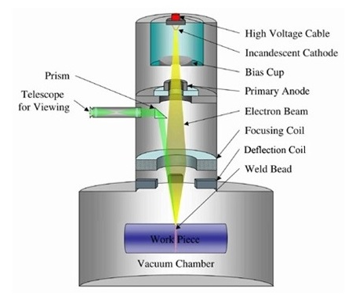
EBM (Electronic Beam Melting)
EMB. Digital image. Types of 3D Printers or 3D Printing Technologies Overview. 3D Printing From Scratch, n.d. Web. 08 Dec. 2016. <http://3dprintingfromscratch.com/common/types-of-3d-printers-or-3d-printing-technologies-overview/#ebm>.
Notes:
Reference http://3dprintingfromscratch.com/common/types-of-3d-printers-or-3d-printing-technologies-overview/#ebm

Slide 8
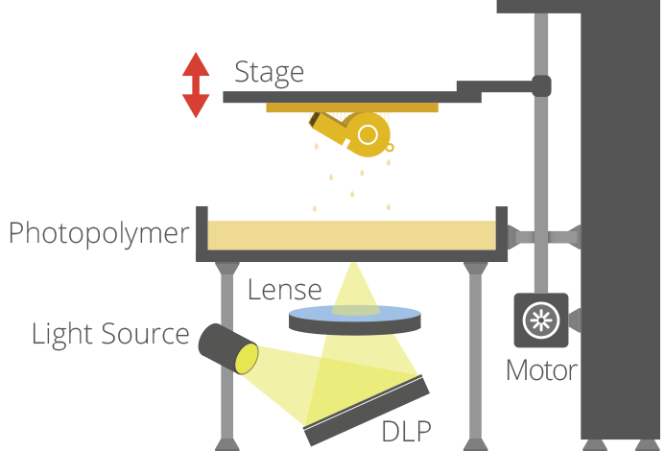
DLP PRinting
SLA but upside down
Infinite print Z height
DLP. Digital image. The Free Beginner’s Guide. 3D Printing Industry, n.d. Web. 08 Dec. 2016. <https://3dprintingindustry.com/3d-printing-basics-free-beginners-guide/processes/>.
Notes:
Reference https://3dprintingindustry.com/3d-printing-basics-free-beginners-guide/processes/

Slide 9
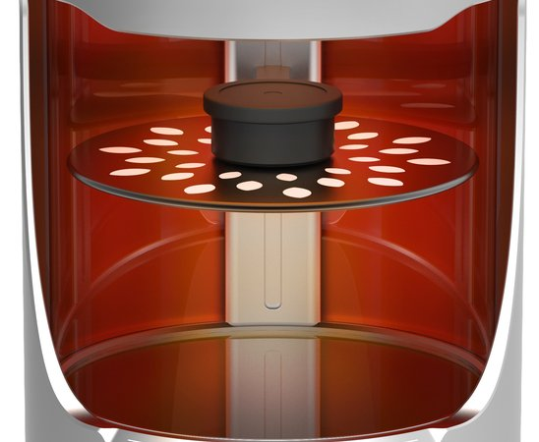
Orange Maker’s Helios One
Orange Maker's Helios One prints in a spiral, as opposed to layer by layer, making the entire process more efficient
Watch the video here
Helios One 3D Printer. Digital image. Coming in 2015: A Faster, Sharper Way to 3D Print. Smithsonian, 21 July 2014. Web. 08 Dec. 2016. <http://www.smithsonianmag.com/innovation/coming-2015-faster-sharper-way-3d-print-180952090/>.
Notes:
Reference of Orange https://www.youtube.com/watch?v=XC6UoqwkTqk http://www.smithsonianmag.com/innovation/coming-2015-faster-sharper-way-3d-print-180952090/
Helios One 3D Printer. Digital image. Coming in 2015: A Faster, Sharper Way to 3D Print. Smithsonian, 21 July 2014. Web. 08 Dec. 2016. <http://www.smithsonianmag.com/innovation/coming-2015-faster-sharper-way-3d-print-180952090/>.

Slide 10
How to Print Faster
What we think of as 3D printing, says Joseph DeSimone, is really just 2D printing over and over ... slowly. Onstage at TED2015, he unveils a bold new technique — inspired, yes, by Terminator 2 — that's 25 to 100 times faster, and creates smooth, strong parts. Could it finally help to fulfill the tremendous promise of 3D printing?
Please watch his TED talk on 3D Printing

Slide 11
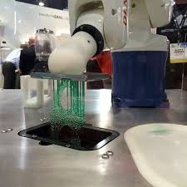
SLAbot
The SLAbot-1 uses an industrial robotic arm, producing parts in sequence. This modular, assembly-line-ready additive manufacturing can be configured in large arrays and enables distributed, automated, high-speed, customized manufacturing.
Watch the video here.
SLAbot-1 at CES 2016. YouTube, 2016.

Slide 12
Getting Robotic
Robotic Arms – read how one man is revolutionizing 3D printing here

Slide 13
Big scale prints
3D Printed Concrete Castle – click here to watch the video
Concrete Printing – click here to read more

Slide 14
Scientists develop a new form of 3D printing that uses ultrasound to 3D print composite materials
In this unique 3D printing process, ultrasonic waves are used to position millions of tiny reinforcement fibers, which are formed into a microscopic reinforcement framework, giving the material significant strength. This microstructure is then set in place with a focused laser beam, which cures the epoxy resin.
“The breakthrough was based on the simple idea of printing using a liquid polymer mixed with millions of tiny fibers,” explained Tom Llewellyn-Jones, the PhD student who developed the system. “This makes a readily printable material that can, for example, be pushed through a tiny nozzle into the desired location. The final object can then be printed layer by layer, as with many other 3D printing processes.”
The biggest challenge for the engineers was finding a way to manipulate the tiny fibers into the correct patterns, in order for them to provide the superior strength generally offered by composite materials. In the end, they found that ultrasonic waves could be used to arrange the fibers into appropriate patterns within the polymer. The precise orientation of each fiber could then be controlled by switching the ultrasonic standing wave pattern during the printing process.

Slide 15
4D Printing
3D printing has grown in sophistication since the late 1970s; TED Fellow Skylar Tibbits is shaping the next development, which he calls 4D printing, where the fourth dimension is time. This emerging technology will allow us to print objects that then reshape themselves or self-assemble over time. Think: a printed cube that folds before your eyes, or a printed pipe able to sense the need to expand or contract.
Watch his TED Talk here.

